Slide 1
Variability and stability in blazar jets on time-scales of years: Optical polarization monitoring of OJ 287 in 2005 - 2009
Carolin Villforth (Turku & STScI), Kari Nilsson (Turku), Jochen Heidt (LSW Heidelberg) + 45 enthusiastic observer who provided data
Details in: MNRAS 402, 2087 (2010)

Slide 2
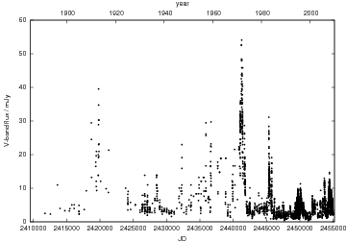
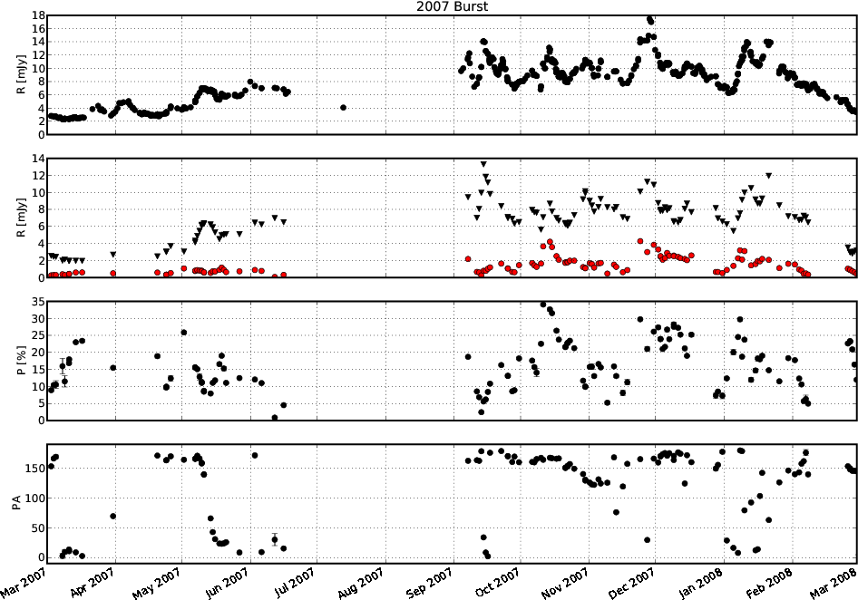
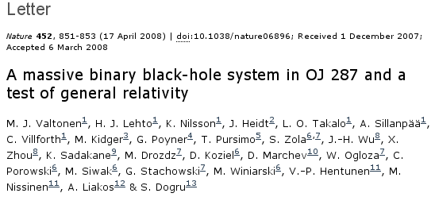
Background: Double-peaked regular outbursts in OJ 287:
Several models based on a binary BH in center of OJ 287
Photopolarimetric monitoring as a means to distinguish between these models (Valtonen vs. Valtaoja) for the outbursts 2007/2009
Using mainly 3 telescopes (CA, NOT, KVA) for polarimetry + 20 other for photometry
Prediction Valtonens model ➔

Slide 3
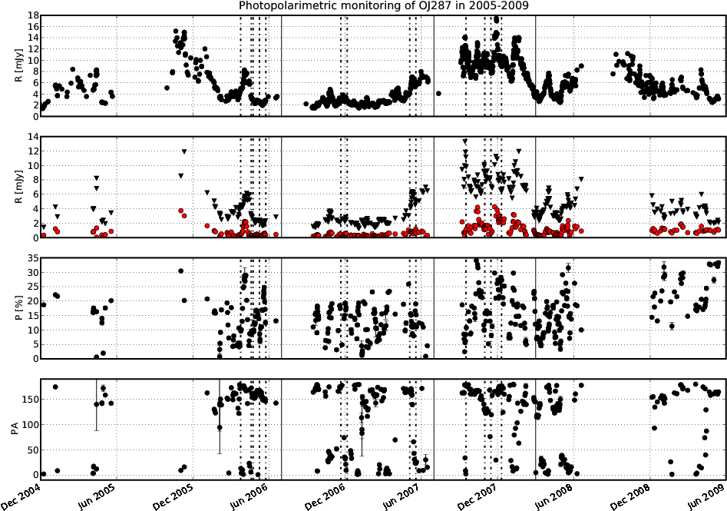
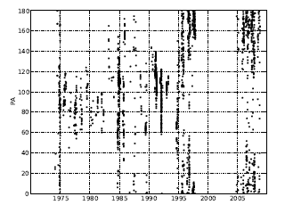
Closer inspection of the data (+some historical ones):
1st outburst Nov 2005 probably OK, but 2nd one Sep 2007 not unique
➔ Valtonen‘s model probably not correct
Flip of PA by about 90deg around 1994

Slide 4
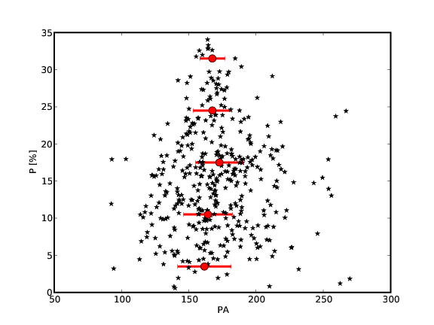
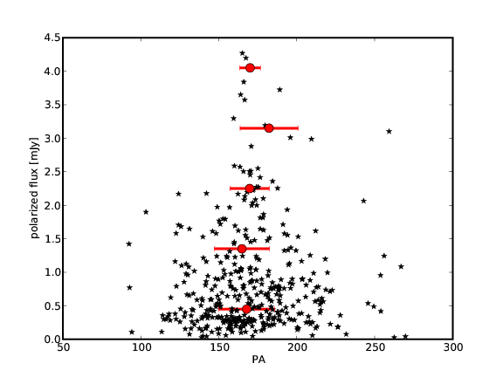
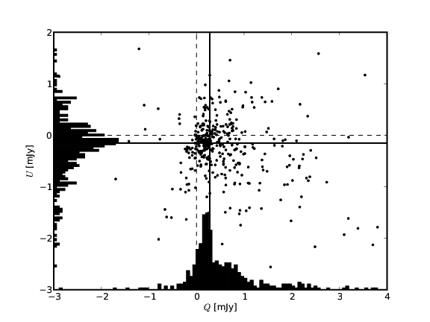
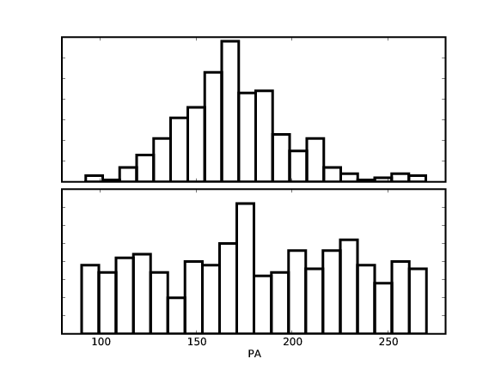
Statistical analysis of the polarimetric 2005 – 2009 data:
Polarisation vs. PA Polarized flux vs PA
Stokes U vs Q ➔ preferred values ➔ Emission has two components:
A stable “optical polarisation core“ + chaotic emission

Slide 5
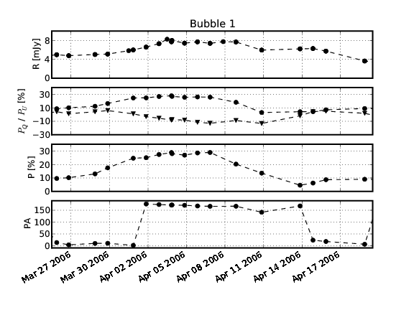
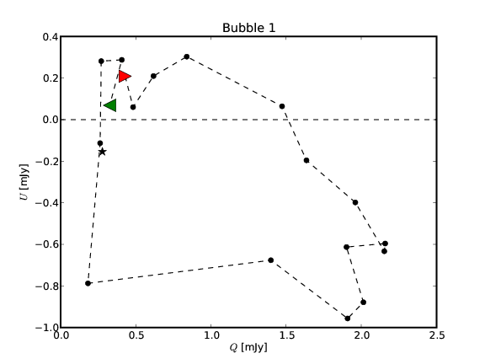
BUT: “chaotic” emission not necessarily chaotic:
➔ At least 6 reoccurring events found by looking at normalized Stokes P_{Q}, P_{U}, optical appearance as “bubbles”
Showcase: bubble lasting ~ 20 days, full circular movement in the Stokes plane
Interpretation: Shock fronts moving forth and back in the jet, swiping through the helical magnetic field

Slide 6
Summary:
➔ 2005 – 2009: Polarimetric emission can be disentangled in a contribution from a quiescent and a chaotic jet component
➔ Strong flip of preferred PA around 1994
➔ 2nd outburst in autumn 2007 not unique, several major peaks
➔ Several “bubbles”, potentially shock fronts moving back + forth in a helical jet
➔➔ Does this really fit to Valtonen’s model?
➔ Lets have a look at other properties of OJ 287

Slide 7
Other properties:
OJ 287 is a BL Lac, hence FR I, which accrete through radiatively inefficient, geometrically thick accretion flows (contrary to FR II)
➔ Valtonen’s model does this not take into account, problems with the timescales of the bursts (should be more delayed)
BH mass of OJ 287 hard to estimate (no lines, which can be used e.g. for reverberation mapping), but best estimates via M_BH vs M_bulge relation differ at least by one order of magnitude from what required for Valtonen’s model
(M_{BH} < 10⁹ M vs 2 • 10¹⁰ M required)
➔ Again serious challenge for Valtonen’s model

Slide 8
An alternative (and speculative) interpretation:
➔➔ Magnetic “breathing” of the accretion disc ⬅⬅
Started at some point in the past: massive accretion of the magnetic field caused strong disturbances in the magnetic field of the accretion disc
Disturbance caused a resonance in the accretion disc
Bursts are due to accretion of magnetic field lines in avalanches
Each burst (the first one) represents a phase of massive magnetic field accretion
The second one is due to matter fed into the jet (note that only one optical outburst had a radio counterpart)
As time goes by central (poloidal) field gets stronger, “chokes” the resonance, strength of outbursts weakens
Prediction: no further double-peaked outburst in 2017/2019
And: no binary BH required!

Slide 9
Finally:
Is OJ 287 unique or representative of the FRI-class?
➔ Set-up of long-term monitoring program in polarized light of ~35
FRI/FRII-type AGN using 85cm telescope at San Pedro Martir
➔ 100N/year over a period of (at least) 3 years
➔ See what the statistical properties of these sources are
Check: http://www.lsw.uni-heidelberg.de/users/jheidt/spm/spm.hml

