Slide 1
Large jets from small-scale magnetic fields
Dimitrios Giannios
Purdue, Department of Physics
Extreme Astrophysics in an Ever-Changing Universe - Time Domain Astronomy in the 21st Century

Slide 2
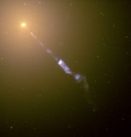
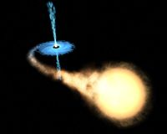
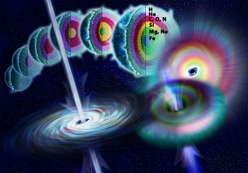
gamma-ray bursts
Relativistic jets: the big, the small, the strong
jets in galactic centers
X-ray binaries
Focus Here: Blazars
M87; NASA/Hubble
M_{BH}~10⁹M
~10M
~3M
Power~10⁴⁴...10⁴⁹erg/s ~10³⁸erg/s ~10⁵²erg/s
Notes:
Collimated outflows of matter moving at relativistic speeds “relativistic jets” have been observed/inferred in various astrophysical settings:
Jets originate from the active supermassive black holes at the centers of galaxies, stellar binaries that contain a compact object
and in gamma-ray bursts.
All these sources contain compact objects (BHs or neutron stars)
SMBHs ~billions of Msun actively fed material from the region around the nucleus of the galaxy form jets
Micro-quasars are binary systems of stars were a bh of ~10Msun is fed matter by the companion.
Gamma-ray bursts are extremely bright and short lived explosions of gamma-rays.
They can be observed at large distances (cosmological redshift of at least z=8).
Come from core collapse of massive stars marking the birth a few solar mass compact object.

Slide 3
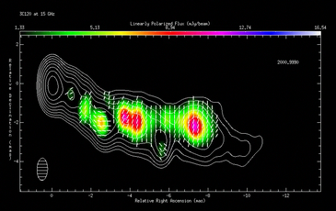
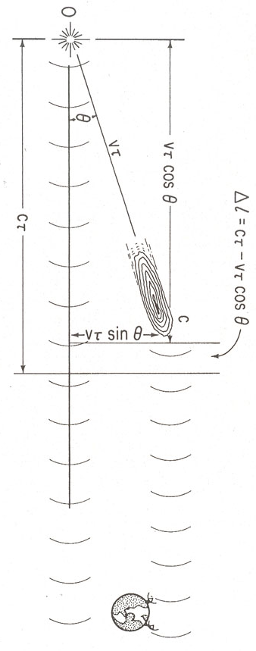
Blazars: relativistic jets from SMBHs
3C120; VLBA; Gomez et al. 2008
Rees 1966
Γ~10-20 for Blazars
Lister et al. 2009
Notes:
But how fast are these jets? What is the bulk Lorentz factor of the flow, Gamma?
Direct observations in the radio resolve fast (superluminal) motions of gas in galactic centers.
Apparent speeds of blobs larger than the speed of light have commonly been measured (show right plot and explain).
These apparent motions are result of matter moving fast close (but not exactly)
along our line of sight. The apparent speeds set a lower limit on the Lorentz factor.
The bulk Lorentz factor of AGN jets is typically ~10
GRBs are not resolved to allow for direct measurement of their LF.
Strong theoretical arguments, however, related to the fact that the gamma-rays avoid annihilation at the source
place the Lorentz factor of the radiating material to 100-1000
jets in binary systems have more modest LFs of a few-10.

Slide 4
Characteristic Blazar variability
Varying on timescales from days to decades
Associated with changes at the BH vicinity:
t_{BH}=R_{sch}/c ~ 3M₉ hours
10 days
3C279; e.g., Collmar et al. 2007

Slide 5

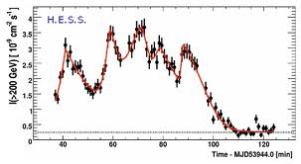
Recent Surprises
ultra-fast varying TeV blazars PKS 2155-304; Mrk 501; Mrk 421; PSK 1222-216; BL Lac
10 min
10 min
Aharonian et al. 2007; Albert et al. 2007; Aleksic et al. 2011
flaring on timescales as sort as t_{v} ~3 min << R_{sch}/c ~ 3M₉ hours! → Central Engine cannot be directly responsible for these flares Begelman et al. 2008; Narayan & Piran 2012

Slide 6
Observational facts and inferences
Fast flaring: rare but generic
  Seen in 5 different blazars; similar timescales
~10-minute flares appear on top of a high state, “envelope” that lasts for ~hours-days
Require extreme Doppler factor of emitter towards the observer δ≥50 for TeVs to escape the source (PKS 2155; Begelman et al. 2008)
Fairly large emission distance R≥0.5 pc (PKS 1222; Tavecchio et al. 2012; Nalewajko et al. 2012)
10 min
High state

Slide 7
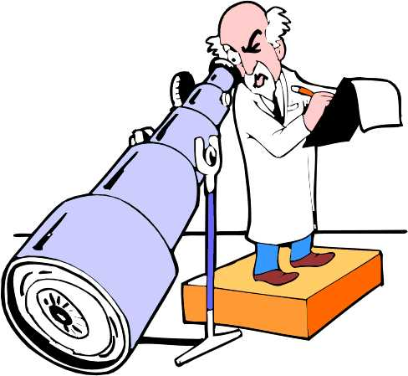
Summary: requirements for emitting region
Emitter must be very compact and extremely fast and form at ~1 pc distance!
R_{em}~10⁻⁴ pc!!!
R_{diss}~1 pc
R_{Sch}
Γ_{em}~50
Γ_{j}~10
Some big questions:
Which process accelerates the particles that radiate?
What determines the distance & size/shape of the
emitting region?

Slide 8

How is the jet flow launched?
jet emission
Central
engine
Acceleration
Internal dissipation
Notes:
While my main focus in this talk will be on the radiation from jets. I argue that it cannot be understood independently of the
properties of the CE and the acceleration process of the jet.

Slide 9
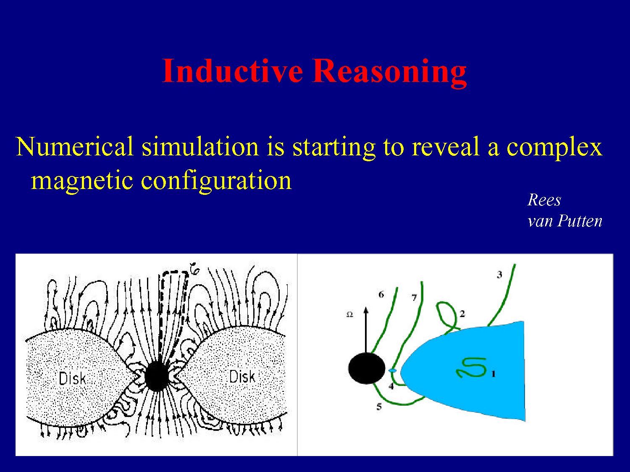
How is the jet flow launched?
jet emission
Acceleration
Internal dissipation
Blandford & Znajek 1977
Begelman & Li 1992
Meier et al. 2001
Koide et al. 2001
van Putten 2001
Komissarov, Lyubarky, McKinney, Tchekhovskoy
…
Notes:
While my main focus in this talk will be on the radiation from jets. I argue that it cannot be understood independently of the
properties of the CE and the acceleration process of the jet.

Slide 10
Magnetic Fields: critical for jet launching and acceleration
thermal component; energetic particles
energy content
magnetic component
Γ>>1
kinetic component
distance r
Important in understanding jet acceleration Michel 1969; …, Vlahakis & Koenigl 2003; Komissarov et al. 2009; 2010; Tchekhovskoy et al. 2009; 2010; Lyubarsky 2009; 2010; Granot et al. 2011

Slide 11
Origin of magnetic fields: generated in the disk?
Parfrey, Giannios, Beloborodov, in prep

Slide 12
GR (force free) MHD simulations Parfrey, Giannios, Beloborodov, in prep

Slide 13
GR (force free) MHD simulations Parfrey, Giannios, Beloborodov, in prep

Slide 14
Jet power L_{j}~Φ²a²
For retrograde
orbits and thick
disks the jet power
reaches up to

Slide 15
The field structure in the jet
~100R_{sch}

Slide 16
Dissipation at large scale in the jet
Jets contain field reversals on small scale ~100 R_{sch}
B-reconnection becomes effective when t_{exp}~t_{rec}
100R_{sch}

Slide 17
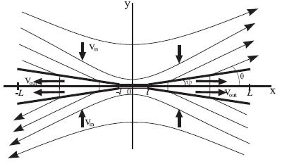
Relativistic Magnetic Reconnection
An efficient convertor of magnetic energy into bulk motion, heat, energetic particles
  cold, magnetized plasma enters the reconnection region
  plasma leaves the reconnection region at the Alfvén speed Γ_{out}~(1+σ)^{1/2}>1
  reconnected material contains energetic (nonthermal) particles
B
B
Relativistic Petschek Reconnection
Lyubarsky 2005

Slide 18

Unsteady reconnection and plasmoids
Reconnection is a highly time-dependent process Lin et al. 2005; Drake et al. 2006; Loureiro et al. 2007; Daughton et al. 2009…
  Current sheet not a smooth flow
  Layer breaks into blobs/plasmoids
Credit N. Loureiro
Solar flares
Karlicky & Kliem 2010

Slide 19
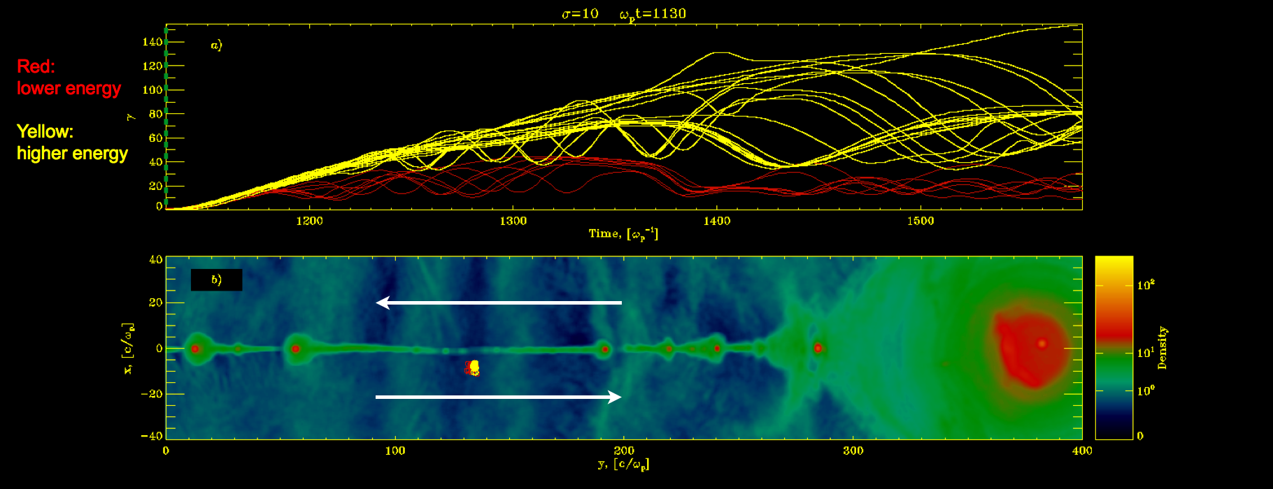
Magnetic reconnection: a powerful particle accelerator
Credit: L. Sironi
PIC simulations can now “attack” relativistic reconnection
Zenitani & Hishino 2007; Lyubarsky & Liverts 2008; Cerutti et al. 2012; 2013; Sironi & Spitkovky 2013

Slide 20
Plasmoid-dominated reconnection in blazars Giannios 2013
Current sheet fragments to plasmoids Loureiro et al. 2007 +++
Plasmoids merge/grow leaving the layer at V_{A}~c
“Monster plasmoids” form with R_{p}~0.1l Uzdensky et al. 2010; Loureiro et al. 2012
Monster plasmoids grow fast (~l/V_{A}) powering blazar flares Giannios 2013

Slide 21
Prediction Giannios 2013: fast flares on slow envelope
At least two timescales of relevance
  The reconnection timescale l/v_{rec}~10l/c
  The “envelope” emission
  Variability time from monster plasmoids ~0.1l/γ_{p}c
  Fast flares from monster plasmoids
  Multiple fast flares expected
t_{envelope}~1 day

Slide 22
Energetics and timescales
Fast flare from “monster” plasmoids
  Luminosity
  Timescale
Envelope emission from reconnection layer
  Luminosity
  Timescale
t_{envelope}~10⁵t₆₀₀γ₂/ε₋₁ s

Slide 23
Inferred parameters
Flare-envelop timescale and energetics can be understood in all fast flaring sources if Giannios 2013
  R_{diss}~ 1 pc
  Γ_{j} ~20
  Jet magnetization σ =B²/4πρc²~ a few
  Size of reconnection regions l’ < 10¹⁶ cm

Slide 24
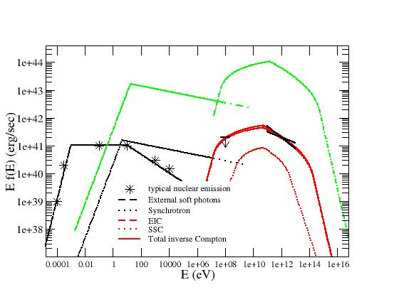
Prediction: flares from blazars and jets viewed off axis
Giannios, Uzdensky & Begelman 2010
Nalewajko et al. 2011
Γ_{j}
Γ_{j}
Off-jet axis
Jet axis
infra-day M87 flaring
θ’
flares from Mrk 501 PKS 2155-304 PKS 1222-21 BL Lac
Rest frame of black hole
Rest frame of jet
Notes:
The emitters in this picture are the pairs of reconnection jets (minijets).
In intriguing consequence of this suggestion is that for every minijet beaming its radiation
along the jet axis, its counter minijet radiates at larger inclination. As a result weak flares that, however,
evolve fast may be observed from jets that do not point directly at us. The flaring from the jet from the nearby
elliptical M87 may be such an example.

Slide 25
The bigger picture for blazar emission
Day-week long
flares
magnetic reconnection region
~min flaring
R_{diss}≥1 pc, σ≤1,
R_{diss}≤1 pc, σ≥1,

Slide 26
Concluding
Fast TeV flares pose major challenge to theoretical models
  e.g., internal shocks do not work
Magnetic reconnection can account for fast flaring because:
  deposits energy into fast-moving, compact regions
  accelerates particles
  bonus: fits nicely in the larger picture of Poynting jets

