Slide 1
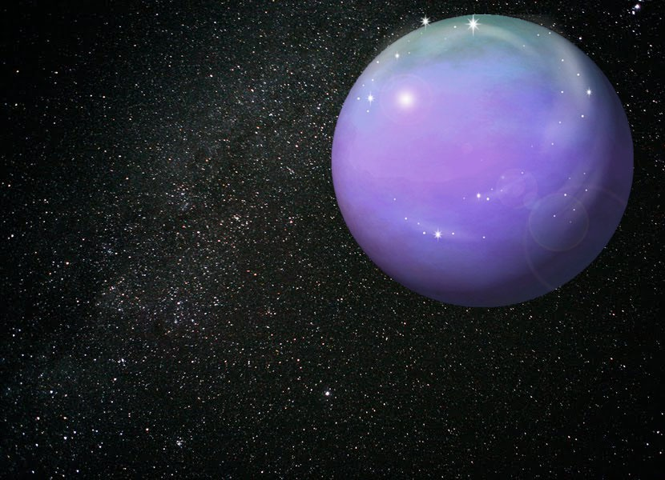
EXPLORING FREE FLOATING PLANETS WITH MICROLENSING
Vasiliki Fragkou (fginie@yahoo.gr)
Msc by Research in Astronomy (University of Manchester)

Slide 2
General Information
INTRODUCTION
Overview of Extrasolar Planets
1992: Discovery of two planets orbiting a pulsar (Wolszczan et al. 1992).
1995: Detection of a giant planet orbiting a solar- type star (Mayor et al. 1995).
2014: More than 1700 exoplanets have been detected (Schneider 2014).
Free Floating Planets
The exoplanets that are not bound to any host free floating planets (Zapatero et al. 2000) .
Detection Methods (Schneider 2014)
Direct Imaging
Transit Method
Radial Velocity Technique
Gravitational Microlensing
Astrometry

Slide 3
Gravitational Microlensing
can detect:
Sensitive to the detection of faint objects
low mass planets around low mass stars (see e.g., Beaulieu et al. 2006).
planets in very distant orbits (Bennett et al. 2008).
free floating planets (Bennett et al. 2008).
Theoretical Background
Gravitational field of stellar object between source star and observer increases apparent brightness of source gravitational lensing effect (Paczynski 1996).
When planet in a certain position around lens star additional lens to the source star’s brightness (see e.g., Mao et al. 1991; Bennett et al. 1996).
Notes:
Gravitational Microlensing

Slide 4
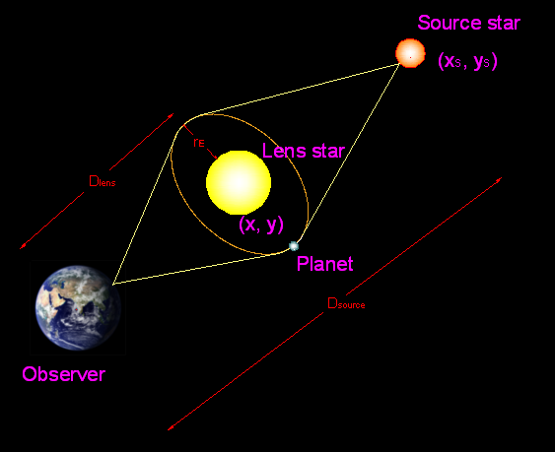
Theory
(e.g., Witt 1990; Gould 1992; Perryman 2000; Mao 2008)
Einstein Radius :
Einstein timescale :
for a single lens:
t₀
time when magnification peaks
u₀
minimum impact parameter (at t=t₀)
for a multiple lens system :
z= x+yi
z_{s}= x_{s}+y_{s}i

Slide 5
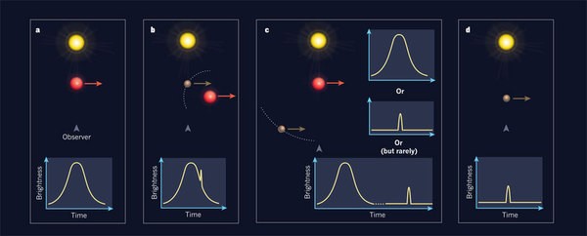
Observational Evidence of Gravitational Microlensing
Magnification of the source star’s brightness vs time light curve (Perryman 2000)
[Figure Credit: Adapted by permission from Macmillan Publishers Ltd: [NATURE] (Wambsganss 2011; p.290), copyright (2011)]
Single star (a) single lensing event curve with one wide peak.
Planet around lens star (b, c) binary lensing event curve with two peaks.
Free floating planet (d) single lensing event curve with one narrow peak.

Slide 6
Gravitational Miclolensing and Free Floating Planets
Discovery, of a Galactic free floating planet population, by the MOA microlensing team (Sumi et al. 2011) .
Are these detected planets actually unbound??
Is it possible for a bound planet to appear as a free floating one, under some certain parameters of the lens star, the source star and the planet?
Testing this possibility by modelling binary lensing events.

Slide 7
BINARY LENSING EVENT MODELLING
Catalogue of Stars
Generated from the synthetic microlensing catalogues (Kerins et al. 2009).
Based on the Besancon Galactic Model (Robin et al. 2003; Marshall et al. 2006).
Represents statistical properties of real stars.
Provides 93763 different combinations of values for:
mass of the lens star
distance to the lens star
distance to the source star
magnitude of the source star
M_{L}
transverse velocity
largest impact parameter (assumed survey limit: 19 mag)
statistical weight of each case
v_{t}
D_{L}
u_{max}
D_{L}
M_{L}
wg

Slide 8
Developing the Code
Random parameters:
time when magnification peaks
host-planet sky projected separation s (from 0.1 to 100 AU)
minimum impact parameter (from 0 to )
angle between lens trajectory and line between host and planet α
t₀
u₀
u_{max}
M_{p}
Planet Mass 9 logarithmically sampled values from 1 to 10000
standard cadence (time data came from: MOA¹; MOA 2012-BLG-306)
Observation times
high cadence (time data came from: MOA¹; MOA 2012-BLG-063)
each pair of stars of catalogue
each planet mass
each time sample
Binary magnification as a function of time for
from magnification A(t) to magnitude M(t)
Poisson deviates
Binary lensing light curves
M(t)
¹ https://it019909.massey.ac.nz/moa/alert/, [date of access: 14th of July 2012]

Slide 9
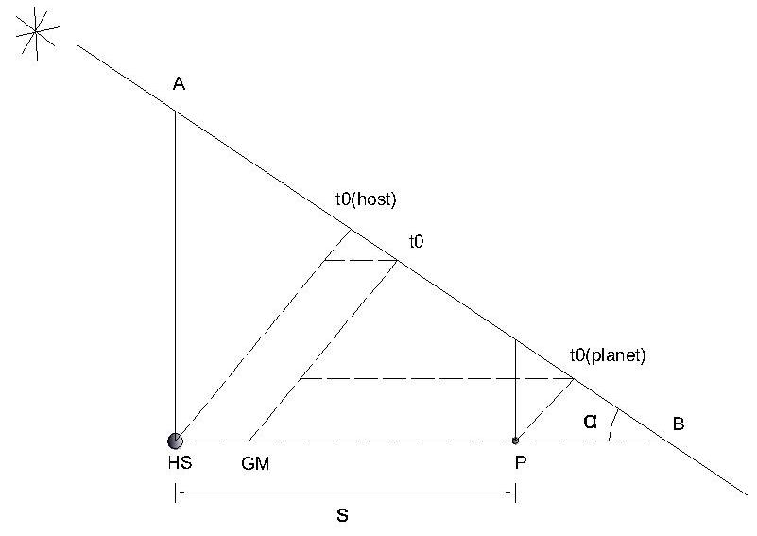
Single lensing event fitting:
least square fitting
simulated binary curves fitted to a single lens model
compute
fitting parameters (u_{0(f)}, t_{0(f)}, t_{E(f)}, M_{S(f)}) and their errors (δu_{0(f)}, δt_{0(f)}, δt_{E(f)}, δM_{S(t)})
reduced chi-squared χ_{r}² (determines the goodness of the fit)
Peak origin
t_{0(planet)}
origin planet
t₀
if close to
t_{0(host)}
origin host

Slide 10
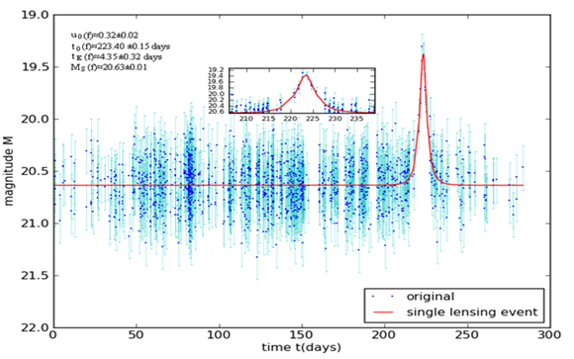
Selection Criteria
statistical information about shape of produced light curves
fraction of free floating planet-like events
Total of simulated events
Free floating planet- like light curve:
fits well to a single lensing event light curve (χ_{r}²<2)
has a narrow peak (t_{E} < 5 days)
origin the planet (magnification peaks close to )
t_{0(planet)}
Single star- like light curve:
fits well to a single lensing event light curve
has a wide peak (t_{E} > 5 days) or
origin the host star
Binary lensing event light curve:
poor model fit to a single lensing event light curve
Microlensing light curve of a free floating planet- like microlensing event

Slide 11
Rejection of Events
entire peak inside time range of simulations
final sample contains events
light curve well defined with distinct origin

Slide 12
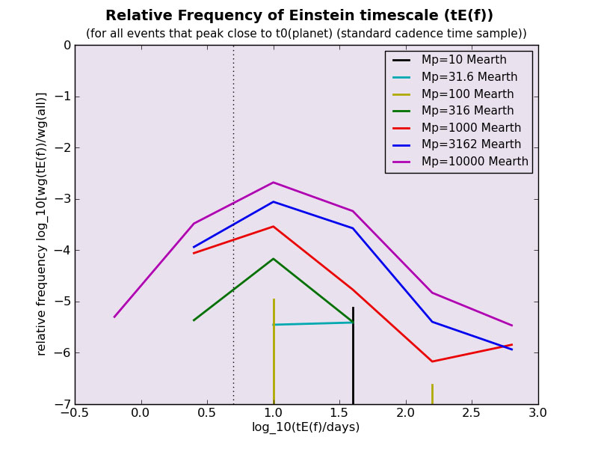
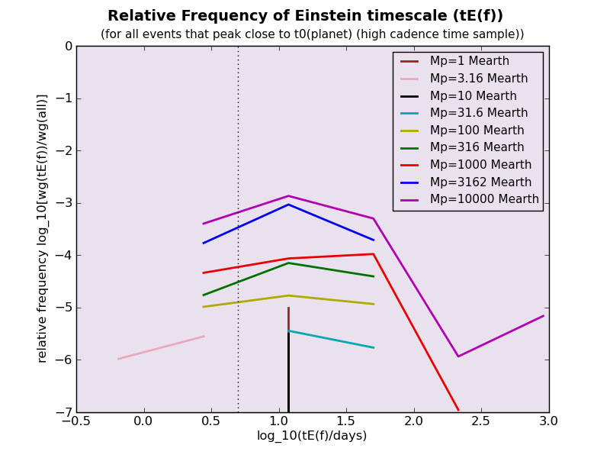
STATISTICAL ANALYSIS
Microlensing Light Curves That Peak Close to t_{0(planet)}
Single lensing events with wide peak close to t_{0(planet)} single star- like events
Majority of events whose light curve peaks close to t_{0(planet)}
cannot be assumed to be recognized as free floating planet events
t_{E(f)} >5 days

Slide 13
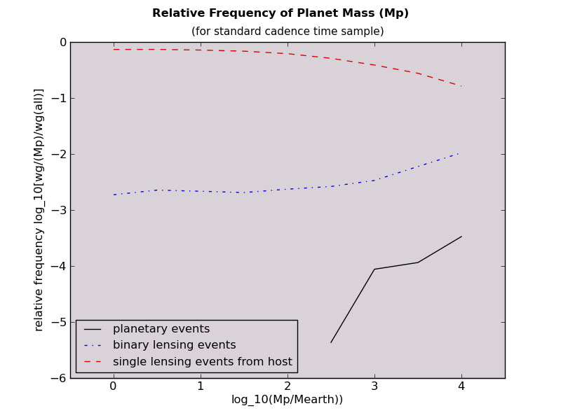
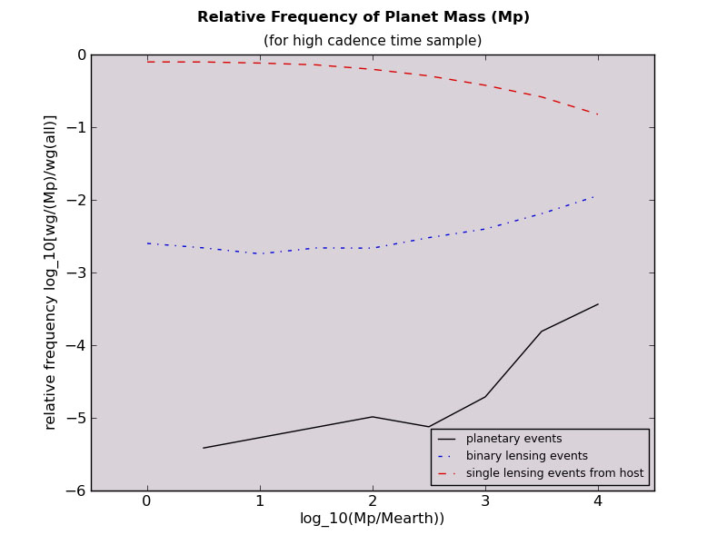
Microlensing Event Origin
Proportion of free floating- like, single star- like and binary events
Free floating planet-like events extremely rare

Slide 14
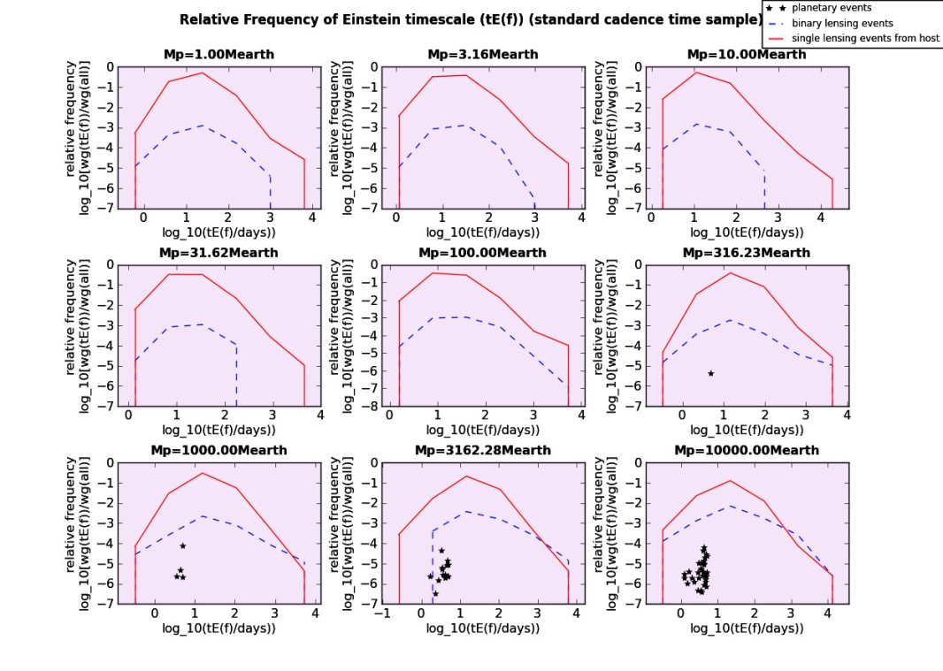
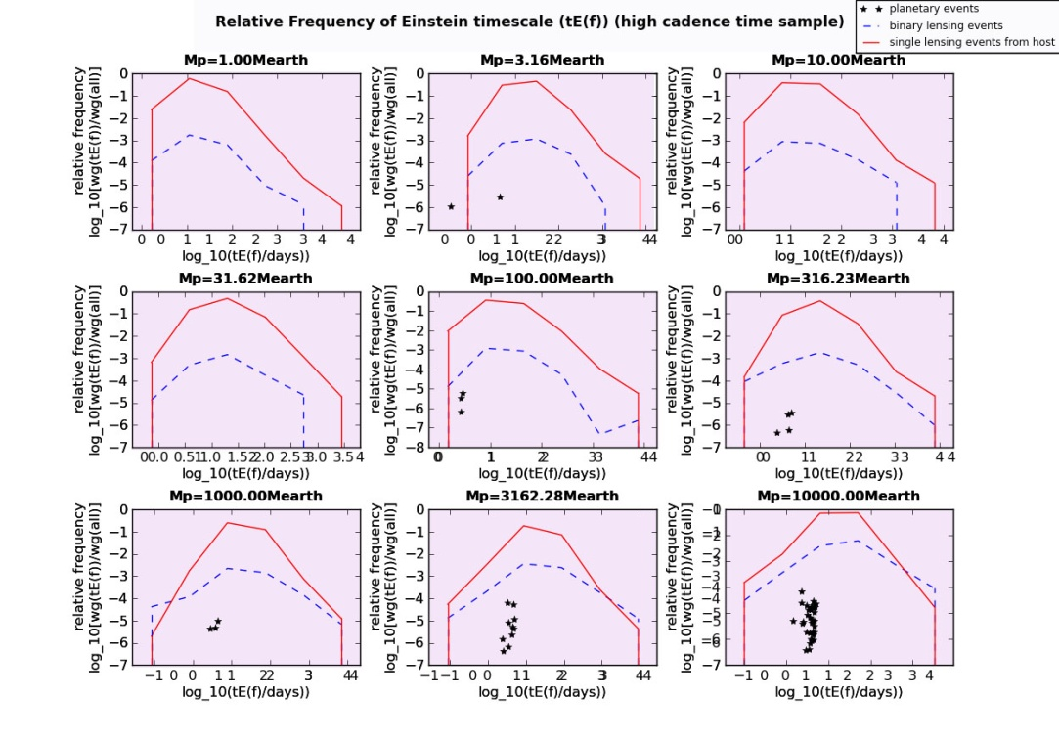
Einstein Timescale
Einstein timescale length of event mass of lensing object
Majority of free floating planet- like events
Einstein timescale > 2 days
(upper limit for the free floating planet events detected by MOA team)

Slide 15
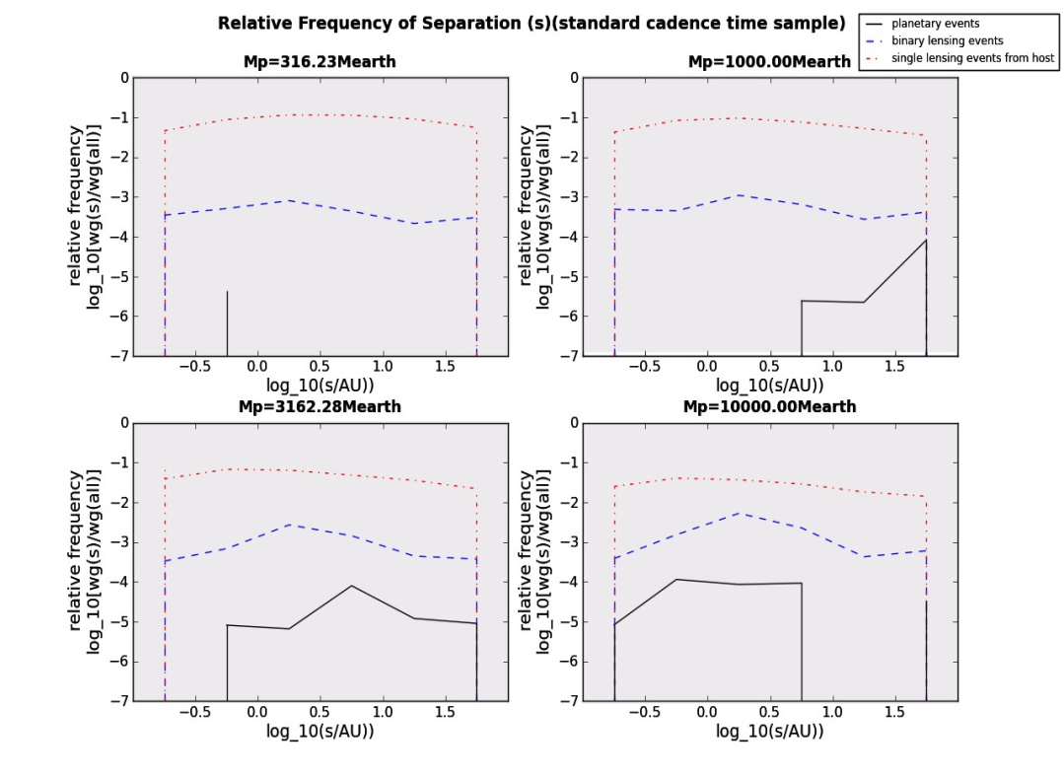
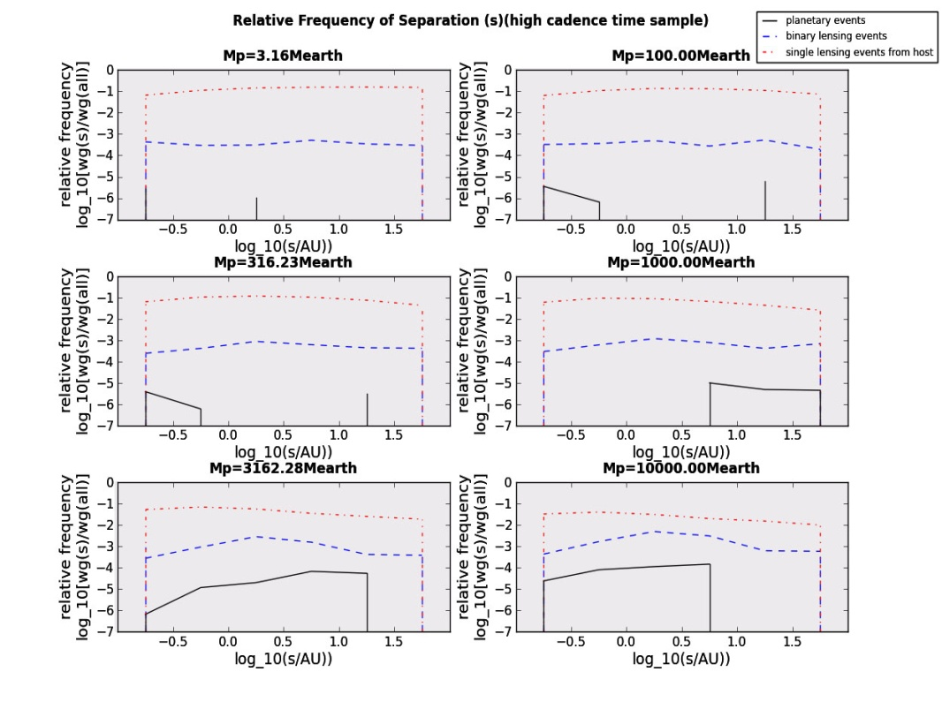
Sky- Projected Separation
Relation between separation and free floating planet- like events
no values of separation result in higher frequency of occurrence of free floating planet- like events

Slide 16
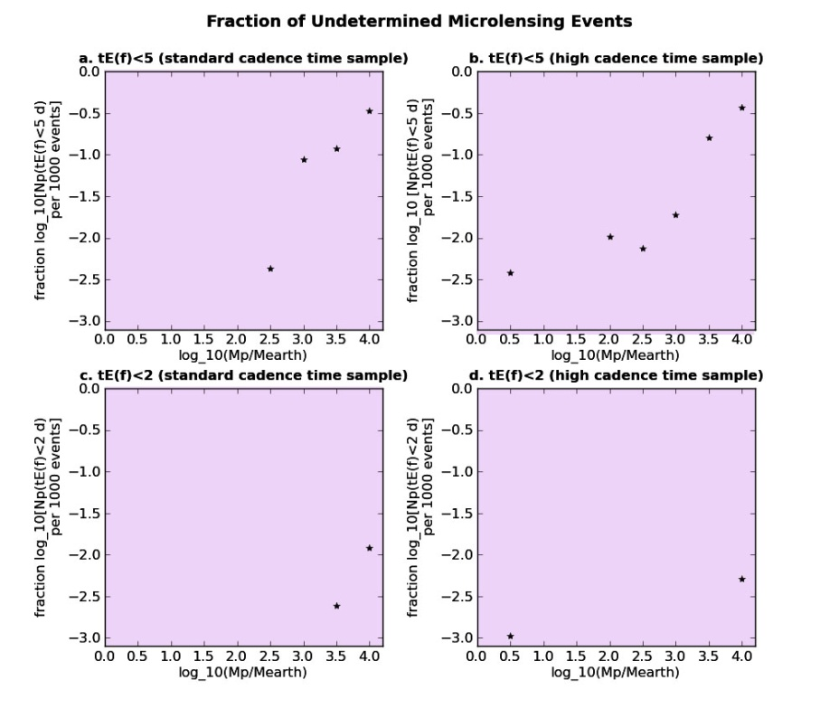
COMPARISON WITH SUMI et al. (2011)
MOA team found around 1000 microlensing events
10 of these events have t_{E}<2 days recognised as free floating planet events
Fraction of discovered planetary events, which could result by bound planets
1000* relative frequency of simulated free floating- like events that have t_{E(f)}<2 days
1000* relative frequency of all simulated free floating planet- like events
very small fraction of events could originate from bound planets but be confused as free floating planet events
only a tiny fraction of the 10 detected free floating planets could be in reality bound

Slide 17
CONCLUSIONS AND FUTURE WORK
Extremely small possibility for bound planets with separations to 100 AU to be confused as free floating when detected with gravitational microlensing
Future work should test this possibility for separations longer than 100 AU
Free floating planets detected by MOA team
unbound or bound with sky-projected separations longer than 100 AU

Slide 18
REFERENCES
Beaulieu J.-P., et al. 2006, 2006Natur.439..437B
Bennett D. P., et al. 2008, 2008ApJ...684..663B
Bennett D. P., Rhie S. H. 1996, 1996ApJ...472..660B
Gould A. 1992, 1992ApJ...392..442G
Kerins E., Robin A. C., Marshall D. J. 2009, 2009MNRAS.396.1202K
Mao S. 2008, 2008mmc..confE...2M
Mao S., Paczynski B. 1991, 1991ApJ...374L..37M
Marshall D. J., et al. 2006, 2006A&A...453..635M
Mayor M., Queloz D. 1995, 1995Natur.378..355M
Paczynski B. 1996, 1996ARA&A..34..419P
Perryman M. A. C. 2000, 2000RPPh...63.1209P
Robin A. C., Reylé C., Derrière S., Picaud S. 2003, 2003A&A...409..523R
Schneider J., 2014, the exoplanet.eu database; [online]. Available at: <http://exoplanets.eu> [date of access: 1st of May, 2014]
Sumi T., et al. 2011, 2011Natur.473..349S
Wambsganss J. 2011, 2011Natur.473..289W
Witt H. J. 1990, 1990A&A...236..311W
Wolszczan A., Frail D. A. 1992, 1992Natur.355..145W
Zapatero Osorio M. R., et al. 2000, 2000Sci...290..103Z

