Slide 1
Choose your own adventure! fast radio bursts
Vikram Ravi
University of Melbourne and CASS
With Ryan Shannon and Paul Lasky
And with particular thanks to the Swinburne CAS staff and students

Slide 2
Fast radio bursts (FRBs) may be markers of a hitherto unknown class of extraordinarily energetic, and possibly cataclysmic, cosmological events.

Slide 3
Outline of talk
Somewhat interesting properties of Parkes FRB 131104
Theoretical ideas - what could they be?
Focus on “Blitzars”
Searching for FRBs following short gamma-ray bursts

Slide 4
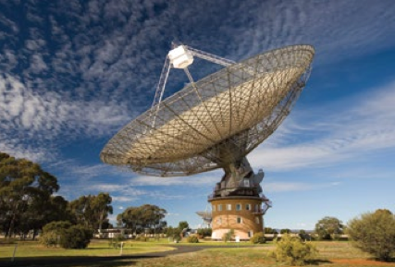
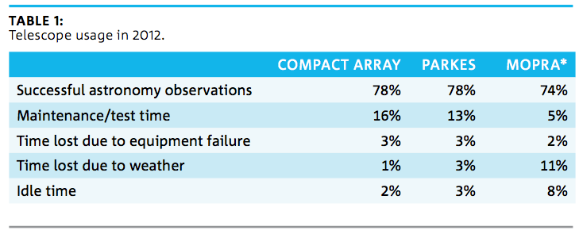
The P855 observing program
Ryan Shannon
2012 ATNF Annual Report

Slide 5
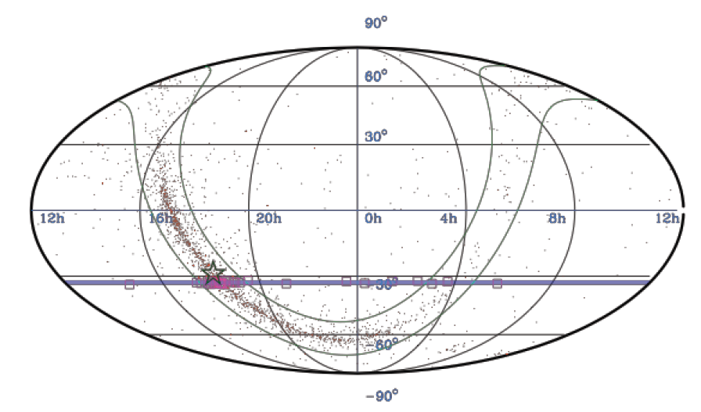
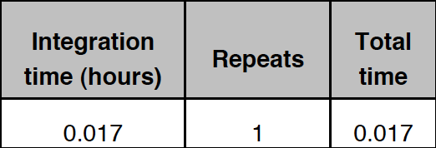

Slide 6
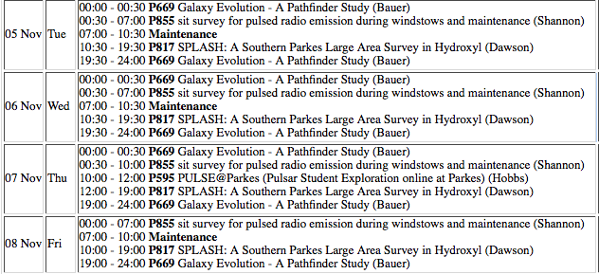
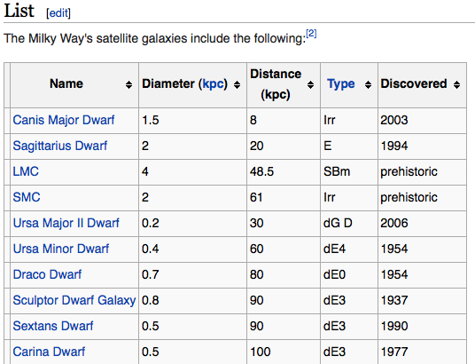
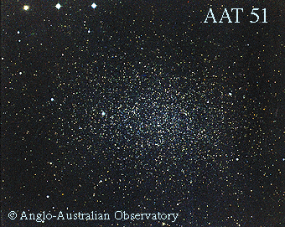

Slide 7
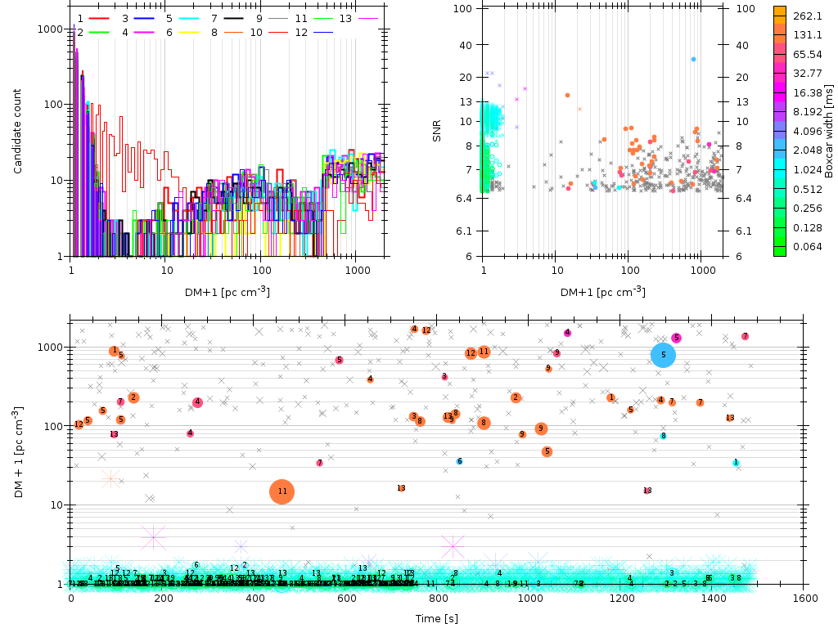
Barsdell et al. (2011)

Slide 8
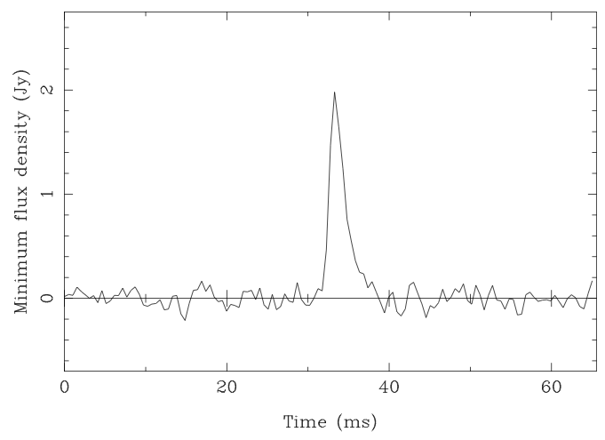
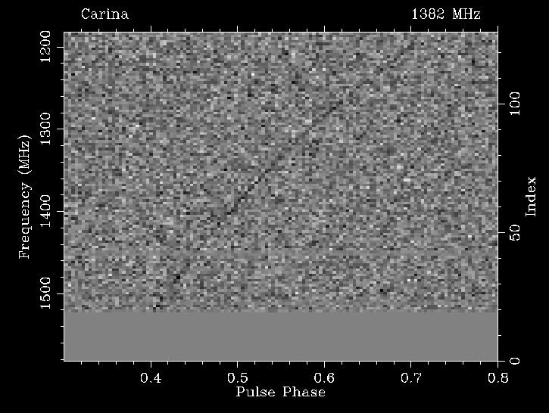
FRB131104

Slide 9
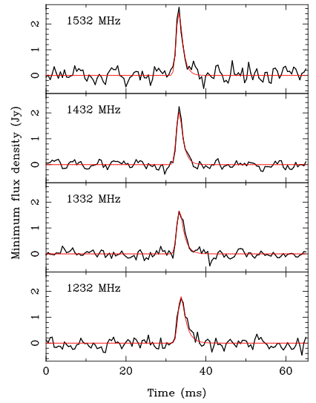
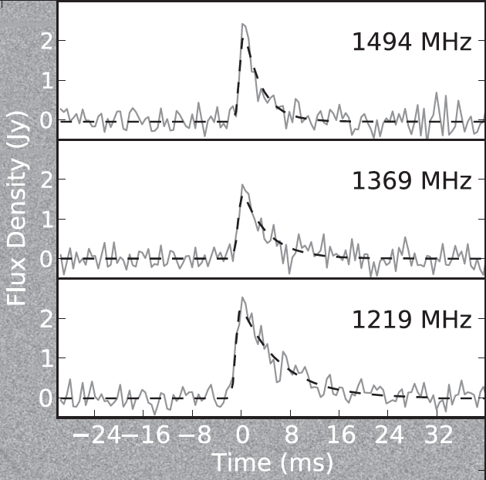
Modelling the pulse shape
0.512 ms resolution
DM smearing
~ 0.6 - 1.5 ms
GAUSSIAN CONVOLVED WITH ONE-SIDED EXPONENTIAL
Gaussian width:
Scaled with DM smearing
DM: 777.7 +- 1 cm^-3 pc
DM_beta: -2.007 +- 0.007
Pulse-broadening:
Tau_0: 1.3 +0.6 -0.4 ms
Alpha: -1.5 +1.5 -2.0
NE2001 Galactic DM contribution is
69 cm⁻³ pc
90% confidence intervals
FRB 110220, Thornton et al. (2013)

Slide 10
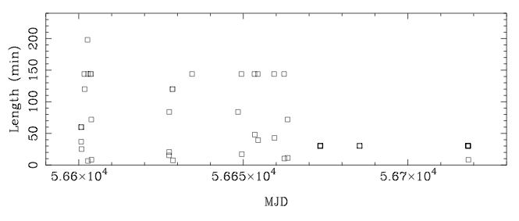
Follow-up observations
ATCA 4 – 8 GHz mosaic of FRB field at four epochs (3 days, 1.5 weeks, 1 month, 4 months)
Swift/XRT – 3 days
VLT/Xshooter spectroscopy of Swift sources
Parkes follow-up for 56.5 hours

Slide 11
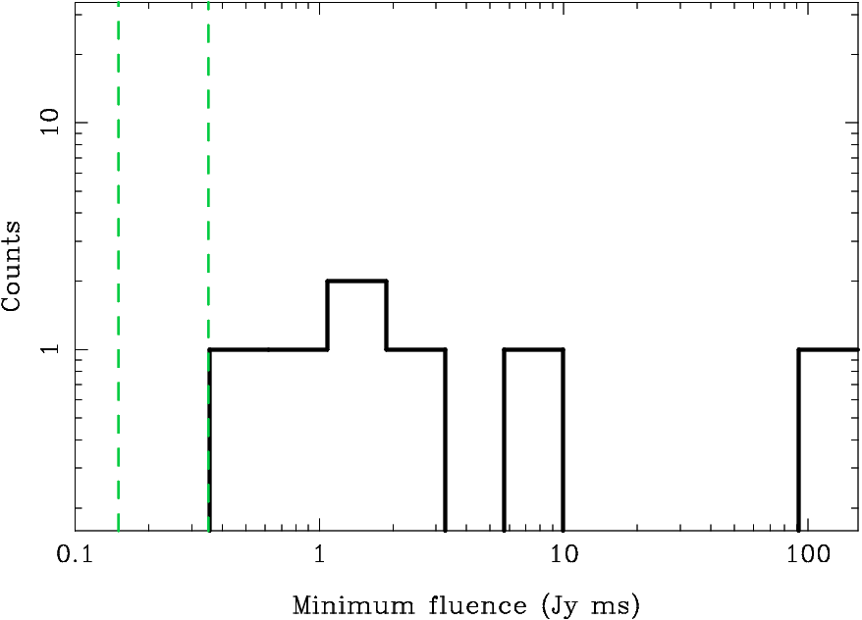
FRB fluences
6σ lower limiting fluence sensitivities at Parkes, for DM smearing at 200 and 1000 cm⁻³ pc

Slide 12
Why it’s hard to derive the intrinsic FRB luminosity function, and hence the rate
DM smearing.
Where are FRBs in the antenna beam patterns?
Frequency-dependent gain issues
How much of a role does time-variable diffractive scintillation play?
How does DM correlate with distance?
What does the intrinsic scatter in the DM-distance relation look like?
What is the host DM contribution, and do intervening objects play a role?

Slide 13
FRB source heuristics
Emission region size, with relativistic beaming:
Brightness temperature – coherent emission:

Slide 14
Theoretical ideas on extragalactic FRBs
Cosmic strings
e.g., Cai et al. (2012)
Compact object mergers
Kashiyama et al. (2013)
Totani (2013)
Magnetar hyperflares
e.g., Popov & Postnov (2013)
Lyutikov (2006)
Giant pulses from pulsars
Luan & Goldreich (2014)
(also ETs)
Blitzars
e.g., Falcke & Rezzolla (2014)

Slide 15
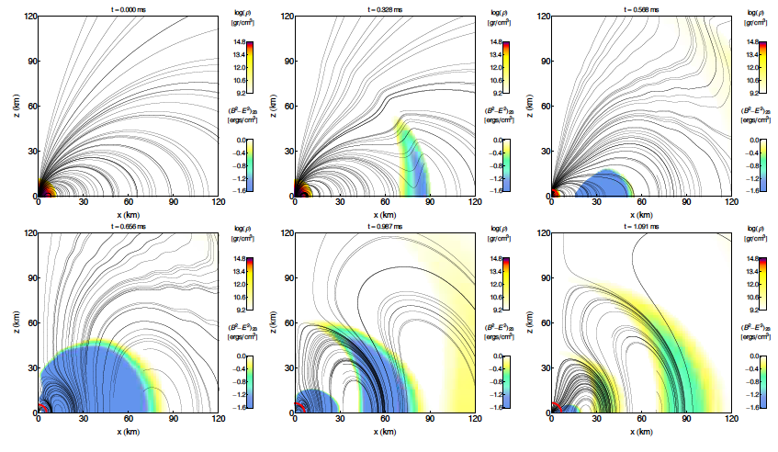
Blitzars
Falcke & Rezzolla (2013)
Dionysopoulou et al. (2013)
Supramassive neutron stars have masses above the maximum (TOV) non-rotating mass, but are supported by uniform rotation.
Electromagnetic spin-down -> collapse to black hole!
Formation mechanism unclear

Slide 16
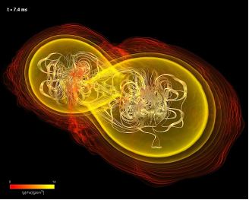
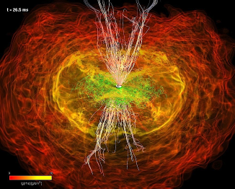
Where are they – short GRBs?
Effective widths < 2 s, typically hard gamma-rays, lower luminosities than long GRBs, found at z ~< 2 and typically in low-SFR regions.
Most commonly linked with binary NS mergers.
Can be powered by black hole or millisecond magnetar remnants
Rezzolla et al. (2011)

Slide 17
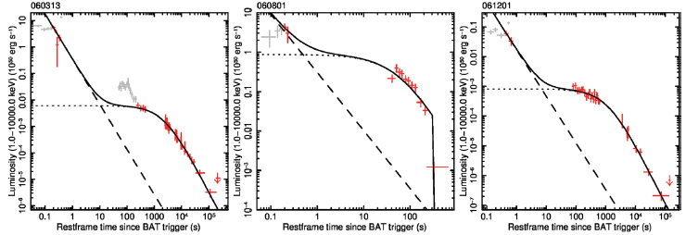
Millisecond magnetar SGRB central engines
Used to explain features of X-ray afterglow lightcurves of SGRBs
bright, quickly-varying flares
plateau phases.
Rowlinson et al. (2013)
Zhang & Mezaros (2001)

Slide 18
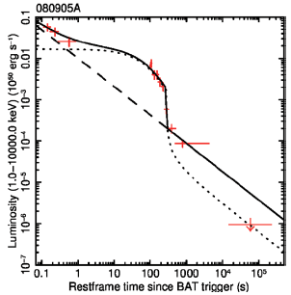
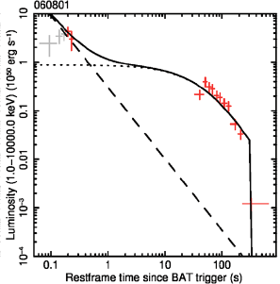
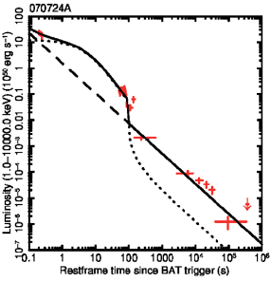
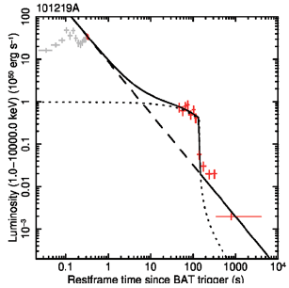
Supramassive, collapsing central engines
0.2%
15%
18%
60%
Abrupt cut-offs are interpreted as supramassive protomagnetars COLLAPSING TO BLACK HOLES. How likely is this (i.e. 0 < t_{col} < ∞)?
I, R, M_{TOV}: from neutron star EOS
M_{p}: probability distribution from Galactic NS-NS binaries (Kiziltan et al. 2013).
Rowlinson et al. (2013)
Lasky et al. (2014)
Ravi & Lasky (2014)
(arXiv:1403.6327)
B_{p}, p₀: measured from Rowlinson fit

Slide 19
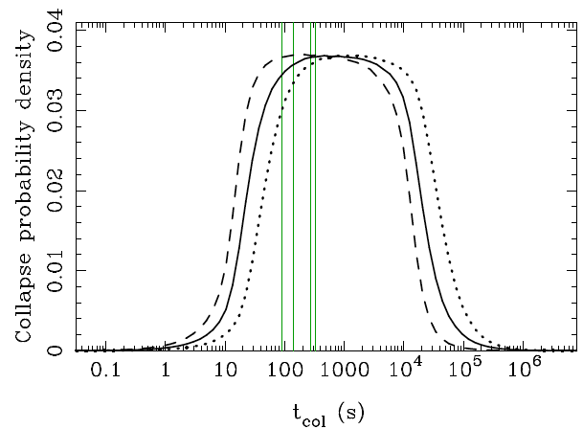
A general collapse time prediction
3 EOSs
10 – 44,000 s (95% confidence)
Ravi & Lasky (2014)

Slide 20
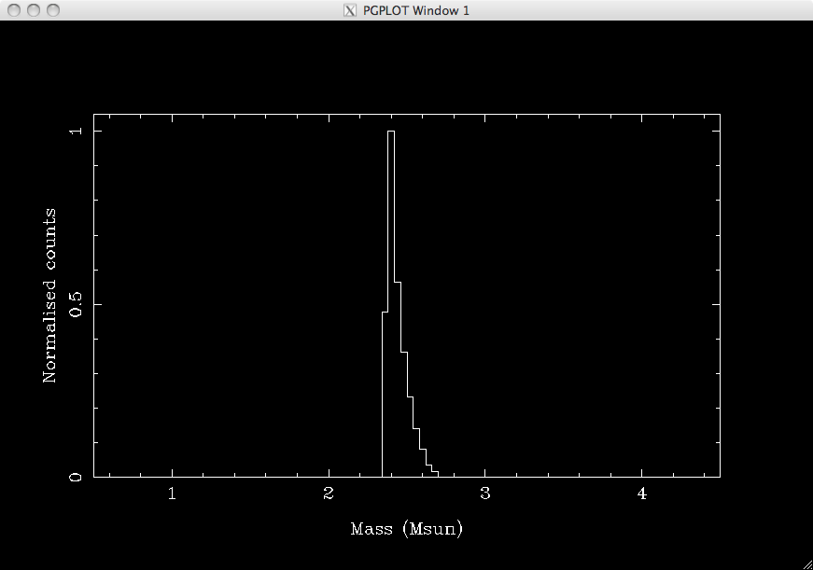
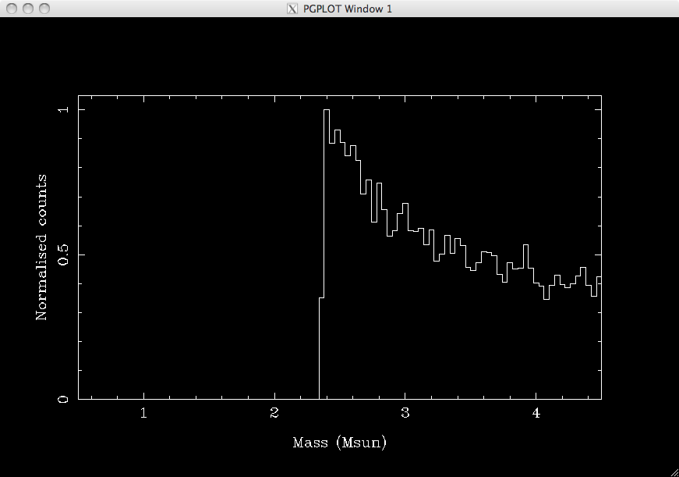
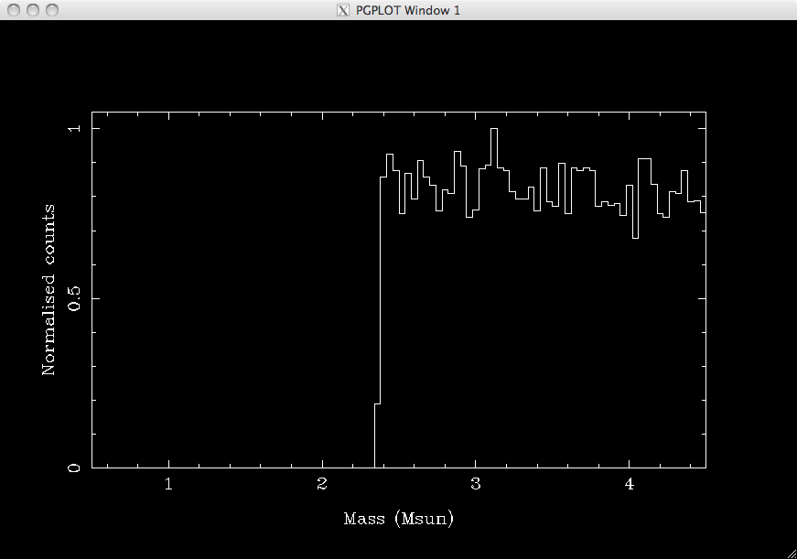
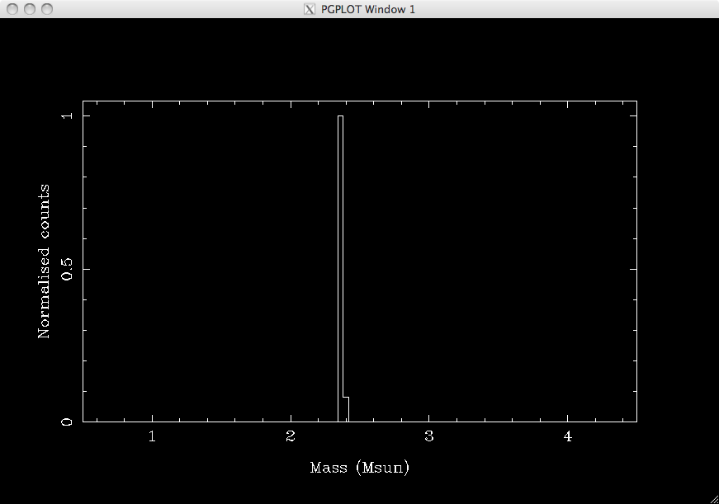
A slightly surprising consequence of the blitzar model
Supramassive NS mass range: t_{col} > 1e2 s
Supramassive NS mass range: t_{col} > 0
Supramassive NS mass range: t_{col} > 1e4 s
Supramassive NS mass range: t_{col} > 1e5 s

Slide 21
Possible caveats – generally on small timescales
Differential rotation support, rather than only uniform rotation
Differential rotation is suppressed on Alfven timescale (< 1 s for protomagnetars)
Gravitational radiation driven by bar-instabilities
T/|W|is likely less than 0.14, independent of (plausible) equation of state
Is vacuum dipole spin-down a reasonable assumption?
Hard to know (simulations suggest a crazy internal field structure), but likely on large scales.
Fall-back accretion torques
Not likely to be significant because of small ejecta masses.
Gravitational radiation from magnetic field induced deformities
Also not likely on long timescales
See discussion in Ravi & Lasky (2014)

Slide 22
Implications
In the ~25% of SGRBs which show signatures of magnetar central engine collapse to a black holes, blitzar-like emission will occur within 13 hours of the SGRB.
Radio propagation in surrounding medium may be possible (Zhang 2014).
X-ray plateaus (and cut-offs) are also seen in ~5% of long GRBs, which are more common.
Collapse time predictions are exceedingly hard for long GRB supramassive central engines

Slide 23
Conclusions
Targeted FRB searches, despite skepticism, allow for interesting science
GRBs, in particular, are an obvious trigger
LOFAR should do this every day!!
Distributions of FRB properties are hard to constrain
Range of pulse shape evolution possibilities
Range of minimum fluences
Always, always try and look for things!

Slide 24
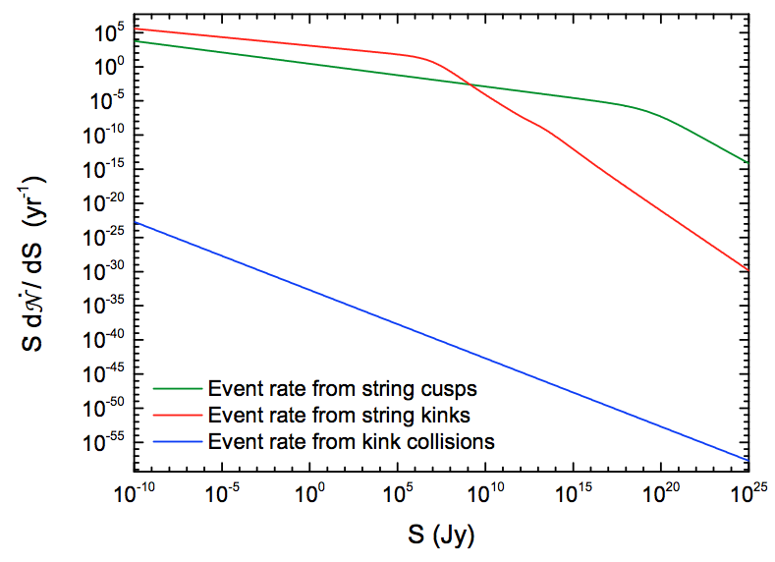
Cosmic string kinks, cusps, collisions
Cai et al. (2012)
Among the most detailed FRB predictions!
Topological defects that are expected in grand unified theories to form during cosmic phase transitions
Predict linearly-polarised radio bursts coincident with cosmic-ray and gravitational-wave events.
Burst durations ~ 1 ms
Calculations for L-band bursts

Slide 25
Magnetar hyperflares
SGRs (10-13 known) are magnetars with B_{p} ~ 10¹⁴ G, spin periods of 2 – 12 s.
Characterised by active periods of repeated soft gamma-ray flaring, and rare hyperflares (up to 10⁴⁷ erg s⁻¹).
Approximate scaling from solar flares suggests that 10⁻⁴ of the SGR luminosity is emitted in radio waves.
Rate estimate agrees with Thornton et al. 10⁴ / sky / day estimate for sources at z < 1.
Are hyperflares magnetospheric or internal in origin?
Popov & Postnov (2013)
Lyutikov (2006)

Slide 26
Targeted searches for FRBs
Huge benefits!
Identification of physical mechanism
Association with astrophysical source leads to new cosmological probe
Possibilities:
Radio stars
Magnetars
Starburst regions, for magnetars and giant pulse emitting pulsars
GRBs

