Slide 1
Aqueye Plus: a very fast single photon counter for astronomical photometry equipped with an Optical Vortex coronagraph
E. Verroi¹, G. Naletto^{2,3}, M. Zaccariotto⁴, L. Zampieri⁵, M. Barbieri⁵, T. Occhipinti⁷ ,
C. Barbieri⁶
¹ Centre of Studies and Activities for Space (CISAS) ‘ G. Colombo’, University of Padova, Via Venezia 15, 35131 Padova, Italy
² Department of Information Engineering, University of Padova, Via Gradenigo, 6/A, 35131 Padova, Italy;
³ CNR/IFN/LUXOR, Via Trasea, 7, 35131 Padova, Italy
⁴ Department of Industrial Engineering, University of Padova, Via Venezia 1, 35131 Padova, Italy
⁵ INAF Astronomical Observatory of Padova, Vicolo dell'Osservatorio 5, 35122 Padova, Italy
⁶ Department of Physics and Astronomy, University of Padova, Vicolo Osservatorio 3, 35122 Padova, Italy; e-mail: cesare.barbieri@unipd.it
⁷ Adaptica s.r.l. Padova, Italy

Slide 2
Topics
The theoretical foundations of our work
Aqueye and Iqueye
Results on optical pulsars
From Aqueye to Aqueye+
Conclusions

Slide 3
The theoretical foundations
Quantum properties: statistics of photon arrival times and Intensity Interferometry
Photon Orbital Angular Momentum and Optical Vortices for astronomical Coronagraphy

Slide 4
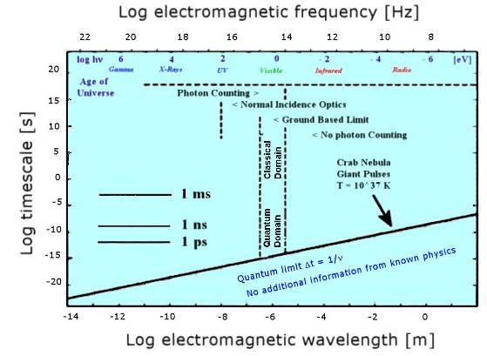
All of Astronomy in Time and Frequency
This slide conveys the idea of all of Astronomy in a time – frequency domain, and of the lower limit imposed by Heisenberg principle.
L3 CCDs
MCP
STJ
TES
PM
SiPM
HPD
APD
SPAD
SSPD
…
Pushing the time resolution towards the limits imposed by Heisenberg’s principle might have the same scientific impact of opening a new window. This new Astronomy can be designated as Quantum Astronomy, or Photonics Astronomy.

Slide 5
1 - Quantum properties of the photon stream
Quantum properties of a light beam are reflected in the second- (and higher) order coherence of light, observable as correlations between pairs (or greater number) of photons.
The information content lies in collective properties of groups of photons, and cannot be ascribed to any one individual photon.
Therefore, one has to investigate the correlation in time (or space) between successive photons in the arriving photon stream. The difference with conventional studies may be significant if the photon emission process has involved more than one photon at a time.

Slide 6
Two photon correlation experiments
Realistically, in astronomical applications we might have some hope to detect two-photon correlation effects, which can be ascribed to quantities of type I *I, i.e. intensity multiplied by itself, which in the quantum limit means observations of pairs of photons, or of statistical two-photon properties.
(R. Glauber, 1965,
Nobel Prize 2005)
with r₂-r₁=d and t₂-t₁=τ
τ = 0 and d ≠ 0 correspond to Hanbury Brown - Twiss Intensity Interferometry (Narrabri).
τ ≠ 0 and d = 0 correspond to photon correlation spectroscopy (R = 10⁹- 10¹⁰ necessary to resolve lased spectral lines).

Slide 7
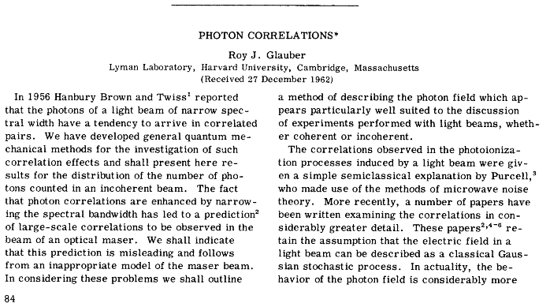
Intensity Interferometry
The first paper by Glauber made reference to the 1956 HBT experiment, whose application to the astronomical field became Intensity Interferometry (HBTII) in Narrabri (Australia) .

Slide 8
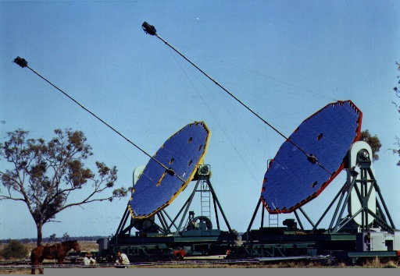
The Narrabri Intensity Interferometer
A ‘stellar interferometer’ was completed in 1965 at Narrabri, Australia by R. Hanbury Brown and R. Q. Twiss. By the end of the decade it had measured the angular diameters of more than 30 stars, including Main Sequence blue stars.
The light-gathering power of the 6.5 m diameter mirrors, the detectors (photomultipliers), analog electronics etc. allowed the Narrabri interferometer to operate down to magnitude +2.0, a fairly bright limit indeed.
The intrinsically low efficiency of the system made the HBTII essentially forgotten, in favor of Michelson type (amplitude and phase) interferometers, e.g. the ESO VLTI.

Slide 9
Michelson vs Intensity Interferometry
(Van Cittert - Zernike theorem)
Normalized correlation between two electromagnetic waves at different positions and times (Michelson interferometer):
Second order correlation (HBT Intensity Interferometry):
Such correlation is proportional to |γ|², namely to the square of the fringe visibility in the Michelson interferometer.

Slide 10
2 - The Orbital Angular Momentum of light
The total angular momentum J^{EM} of a light beam can be written as:
the first term is the spin angular momentum (SAM), it is tied to the helicity (polarization) of the light beam. For a single photon its value is S_{z} = ± ħ
the second term is the orbital angular momentum (OAM), it is tied to the spatial structure of the wavefront, i.e. the orbital terms are generated by the gradient of the phase. For a single photon it assumes the value L_{z} = l ħ where l = 0 for a plane wave with S || k, and l ≠ 0 for a helicoidal wave front, because S precesses around k.

Slide 11
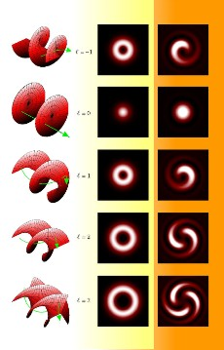
Graphical representation of L-G modes for p = 0
The mathematical representation of OAM is usually done in terms of Laguerre - Gauss modes containing two integer numbers:
l = nr. of helicoidal twists along a wavelength, p = nr. of radial nodes
l = topological
charge
Wavefront Intensity Phase
Graphics for p = 0.
The wavefront has a helicoidal shape composed by ℓ lobes disposed around the propagation axis z.
A phase singularity called Optical Vortex is nested inside the wavefront, along the axis z.
In our application
l = 2

Slide 12
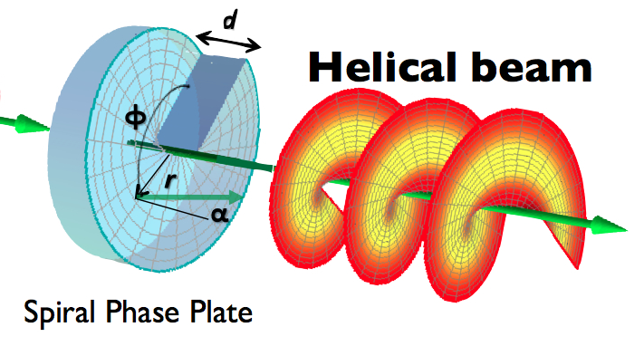
Imparting OV with l = 2
Beams nesting OV can be produced by inserting in the optical path a phase modifying device which imprints vorticity on the phase distribution of the incident beam, in our case with a spiral plate having l = 2:

Slide 13
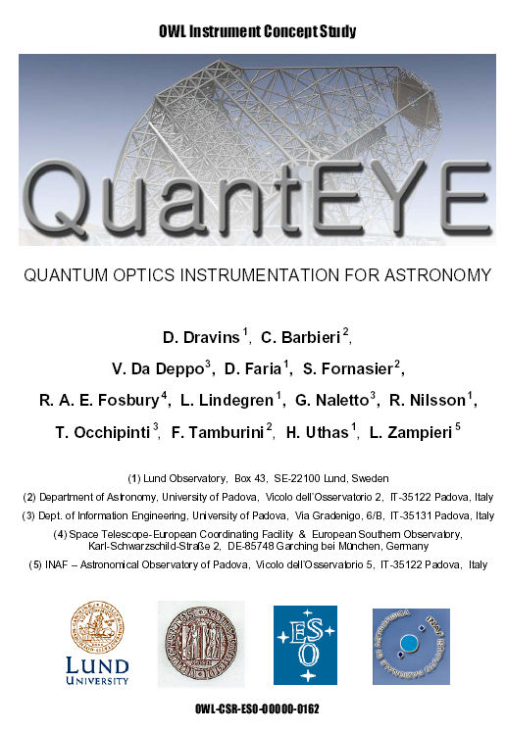
Those concepts were exposed in our study QuantEYE (the ESO Quantum Eye, 2005) in the frame of the studies for the (then) 100m Overwhelmingly Large (OWL) telescope.
The study summarized the features of quantum optics applicable to Astronomy with very large telescopes,
demonstrated the possibility to reach the picosecond time resolution needed to bring quantum optics concepts into the astronomical domain with existing technologies,
and pointed out that OAM too had interest for Astronomy.

Slide 14
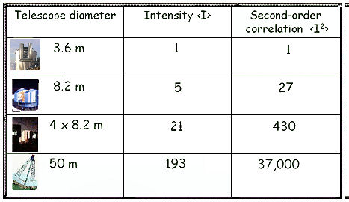
Why Extremely Large Telescopes?
The above mentioned quantum correlations are fully developed on time scales of the order of the inverse optical bandwidth. For instance, with the very narrow band pass of 1 A (0.1 nm) in the visible, through a definite polarization state, typical time scales are ≈ 10⁻¹¹ seconds (10 picoseconds). Or else, photon rates of GigaHertz are required. Actually, the photon flux is very weak even for the brightest stars, so that only Extremely Large Telescopes (ELTs) can bring Quantum Optical effects in the astronomical reaches.
From another point of view, the amplitude of second order functions increases with the square of the telescope area (not diameter!), so that a 40m telescope will be 256 times more sensitive to such correlations than the existing 8-10m telescopes.

Slide 15
Astrophysics below millisecond limit
At any rate, in addition to quantum effects there are also more conventional astrophysical phenomena below the millisecond frontier, e.g.:
Earth Atmospheric phenomena
Structures in the atmospheres of exoplanets
Variability near black holes
Surface convection on white dwarfs
Non-radial oscillations in neutron stars
Surface structures on neutron-stars
Photon bubbles in accretion flows
Free-electron lasers around magnetars
……
and then the unexpected…

Slide 16
From theory to reality: the key technological limitation is the detector
The most critical point, and driver for the design of QUANTEYE, was the selection of very fast, efficient and accurate photon counting detectors.
No detector on the market had all needed capabilities: In order to proceed, we choose SPADs operating in Geiger mode. The main drawbacks of SPADs were (and still are) the small dimensions, the lack of CCD-like arrays, a ≈70 ns dead-time and a ≈ 1.5% after-pulsing.
To overcome both the SPAD limitations and the difficulties of a reasonable optical design (coupling the pupil of a very large telescope to ≈ 100 μm detectors), we split the problem by subdividing the large telescope pupil into N×N sub-pupils, each of them focused on a single SPAD. In such a way, a “sparse” SPAD array collecting all light and coping with the required very high count rate could be obtained. The distributes array samples the telescope pupil, so that a system of NxN parallel smaller telescopes was realized, each one acting as a fast photometer.

Slide 17
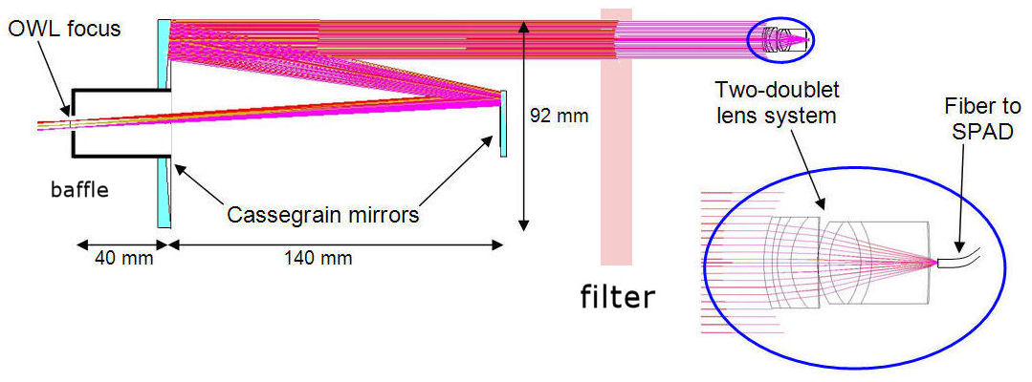
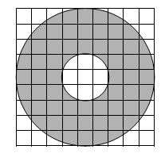
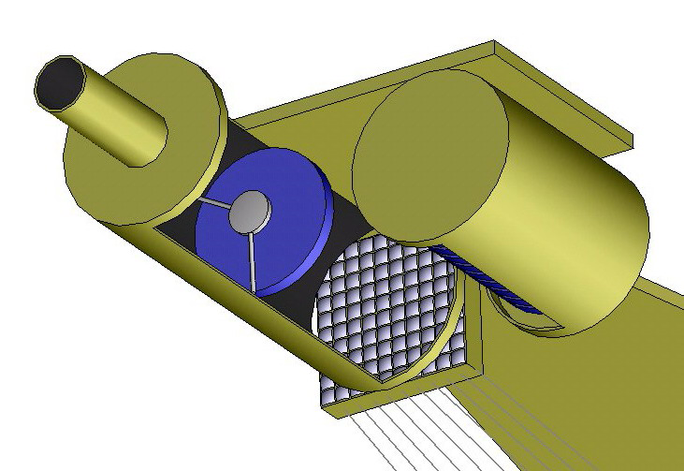
QuantEYE optical design, NxN= 10x10
telescope pupil subdivision

Slide 18
Aqueye and Iqueye
To gain real experience with those novel instrumental concepts, we built two prototypes for much smaller telescopes, Aqueye for the Asiago 1.8m telescope and Iqueye for a 4m class telescope (initially the ESO 3.5m NTT in La Silla).
No quantum optics effect is detectable with such small telescopes, however we carry out with them frontier scientific observations thanks to the very accurate timing capabilities of the photometers.
Actually, Aqueye and Iqueye are the best ‘time machines’ available to Astronomy.

Slide 19
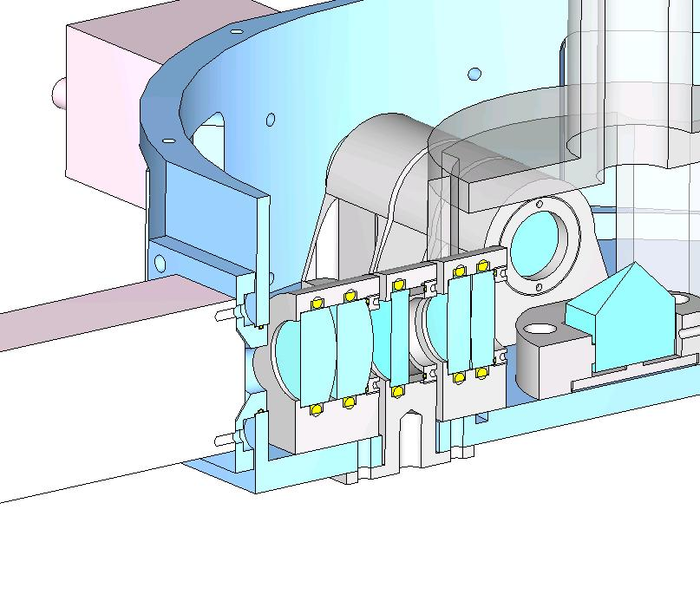
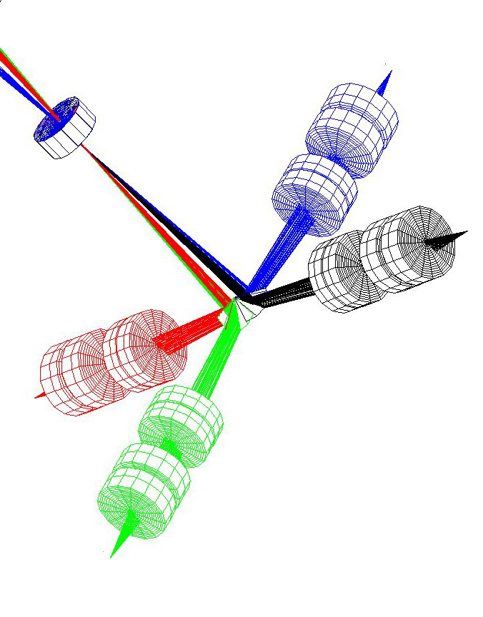
Optomechanical design
The light beam is divided in four parts by means of a pyramidal mirror. Each beam is then focused on its own SPAD by a 1:3 focal reducer made by a pair of doublets. Different filters can be inserted in each arm to produce simultaneous multicolour photometry.
pinhole
SPAD
pyramid
pyramid
1:3 focal reducer
filter
SPAD

Slide 20
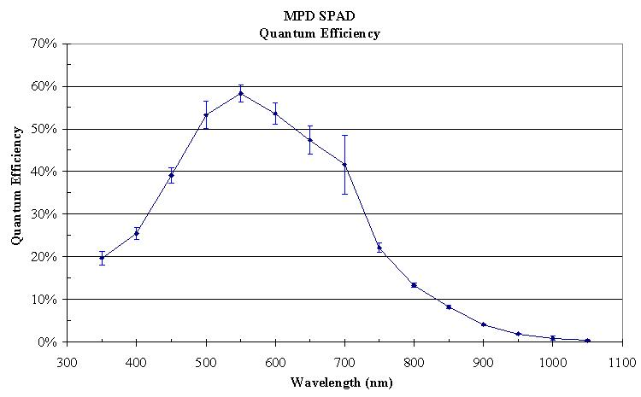
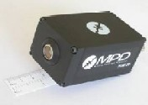
MPD’s SPADs
The selected detectors were Geiger mode SPADs produced by MPD (Italy). They are operated in continuous mode, the timing circuit and cooling stage are integrated in a ruggedized box. The timing accuracy out of the NIM connector is around 35 ps.
Their main drawbacks are the small sensitive area (100 µm diameter), a ≈77 ns dead time and a 1.5% after-pulsing probability.

Slide 21
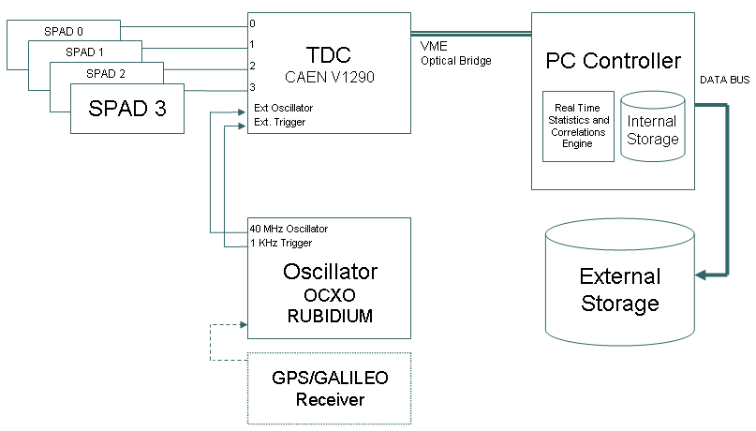
Electronics and data acquisition
A Time To Digital Converter board originally made for CERN, at 40 GHz (ticks at 25 ps).
ATFU
The arrival time of each photon is stored separately for each channel, guaranteeing data integrity for the subsequent scientific investigations.

Slide 22
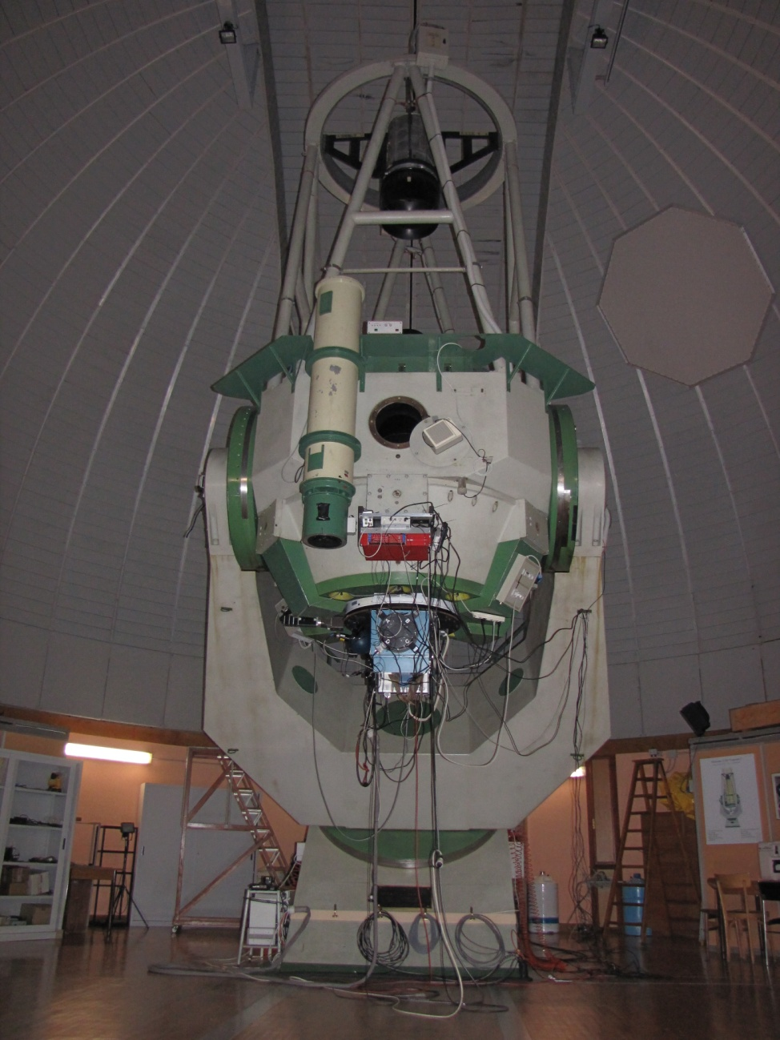
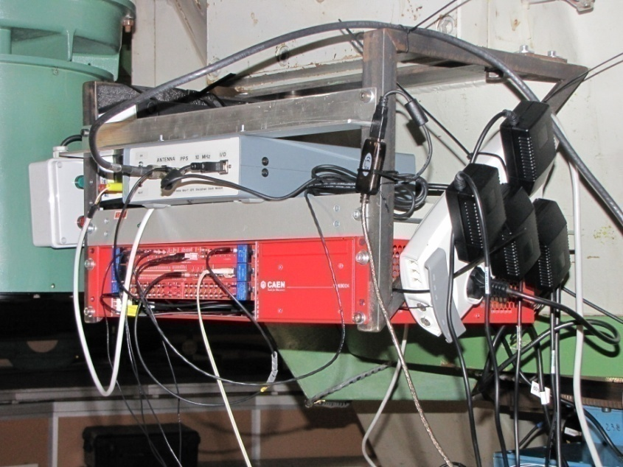
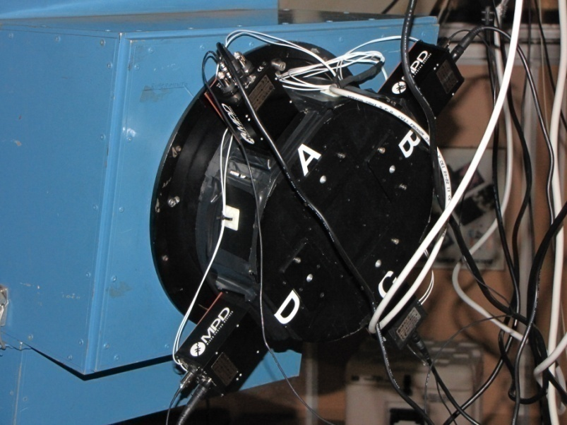
AquEYE
AquEYE, the Asiago Quantum Eye.
It was originally mounted on the focal plane of the imaging spectrograph AFOSC of the 182 cm Copernicus telescope in place of the usual CCD camera.
AFOSC plays the role of a 1:3 focal reducer,

Slide 23
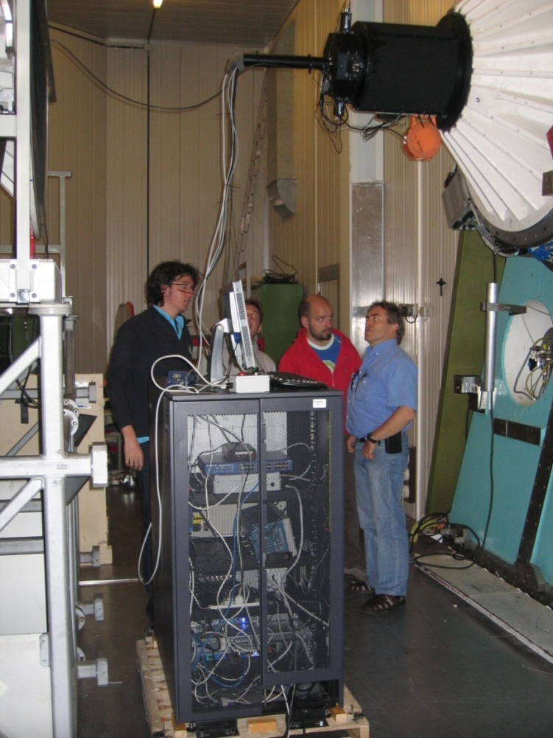
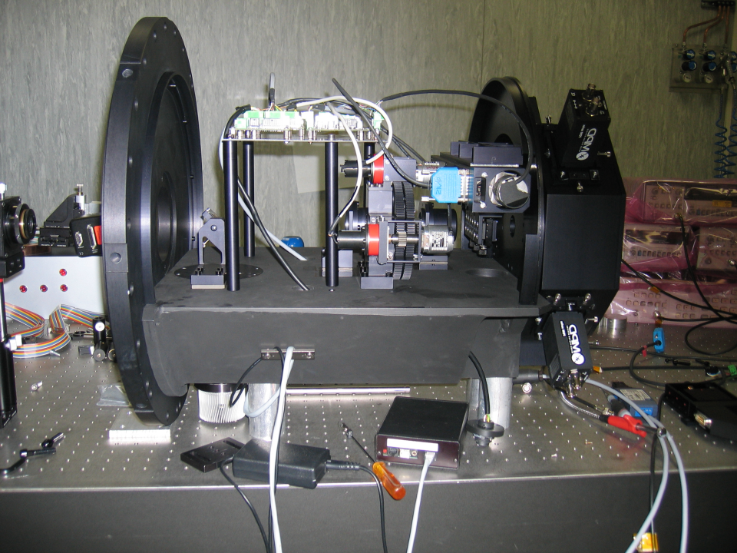
Iqueye
IquEYE, for the Nasmyth A focus of the ESO 3.5m NTT in La Silla (Chile).

Slide 24
Timing of the CRAB pulsar with Aqueye and Iqueye
In collaboration with M. Calvani (INAF OAPd, Italy), A. Čadež (Lubljiana, Slovenia), A. Shearer (NUI Galway, Ireland), R. Mignani (INAF Milano, Italy)

Slide 25
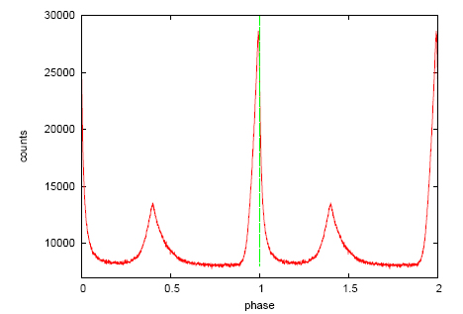
Aqueye - Two days in Oct. 2008
Folded light curve of the Crab pulsar. The folding period and the bin time are 0.0336216417 s and 33.6 μs, respectively.
Phase zero/one corresponds to the position of the main peak in the radio band and is marked with a vertical green dashed line. It appears that the radio peak follows the optical one, as detailed later.

Slide 26
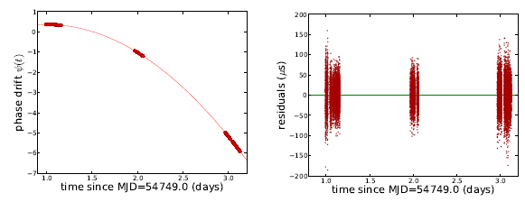
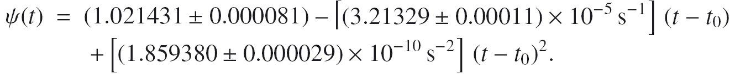
Phase drift and phase residuals
Left: Phase-drift of the main peak of the Crab pulsar measured during the observing run in Asiago in October 2008. The red curve is the best-fitting parabola. Reference epoch t₀ is MJD=54749.0, reference rotational period is Pi_{nit} = 0.0336216386529 s.
Right: Phase residuals (in μs) after subtracting the best-fitting parabola to the phase-drift.

Slide 27
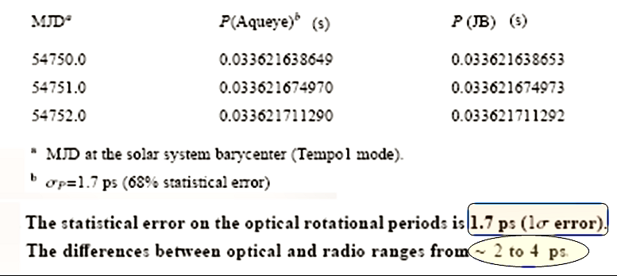
Comparison with Jodrell Bank (radio)
Rotational periods of the Crab pulsar compared to those reported in the JB radio ephemerides

Slide 28
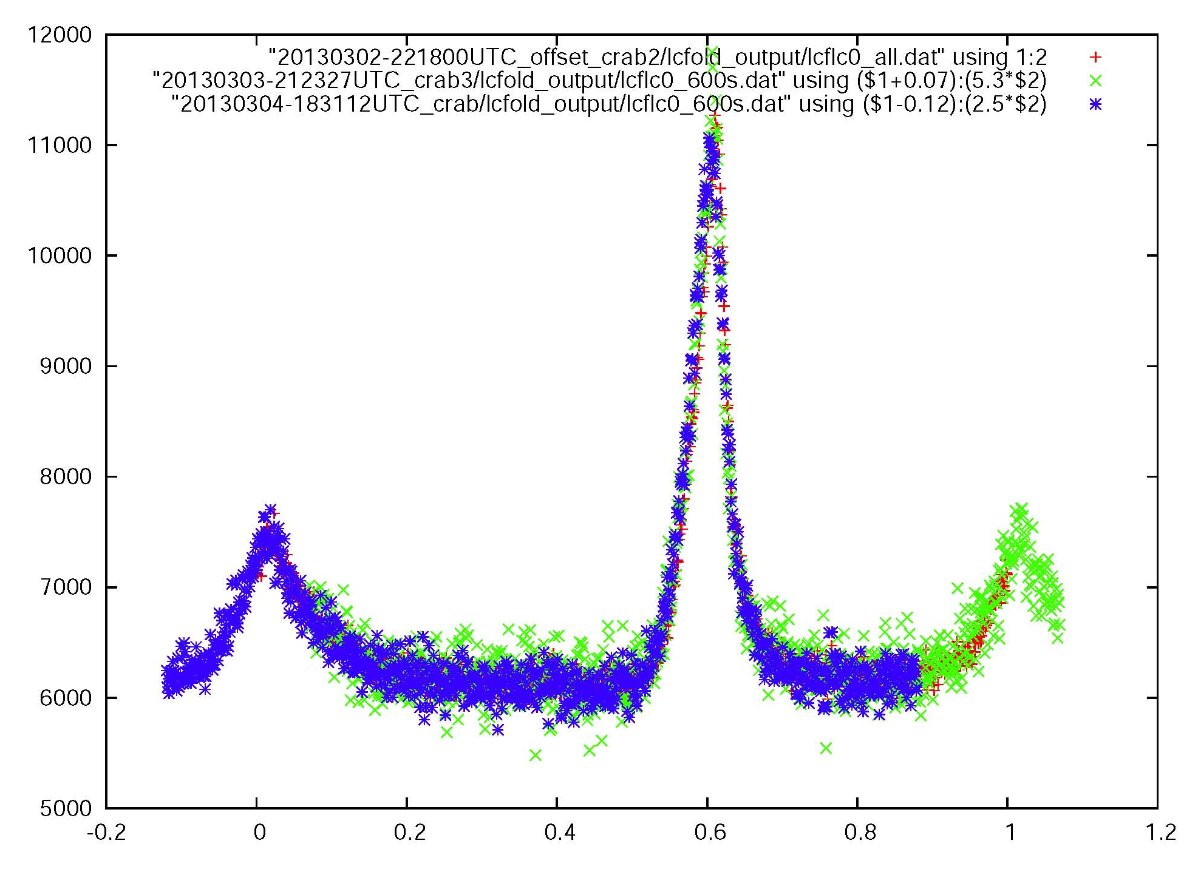
The X- and Gamma flares of March 2013
During the flaring up of the Crab pulsar detected by Fermi, AGILE and Integral in early March, 2013, we were observing the pulsar with Aqueye.
To our knowledge, Aqueye’s data are the only optical ones in that occasion. A preliminary analysis of the light curves of 3 consecutive nights with a time resolution
of 33.6 microseconds shows no significant variation of the pulse shape and amplitude during the occurrence of the flare.

Slide 29
Iqueye at the NTT - 2009
The Crab pulsar was observed with Iqueye at the NTT in January 2009 and again in December 2009.
In the last occasion simultaneous data were obtained with Jodrell Bank, which detected hundreds of Giant Radio Bursts during the Iqueye observations.

Slide 30
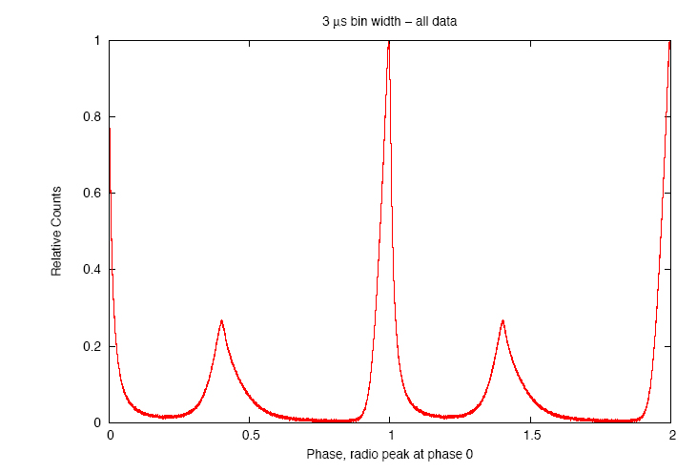
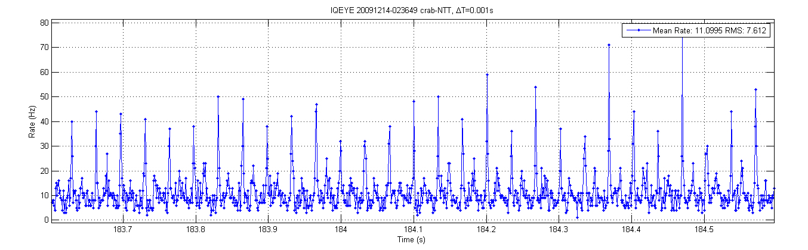
The CRAB pulsar at the NTT
A comparison with JB radio ephemeris shows agreement in the periods to the 1 picosecond level.
Time bin:
3microsec = 10⁻⁴ P

Slide 31
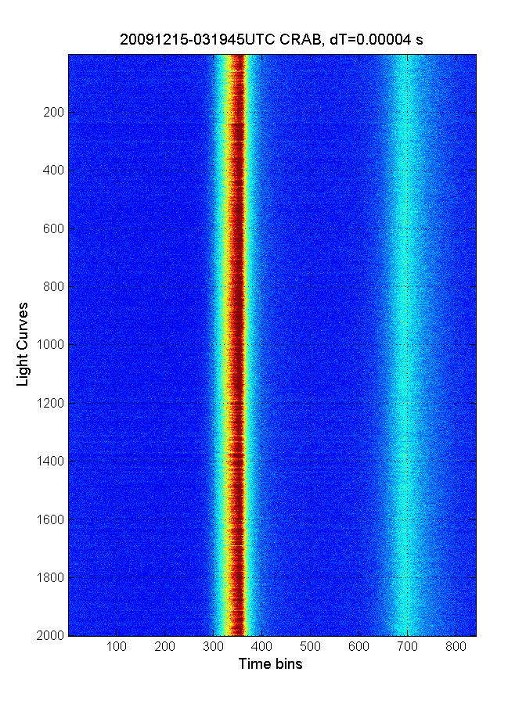
Waterfall diagram of the Crab pulsar
Figure 2 . Waterfall diagram of a two hours Crab pulsar acquisition with Iqueye at NTT on 15 December 2009, binned at 4x10⁻⁵ s. The slight curvature of the vertical lines is due to the pulsar spin-down during the two hours.
The residual curvature allows to measure such period variation, namely dP/dt ≈ 4:2×10⁻¹³ s/s at the time of observation (Zampieri et al. 2014), corresponding to a change in the period of only 3 ns from the beginning to the end of the observation, or equivalently to a total phase variation of −0.0096.

Slide 32
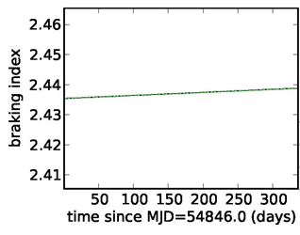
Optical Braking Index in 2009
The optical braking index measured by Iqueye during year 2009 was around 2.435, with no indication of significant glitches.

Slide 33
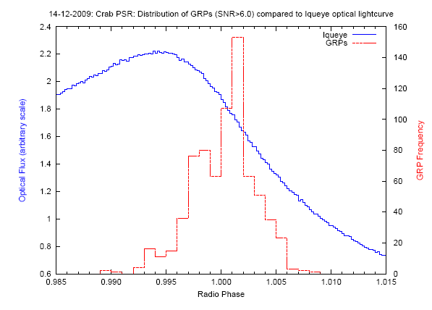
Concurrent GRBs
The observations in December 2009 had concurrent radio observations taken at Jodrell Bank. The radio data were de-dispersed, cleaned and analyzed to find so-called ‘giant radio pulses’ (GRPs ). 737 GRPs were identified above a 6.0-σ cutoff, of which 663 GRPs had concurrent optical observations.
Distribution of the phases of those 663 GRPs with respect to the optical light curve.
Red: Frequency distribution of Crab pulsar Main-Pulse GRPs, with SNR >6.0 σ.
Blue: Iqueye optical lightcurve for the same observing period, showing how the optical peak precedes the radio peak.

Slide 34
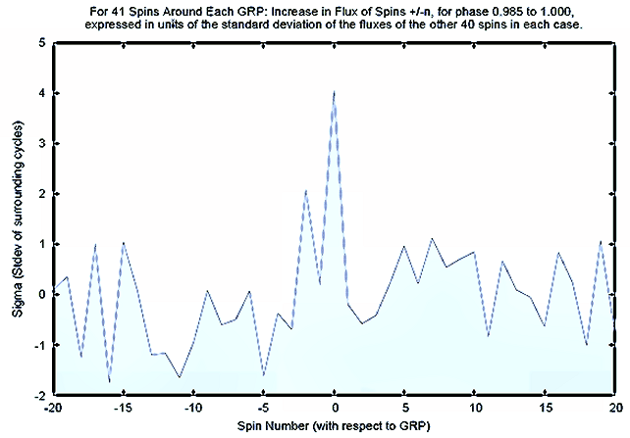
The plot shows a noticeable increase in optical flux up to a 4-σ level in correspondence with the radio GRP, in agreement with previous findings (Shearer et al., 2003)

Slide 35
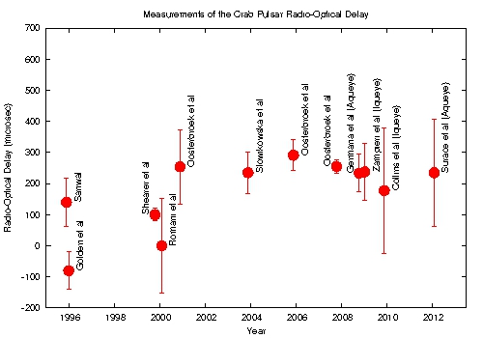
Radio - Optical Delay
Aqueye + Iqueye
Aqueye and Iqueye error bars are dominated by the radio errors

Slide 36
Developments of Iqueye
We have adapted Iqueye to the Cassegrain focus of the 4.2m William Herschel Telescope on the Roque de los Muchachos. A first engineering run was performed in November 2013, we hope to gain further observing time.
With the help of TNG personnel, an interface has been built for the Nasmyth A focus. A first run will be performed mid-June, 2014.

Slide 37
From Aqueye to Aqueye+, the optical design
We have undertaken a major refurbishment of Aqueye (Aqueye+):
    AFOSC has been eliminated, and a dedicated focal reducer has been implemented, with a field camera and a fifth SPAD which monitors the adjacent sky background
    A OV coronagraphic module with l = 2 can be inserted, fed by a dichroic filter plus a very narrow filter
    An adaptive optics module can be inserted between the focal reducer and Aqueye, to stabilize the star on the tip of the coronagraph phase plate. The deformable mirror is driven by the signals of the 4 SPADs.

Slide 38
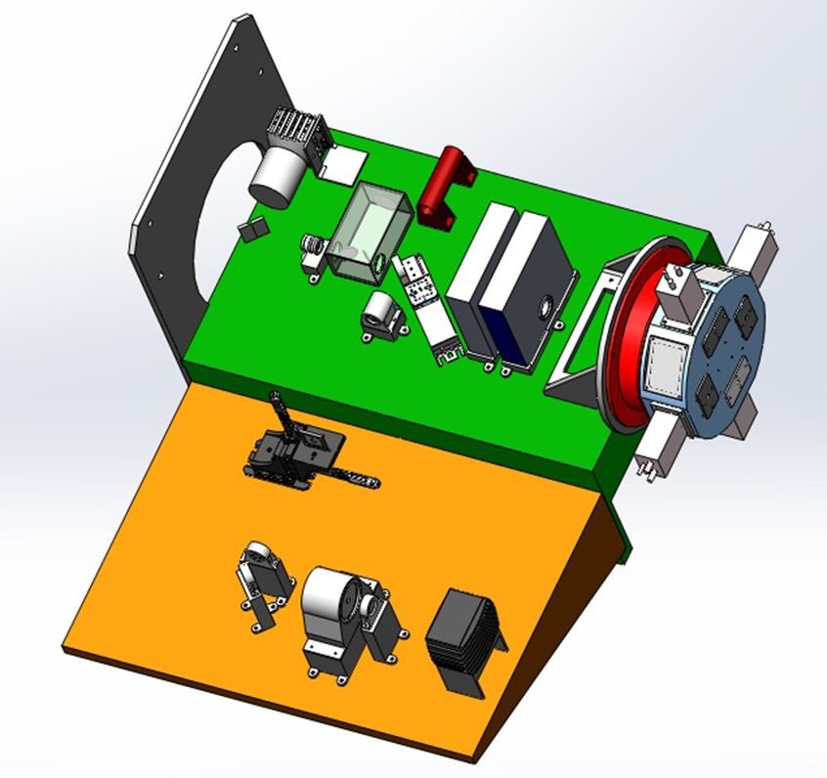
The overall design of Aqueye+
Telescope Cassegrain interface
AdOpt module
Filter wheels
Fifth SPAD for sky control
Pyramid, SPADs and individual filters
Coronagraphic module

Slide 39
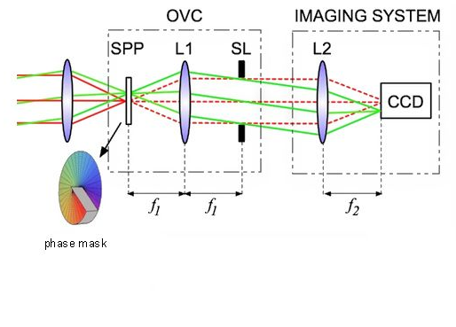
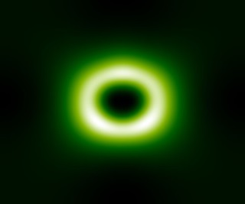
The OAM/OV Coronagraph
On the focal plane, the image of the bright primary star is strongly attenuated while the secondary passes almost unaltered.
Spiral phase plate
with topological
charge l =2.
Fourier stop: removes light scattered from pupil
Lyot stop
After the SPP, the ring of light is removed by the Lyot stop.

Slide 40
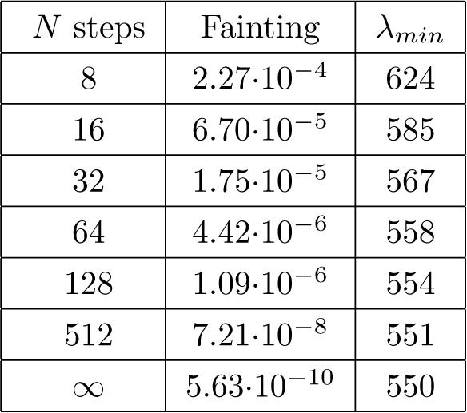
Coronagraphic theoretical performances

Slide 41
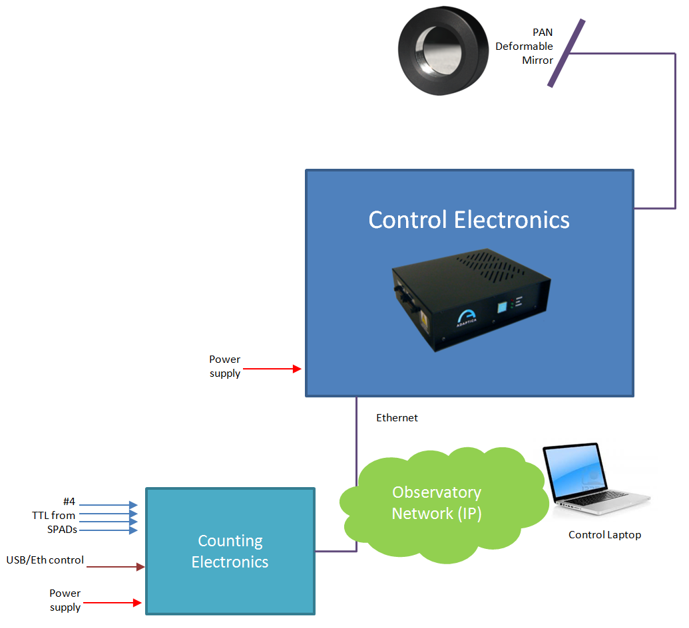
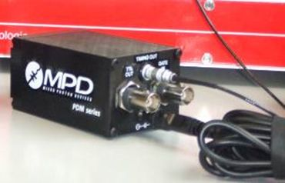
The AdOpt module

Slide 42
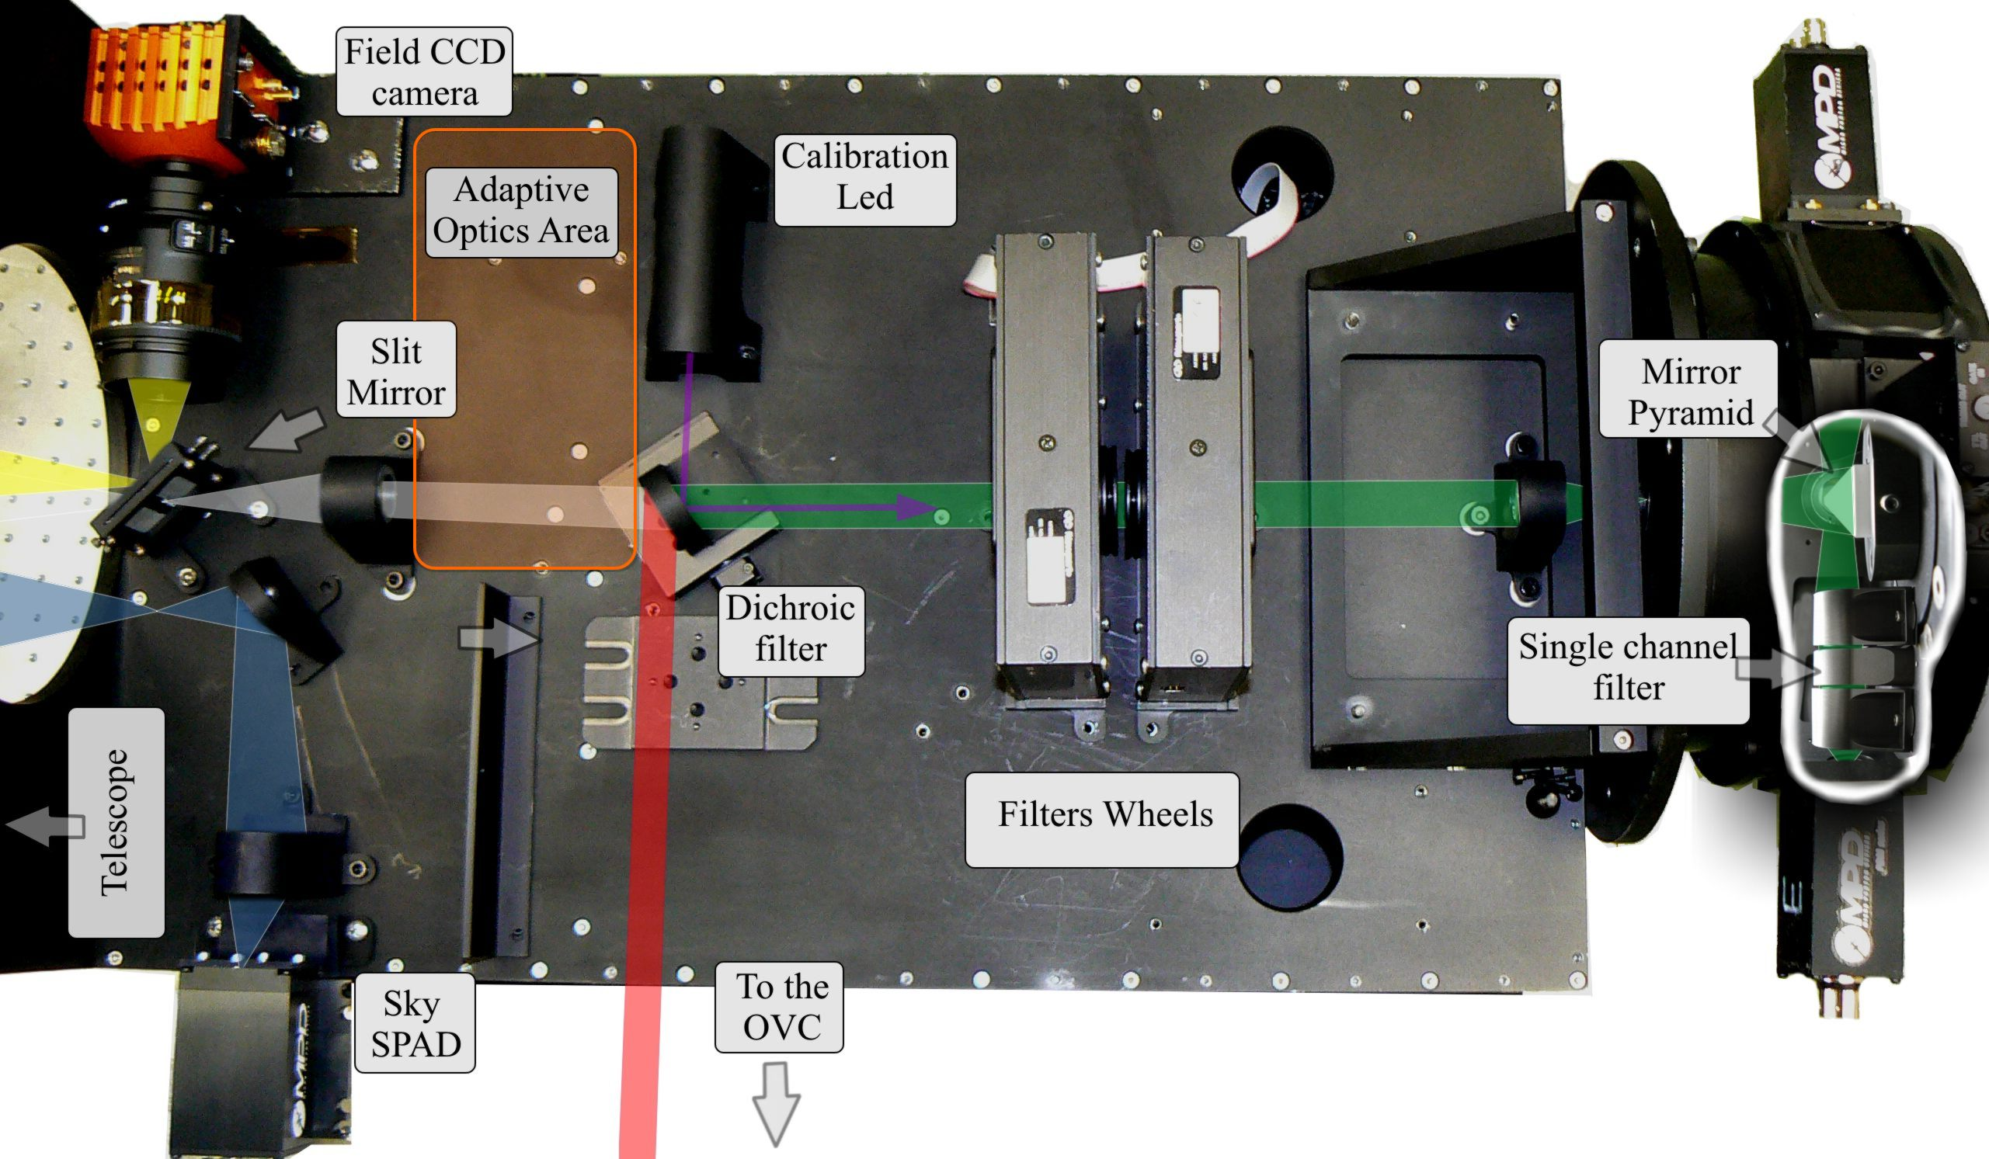
The real instrument

Slide 43
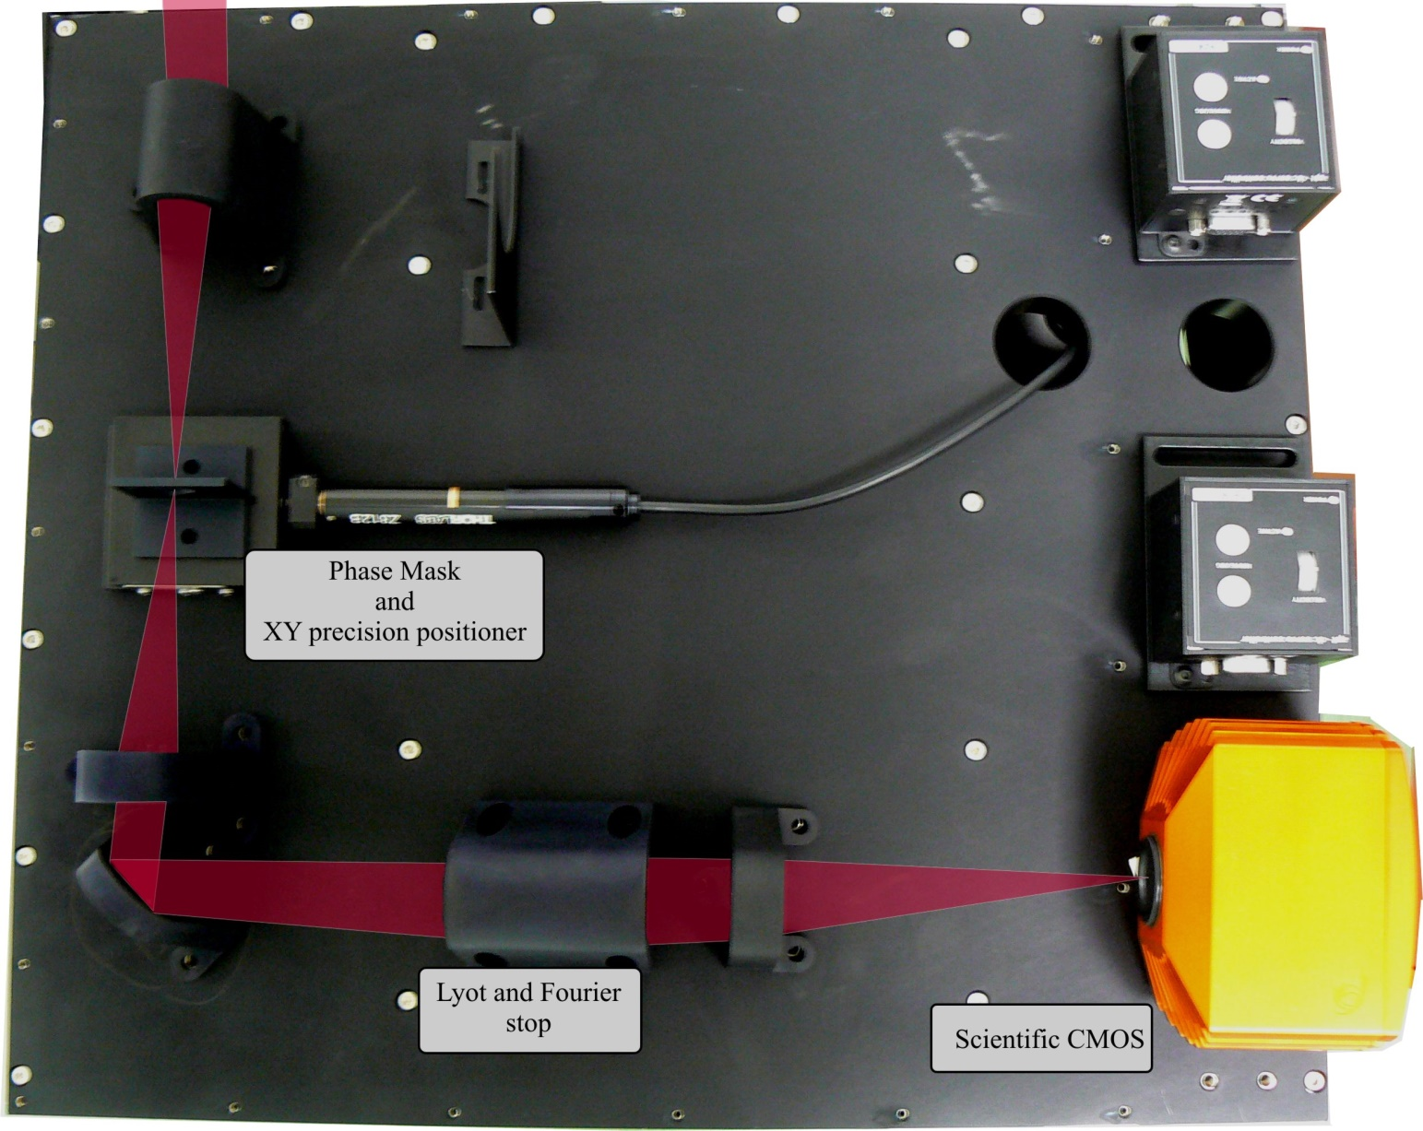
The coronagraphic module

Slide 44
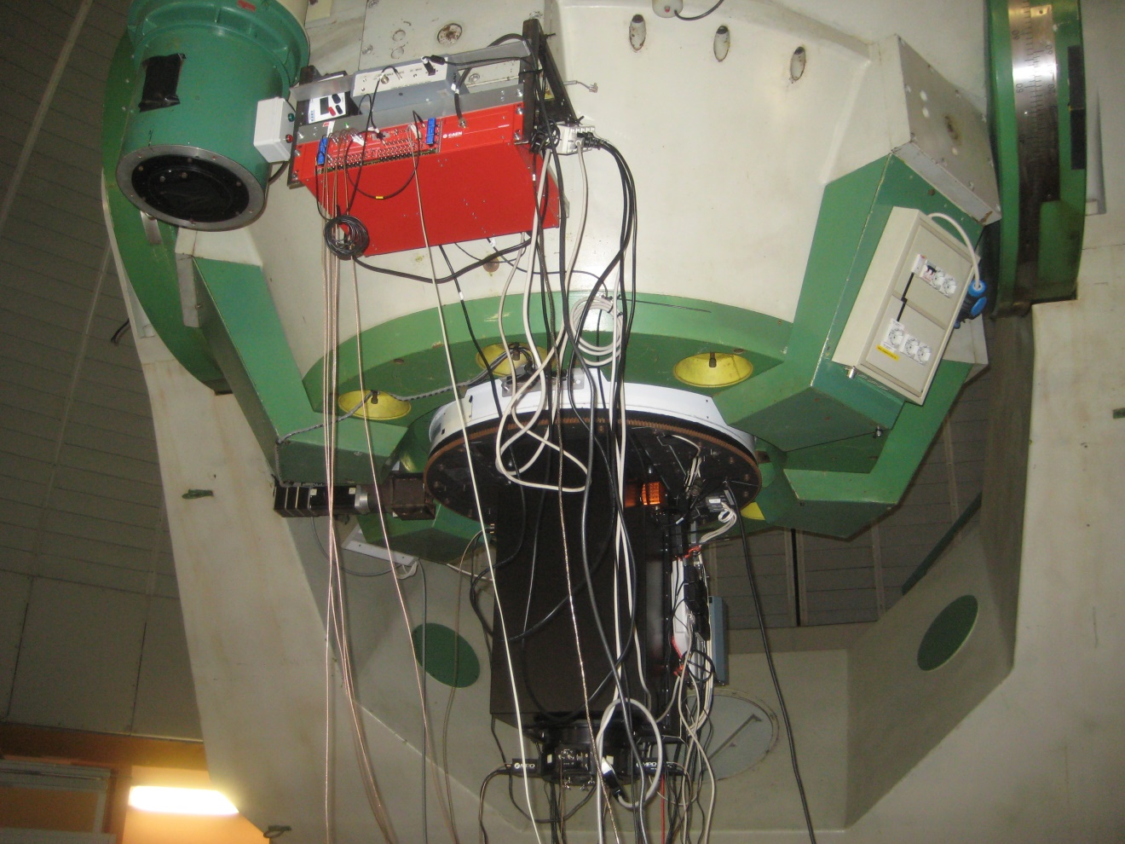
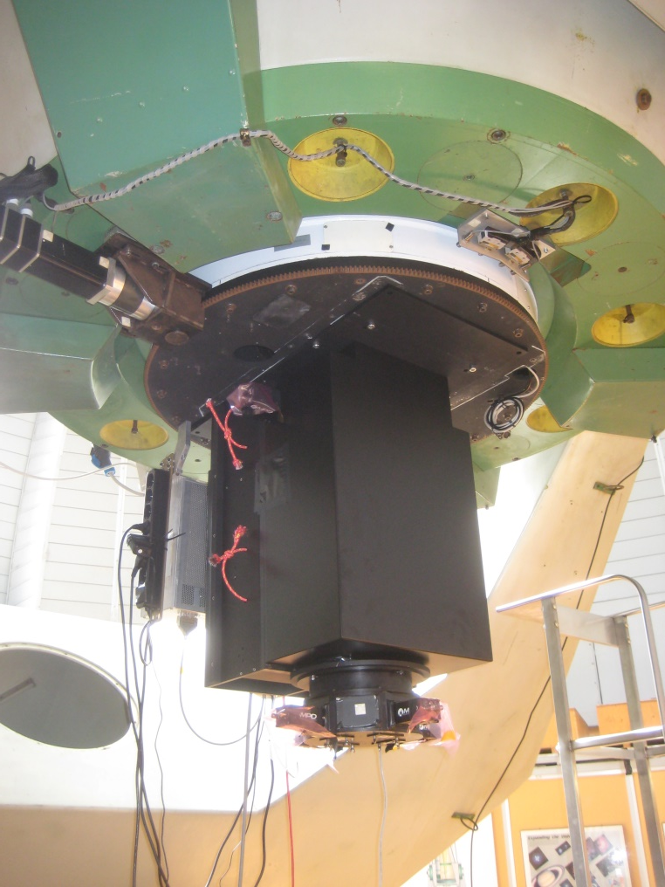
First tests at the telescope
May 8, 2014

Slide 45
Aqueye+ at the Nasmyth focus
Prompted by the occurrence of the X- and Gamma- flare in March 2013, when Aqueye was the only optical instrument observing the Crab pulsar, we’ll make Aqueye+ a permanent addition to the Copernicus telescope, by mounting it on the Nasmyth focus.
Design is under way, with the hope to complete the interface by the end of 2014.

