Slide 1

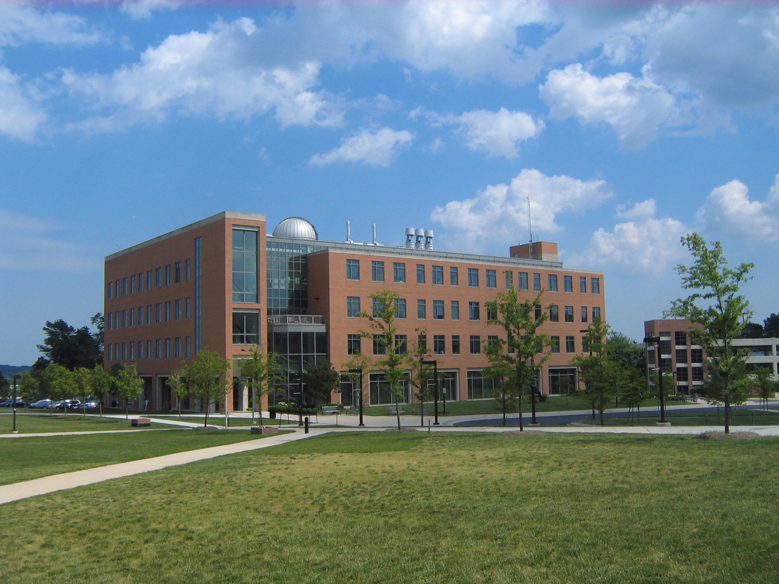


Understanding powerful jets at different scales in the Fermi era.
Markos Georganopoulos^{1,2}
Eileen Meyer³
Rodrigo Nemmen⁴
Amanda Dotson¹
¹ University of Maryland Baltimore County
² NASA Goddard Space Flight Center
³Space Telescope Institute
⁴University of Sau Paulo, Brazil

Slide 2
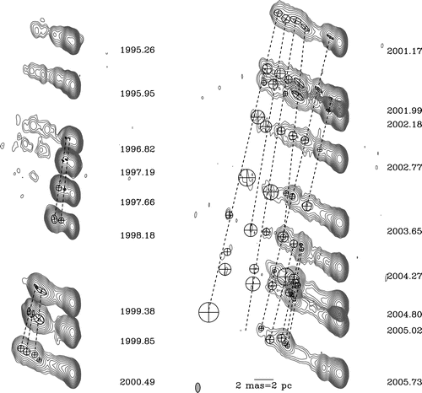
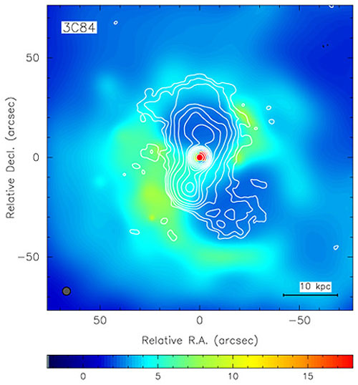
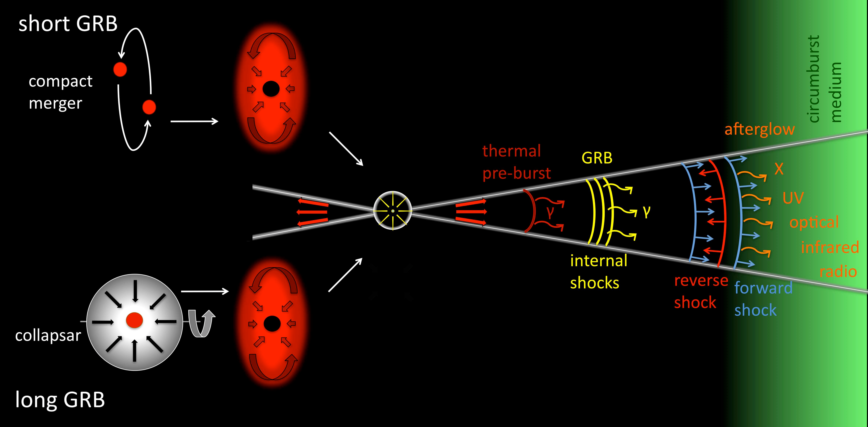
SOME BASICS
Kadler et al. 2008
3C 111 Hogan 2011
Fabian et al. 2003
Gomboc 2012

Slide 3
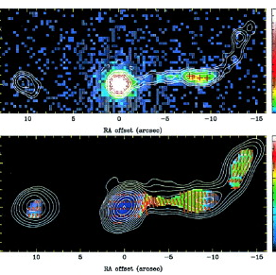
SOME BASICS
Celotti et al. 2001
projected length~100 Kpc
Chartas et al. 2000
Schwartz et al. 2000
The core (blazar) dominates over the large scale jet.

Slide 4
The same fraction of jet power is radiated for both blazars and grbs
Nemmen et al. 2012, Science, 338, 1445
L~L_{iso}/Γ²

Slide 5

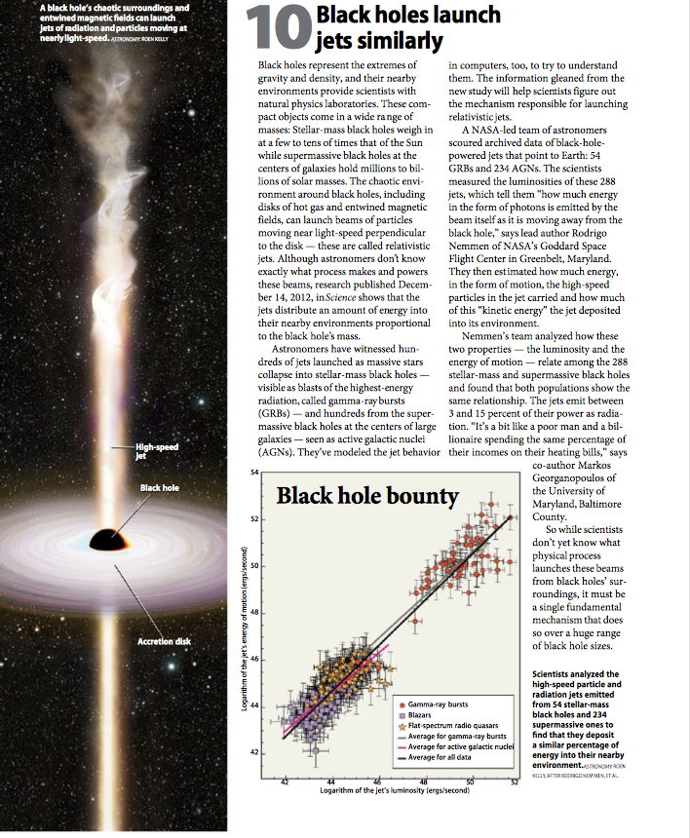
Astronomy Magazine, January 2014

Slide 6
Where is The location of the GeV power dissipation?
BLR
MT

Slide 7
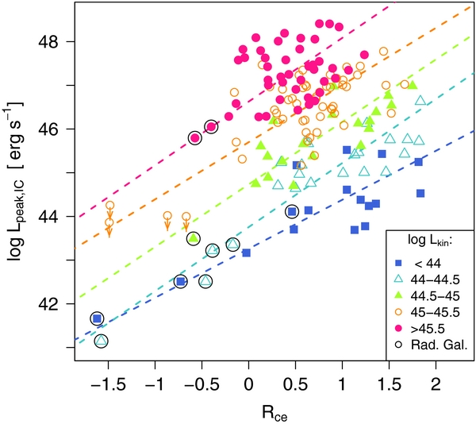
The location of the GeV power dissipation: powerful blazars: gev comes form ec.
Meyer et al. 2012 ApJ 752 L4

Slide 8
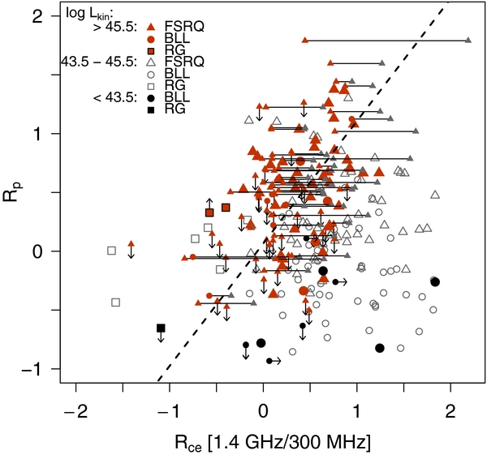
The location of the GeV power dissipation: powerful blazars: gev comes form ec.
Meyer et al. 2012 ApJ 752 L4

Slide 9
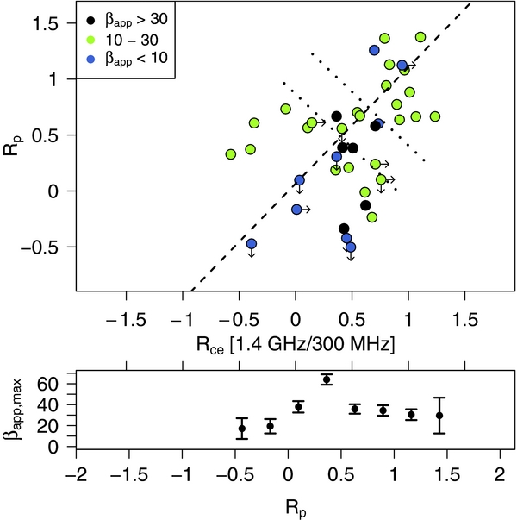
The location of the GeV power dissipation: powerful blazars: gev comes form ec.
Meyer et al. 2012 ApJ 752 L4

Slide 10
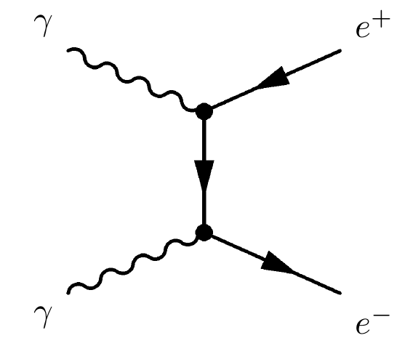
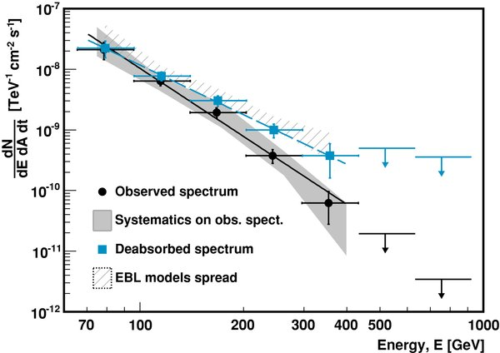
The location of the GeV power dissipation:
The pair production argument: not in the blr
PKS 1221-21
BLR
γ-ray propagation through the BLR UV photons:
Optical depths τ~2-10 are expected, but absorption features are not seen in the multi-GeV SED [3C 279 (Albert et al. 2008), PKS 1222_21 (Aleksic et al. 2011), 1239+0443 (Pacciani et al. 2012), PKS 1510-089 (Abramowski 2013), PKS B1424-418 (Tavecchio et al. 2013)]
MT
The γ-rays cannot be produced within the BLR.

Slide 11
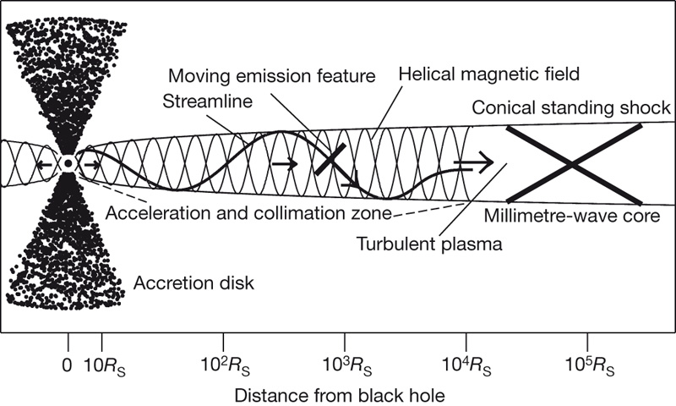
The location of the GeV power dissipation
PKS 1510-089, Marscher 2013
Marscher 2008
0.1 pc 1pc 10 pc

Slide 12
The location of the GeV power dissipation
The energy dependent fermi variability method
BLR
Dotson et al. 2012, ApJ, 758, L15:
Electron cooling on the UV BLR photons is at the onset of the Klein-Nishina regime => energy independent.
Electron cooling on the IR MT photons is in the Thomson regime
=> energy dependent.
MT

Slide 13
The location of the GeV power dissipation:
The energy dependent fermi variability method
Dotson et al., in prep.
T_{f,HE}=2.54+0.89-1.30 h
T_{f,HE}=7.1+1.4-1.9 h
T_{f,HE}=30.3+4.4-6.2 h
T_{f,LE}=92.0+10.0-12.7 h
PKS 1510-089: Slower decay time in low energies (E<500 MeV),
Flare takes place inside the MT with a radius of a few pc (TBD).

Slide 14
LARGE SCALE JETs:
FAST and super-eddington oR
Slow but extreme particle accelerators?

Slide 15
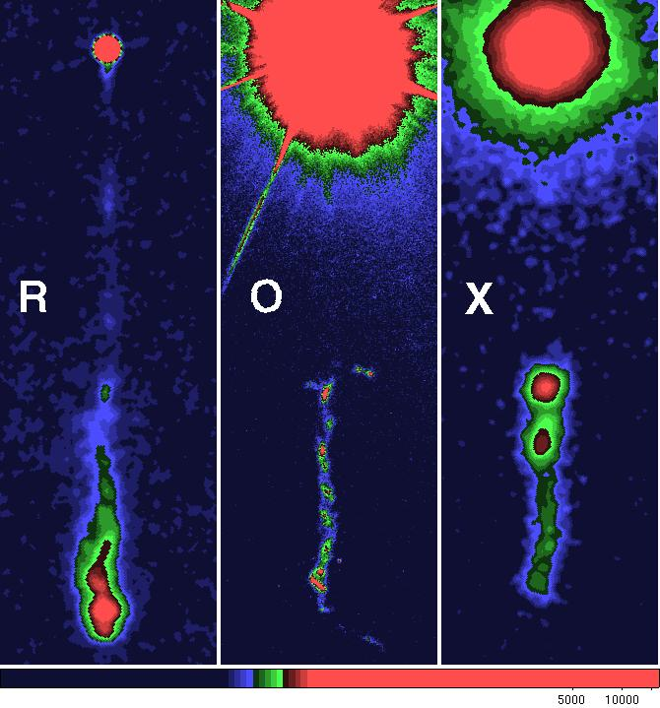
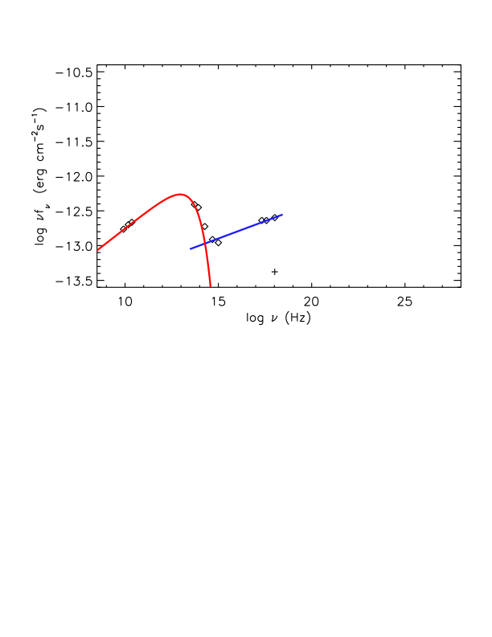
THE JET OF THE ARCHETYPICAL QUASAR 3C 273
Marshall et al. 2005
Jet length:
~60 Kpc projected

Slide 16
THE JET OF THE ARCHETYPICAL QUASAR 3C 273
X-rays: SSC or External Compton scattering off the CMB (EC/CMB)?
In equipartition and no beaming they underproduce the X-rays severely.
Jet length:
~60 Kpc projected

Slide 17
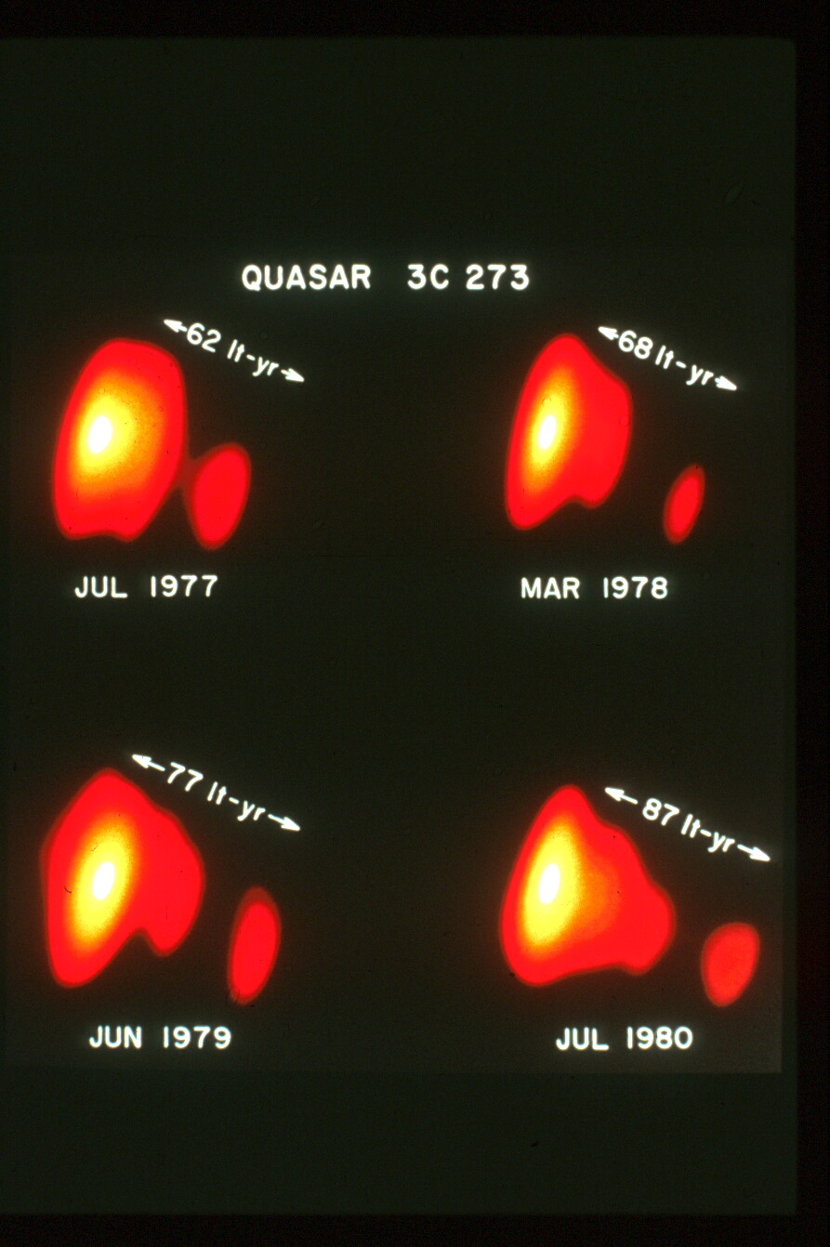
If the Kpc scale jet retains the pc-scale relativistic speeds, the X-ray emission
can be interpreted as EC/CMB
(Tavecchio et al 2000, Celotti et al. 2001).
Jet length:
~60 Kpc projected

Slide 18
the ec/CMB X-ray Interpretation.
•Extends the electron energy distribution (EED) down to ~1 MeV
•Requires relativistic large scale jets (Γ~10-20)
•Requires (super) Eddington jet power and Mpc-length jets
(Dermer & Atoyan 2002, 2004)
Log n(γ)
Log γ

Slide 19
Q: What γ-ray emission is predicted by the EC/CMB model?
A: The γ-ray SED depends on a single parameter (B/δ)
or just δin equipartition.
Β/δ (δ in equipartition) is fixed by the requirement to fit the radio-optical and X-ray SED.
The γ-ray SED is predicted with no freedom.
Test of the EC/CMB model:
The level of the Fermi emission
3C 273, Georganopoulos et al. 2006
∝δ⁴
∝δ²

Slide 20
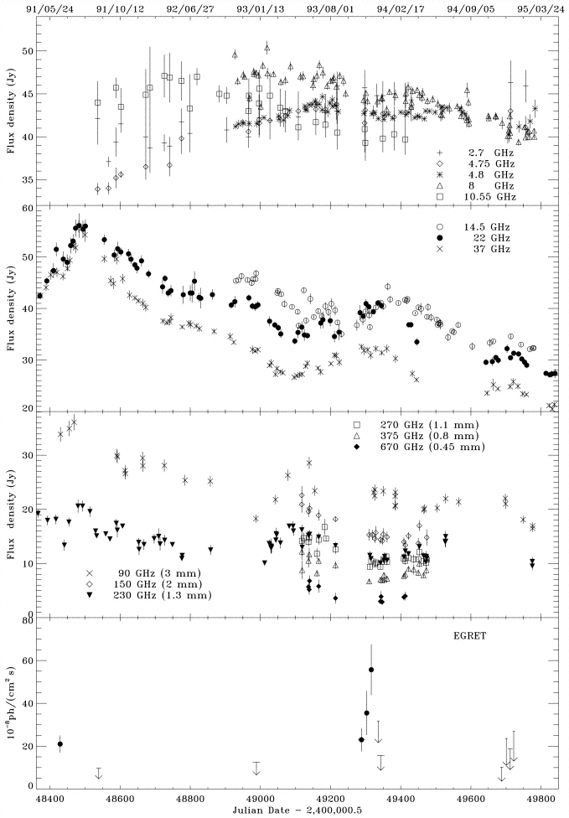
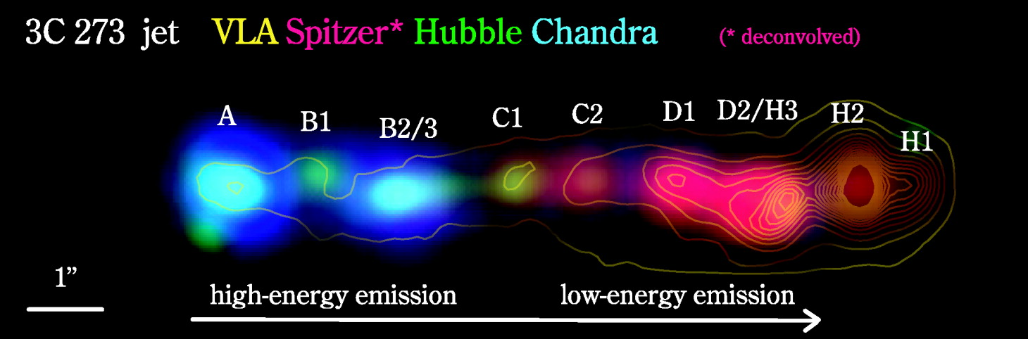
Predictions of the EC/CMB mechanism for the Γ-rays
3C 273
The γ-ray observed emission is the sum of the variable blazar component and the steady large scale jet emission.
3C 273 was below the EGRET sensitivity limit for
more than half of the times it was observed.
The lowest GeV flux limit is an upper limit for
the large scale jet flux.
Uchiyama et al. 2006
Von Montigny et al 1997

Slide 21
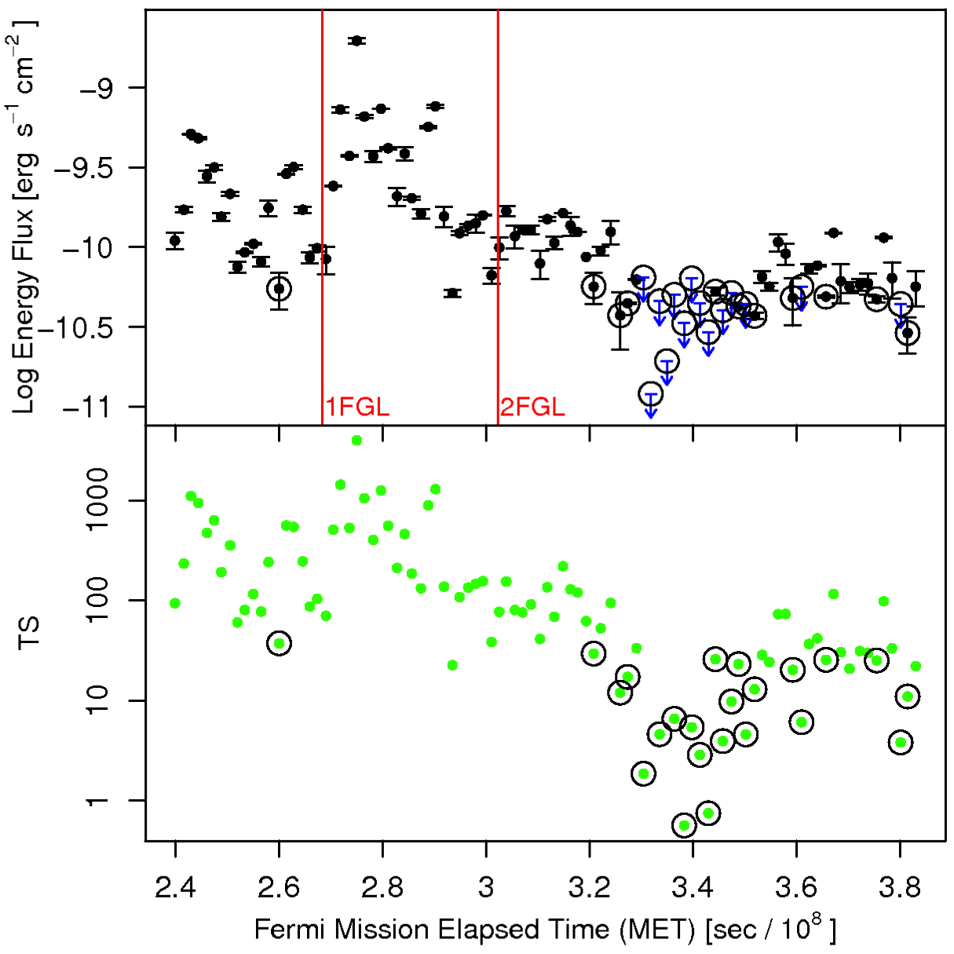
Waiting 3 years for a low blazar state
Meyer & Georganopoulos
2014 ApJ 780, L27
Fermi flux
=
variable blazar flux
+
steady kpc-scale jet flux
Obtaining an upper limit
for the large scale jet
γ-ray emission:
Stich together ~2-week
GTI intervals of low flux
and flux upper limits.

Slide 22
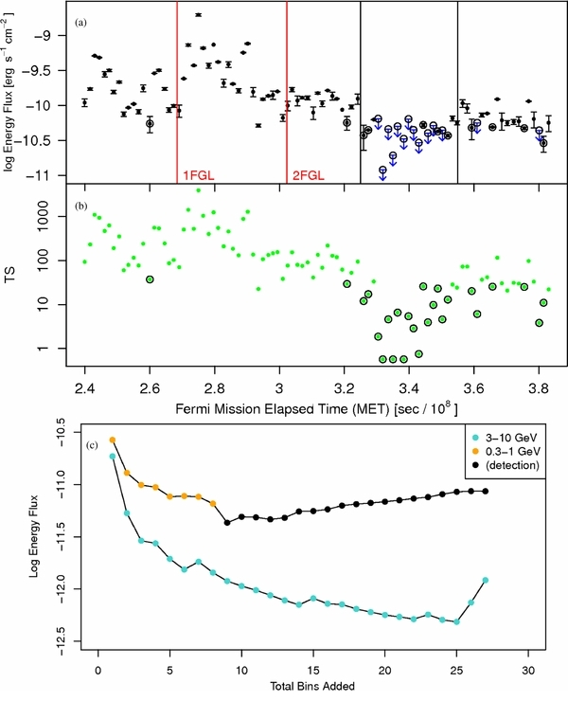
Waiting 3 years for a low blazar state
3-10 GeV: extremely low background
Upper limits scale at t⁻¹, not t^{-1/2}
Meyer &
Georganopoulos 2014

Slide 23
Fermi rules out the ec/cmb model for 3c 273
Meyer & Georganopoulos 2014
Knot A
To satisfy the 3-10 GeV flux upper limit requires δ<9.

Slide 24
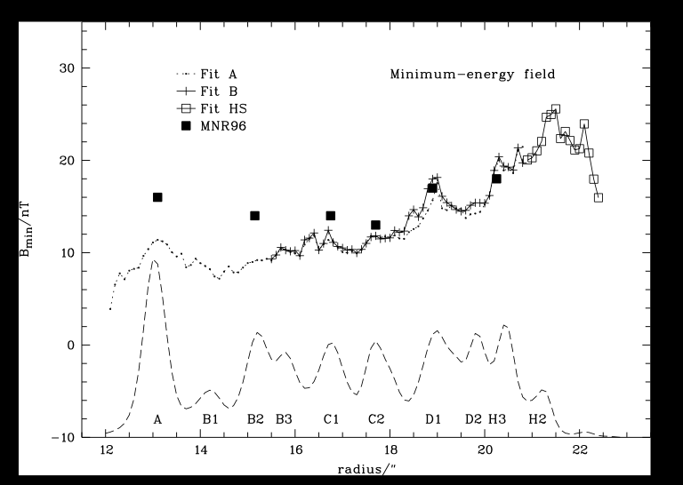
Fermi rules out the ec/cmb mechanism for 3c 273
Can we constrain δ more? Sum up the flux of many knots
The radio polarization direction up to knot D1 is parallel to the jet, then abruptly turns by 90º, possibly by strong deceleration at a shock.
The equipartition magnetic field varies by less than a factor of 2 along the A to D1 knots
Assumption:
A single δ and B characterize all the knots from A to D1.
Conway et al. 1993
Jester al. 2005

Slide 25
Fermi rules out the ec/cmb mechanism for 3c 273
SED of the sum of knots A to D1:
To satisfy the Fermi upper limit we require
δ_{eq}<5.0

Slide 26
What CAN the X-ray Emission mechanism BE?
•Synchrotron (e.g. Harris et al. 2004, Hardcastle 2006)
•In situ electron acceleration et least up to 100 TeV energies
•No need for highly relativistic large scale jet, easily sub-Eddington
Log n(γ)
Log γ

Slide 27
What CAN the X-ray Emission mechanism BE?
• What physical situation produces this double power law?
• Are the two electron populations strictly co-spatial?
•How large is the X-ray emission site?
Log n(γ)
Log γ

Slide 28
The large scale jet: not as wimpy as you think

Slide 29
The large scale jet: not as wimpy as you think
L~L_{iso}/Γ²
• The beaming-corrected large scale jet has a radio to optical output comparable to that of the blazar.
• The beaming-corrected GeV-TeV large scale jet output can also be
comparable to that of the blazar (implications for GeV background).

Slide 30
Conclusions:
Blazars and GRBs ‘burn’
similar (~10-30%) fractions
of their jet power

Slide 31
Conclusions:
Energy dependent cooling ➔
Flares in the molecular torus

Slide 32
Conclusions:
Large scale jets:
•Synchrotron X-rays
•100 TeV particle accelerators,
•Not as fast as the blazars (Γ~few)
•Comparable radiative output
to the blazar component
Log n(γ)
3C 273
Log n(γ)
IC/CMB
Second EED component
Log γ
Log γ

