Slide 1

Modeling polarization from relativistic outflows
Tania Garrigoux
NWU, Potchefstroom
With M. Boettcher, B. Singh, Z. Wadiasingh, and M. Zacharias

Slide 2
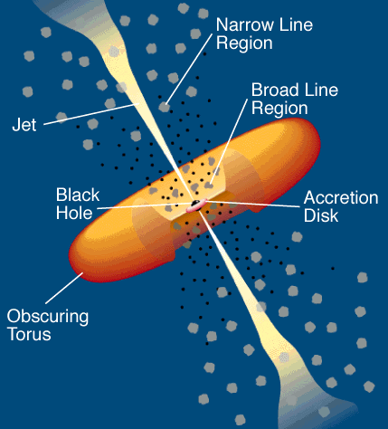
Leptonic Blazar Model
0
Relativistic jet outflow with Γ ≈ 10
Observing direction
Injection, acceleration of ultrarelativistic electrons
Isotropic radiation field
Radiative cooling ↔ escape

Slide 3
Polarization in the IC scenario
Outline
Calculating the Stokes parameters and degree of polarization
- Obtaining F0 and F3 using the differential cross-section
Application on a specific case
- Choosing an electron and photon distribution
- Polarization degree as a function of
ε_{f}

Slide 4
Polarization in the IC scenario
We define Stokes parameters normalized by I, the total energy density of the photon (Chang et al, 2013)
The degree of polarization Π is then defined by:
also

Slide 5
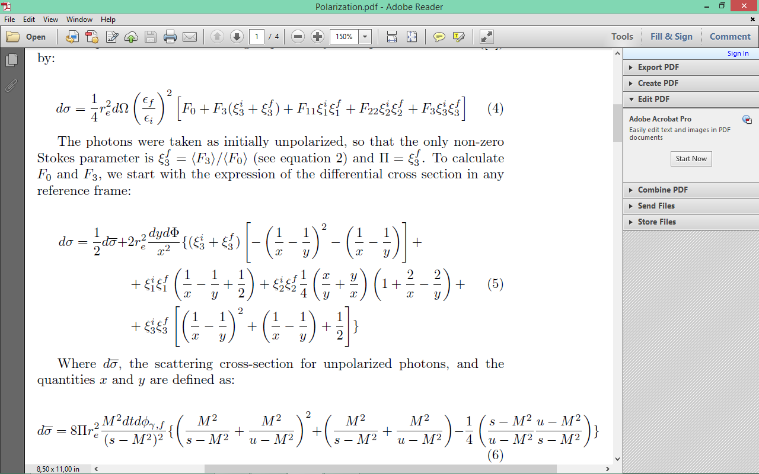
Polarization in the IC scenario
Coefficients F_{a} in the differential cross section for the scattering of a photon by an unpolarized electron:
Ratio of coefficients of over independent terms:
In the case of initially unpolarized photons:
and

Slide 6
Polarization in the IC scenario
Calculating F0 and F3:

Slide 7

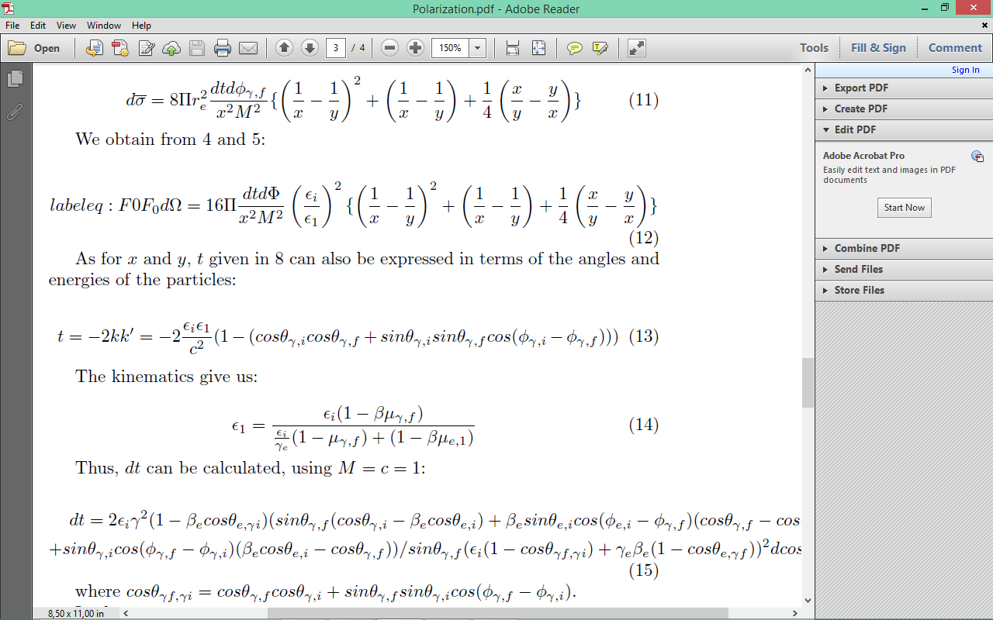
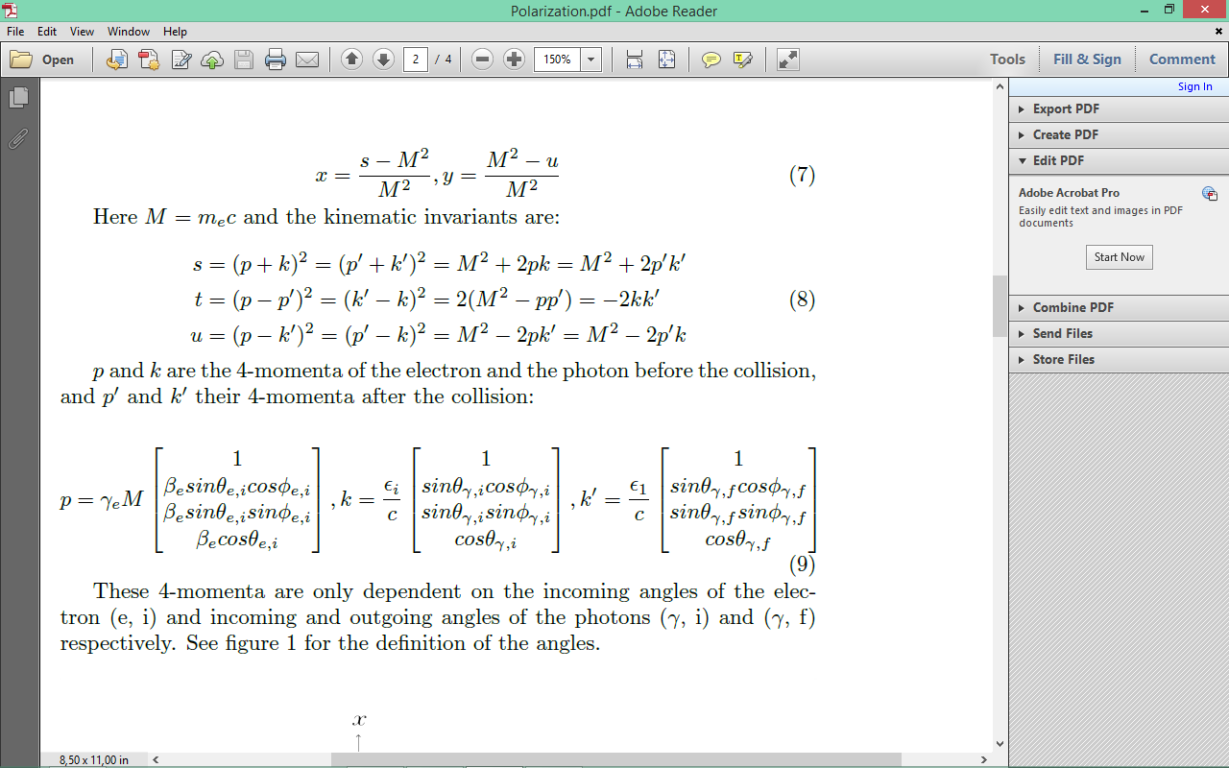
Polarization in the IC scenario
Calculating F0
=
We have:
Hence:
where M = mec, and .

Slide 8
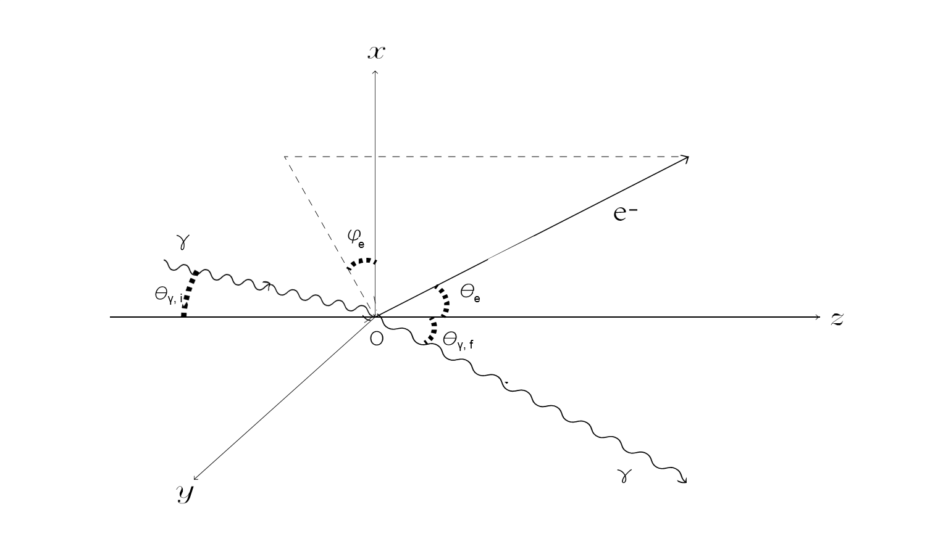
Polarization in the IC scenario
Calculating F0
In the co-moving frame

Slide 9
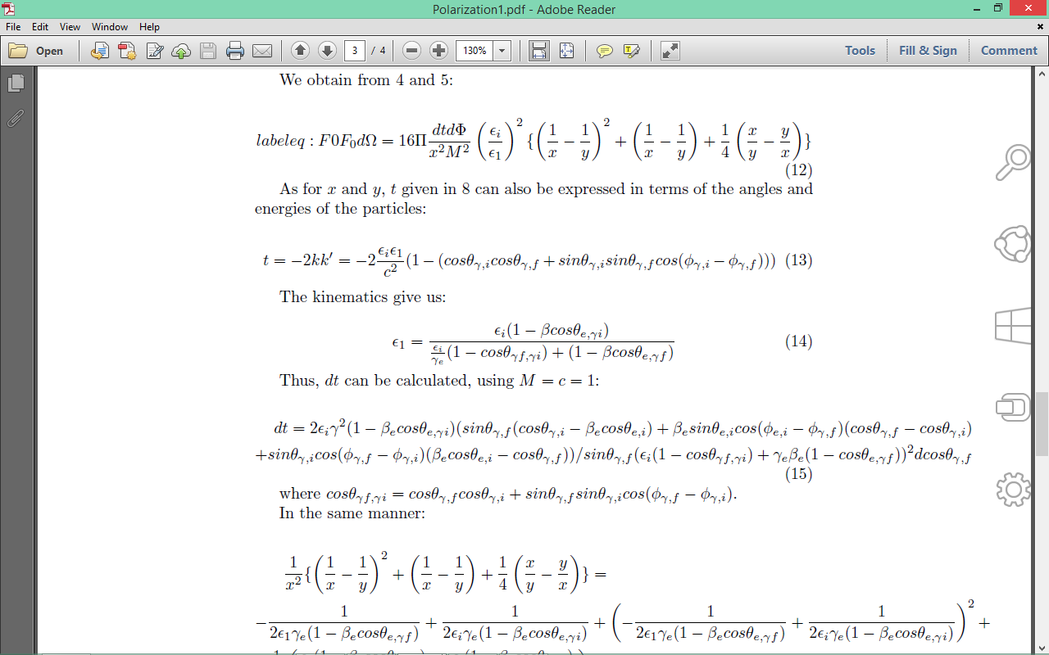
Polarization in the IC scenario
Calculating F0
p and k : 4-momenta of the e⁻ and the photon before collision
p’ and k’ : 4-momenta after the collision
Kinematic invariants:
with

Slide 10
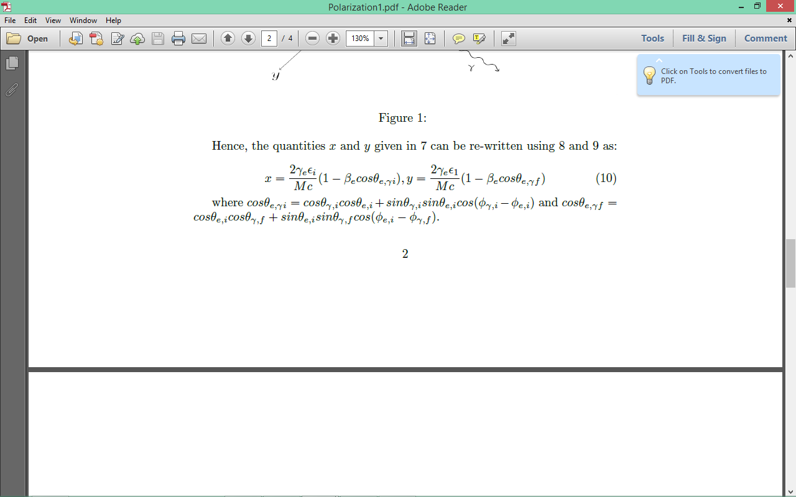
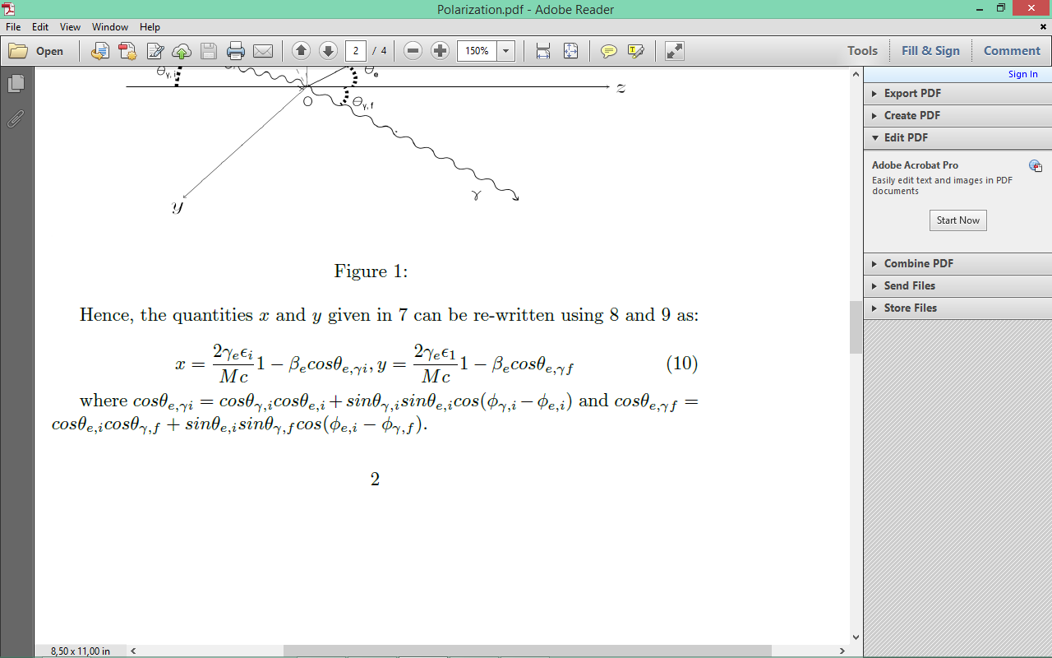
Polarization in the IC scenario
Calculating F0
Kinematic invariants:
with

Slide 11
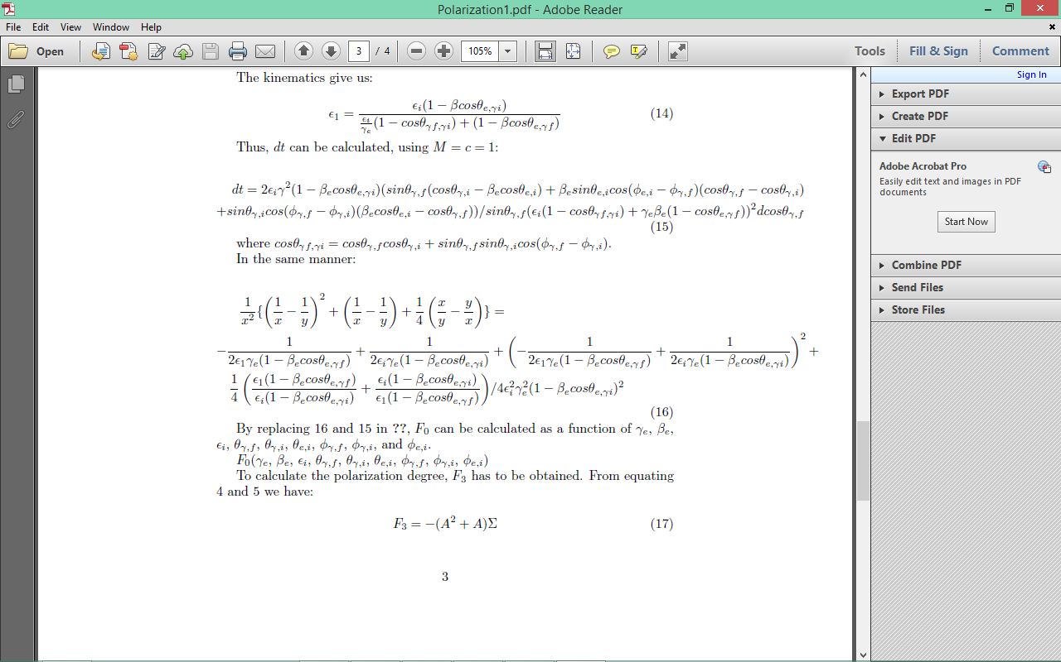
Polarization in the IC scenario
Calculating F0
Kinematic invariants:
In addition:
So now we have:

Slide 12
Polarization in the IC scenario
Calculating F0 and F3:

Slide 13
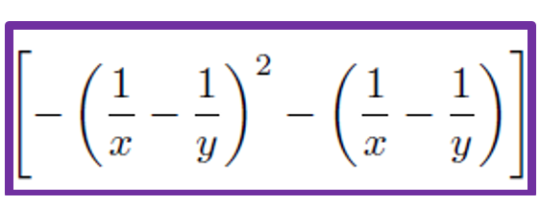
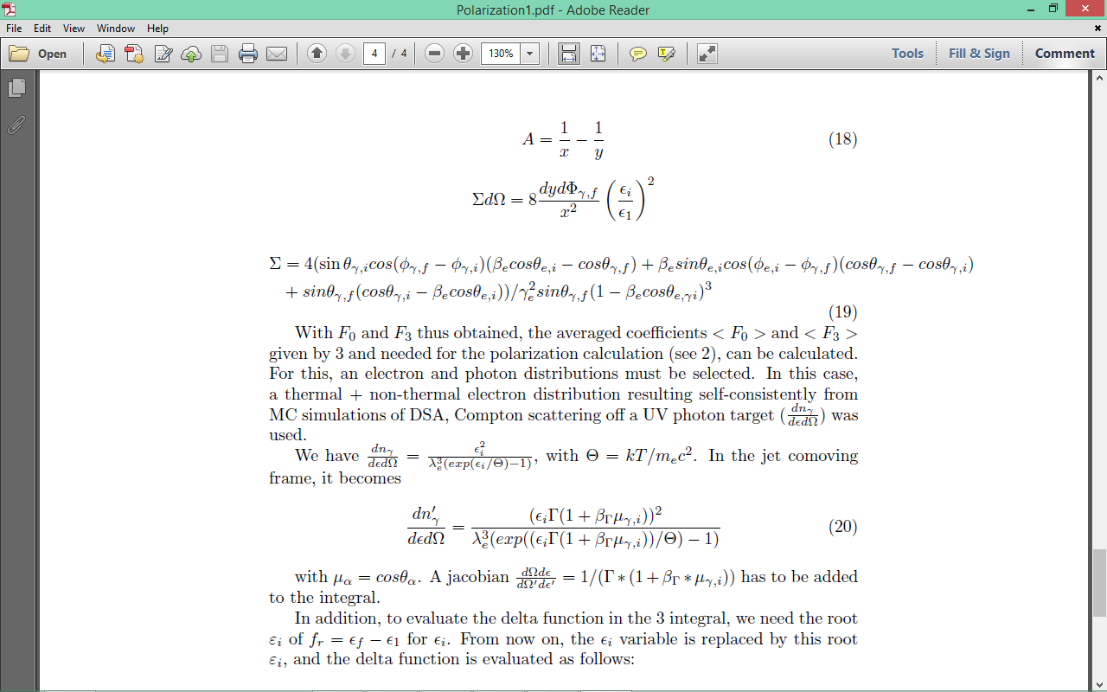
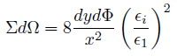
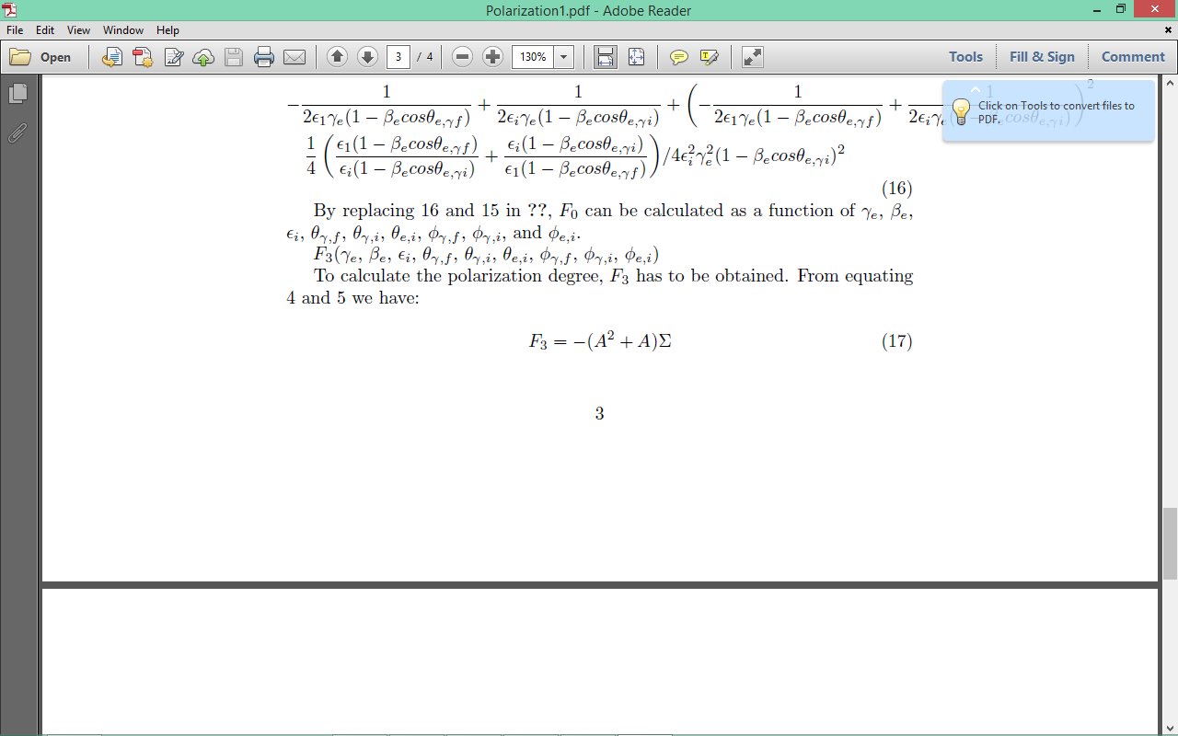
Polarization in the IC scenario
Calculating F3
=
with
and
As previously:
So now we have:

Slide 14
Polarization in the IC-UV scenario
The photon distribution
We chose initially unpolarized photons:
,
We have F3 and F0, but need the “average”:
We take a UV thermal photon distribution:
with
in the comoving frame :
and the jacobian is needed.

Slide 15
Polarization in the IC-UV scenario
The electron distribution
Modeling of AO 0235+164
Thermal + non thermal electron distribution results self-consistently from MC simulations of DSA
External Compton scattering of thermal distribution
Importance of Bulk Compton process
(Baring et al., 2016)
Notes:
Calculate X-ray polarization signature from this scenario
Physical handle of importance of bulk compton process

Slide 16
Polarization in the IC-UV scenario
The delta function
To evaluate , we need the root of for
As previously:
Then, the variable is replace by this root , and the delta function is evaluated:

Slide 17
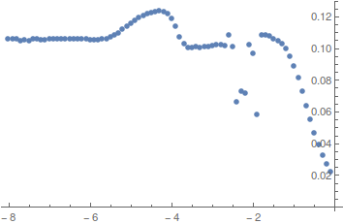
Polarization in the IC-UV scenario
Initially unpolarized UV photons: Π = ξ₃^{f} and ξ₃^{f} = <F₃>/<F₀>
Π
Thermal + non-thermal electron distribution
Bulk Lorentz factor Γ = 5
Observation angles:
= π/2 , = 0
Polarization signatures can characterize the model being developed
Log₁₀[ε_{f} (m_{e}c²)]

Slide 18
Summary
0
A model is being developed to study x-ray polarization in the IC-UV scenario, including the Bulk Compton process.
Next steps:
- study of the influence of different parameters (bulk factor, temperature of electron distribution)
- study of the evolution as a function of the viewing angles and

Slide 19

Thank you!

