Slide 1
Polarised structures in the restarted radio galaxy B2 0258+35 Magnetic field compression or magnetic draping
Netherlands Institute for Radio Astronomy
Björn Adebahr
Marisa Brienza
Raffaella Morganti
ASTRON is part of the Netherlands Organisation for Scientific Research (NWO)

Slide 2
Introduction
How long and how frequently are radio-loud AGN active?
Duty cycle depends on the power of the radio source
Young radio galaxies (GPS-, CSS-, HFP-sources) are the best candidates for an investigation
25% of GPS sources show associated diffuse emission on the kpc- to Mpc-scale, which is possibly a remnant of a previous episode of jet activity
Best et al. 2005
Stanghellini et al. 1990, Stanghellini et al. 2005
Strategy:
Find a young radio galaxy embedded in diffuse emission
Investigate the morphology/spectral index of the diffuse emission and the compact source to get a handle on the duty cycle of the source

Slide 3
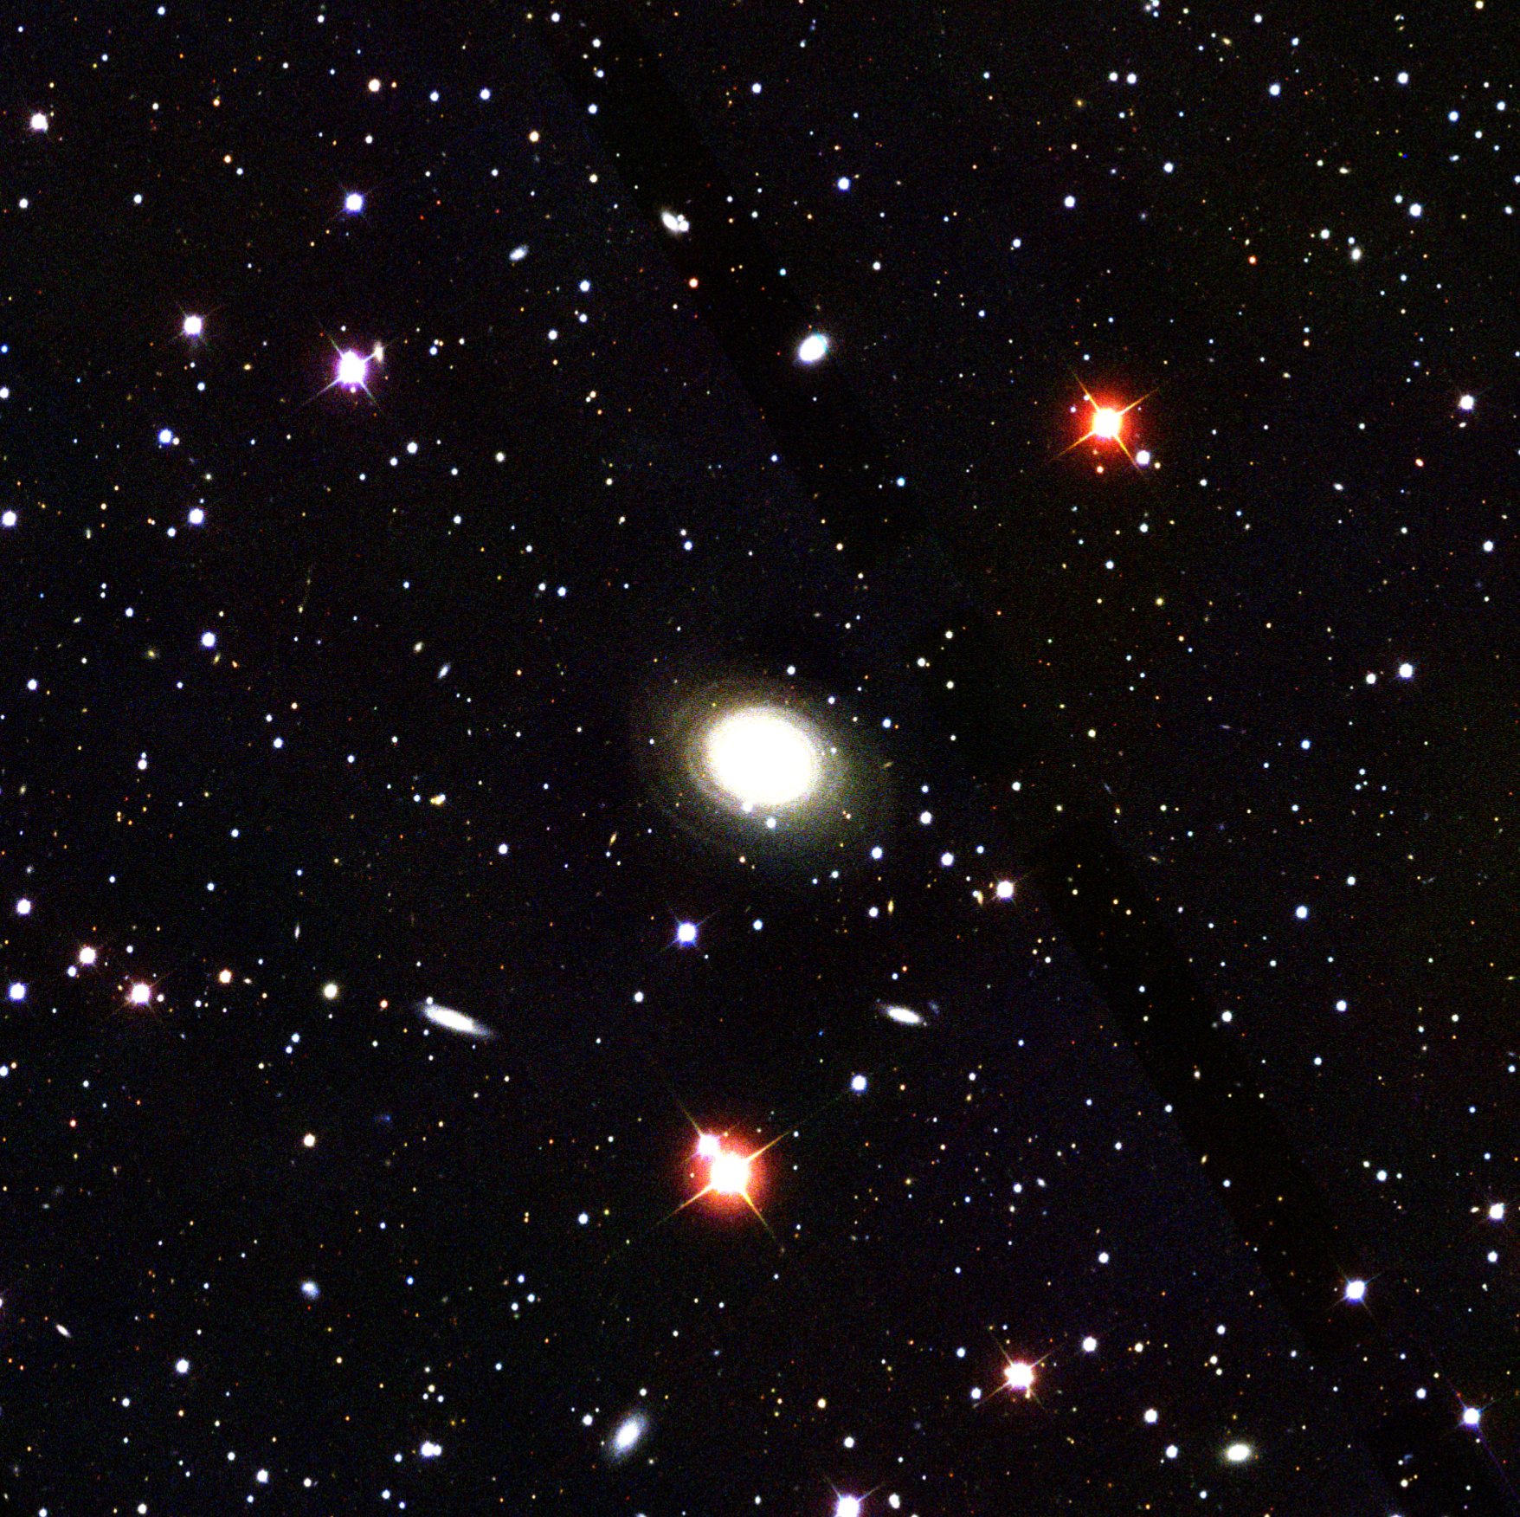
NGC 1167 B2 0258+35 SDSS
5’ / 100 kpc

Slide 4
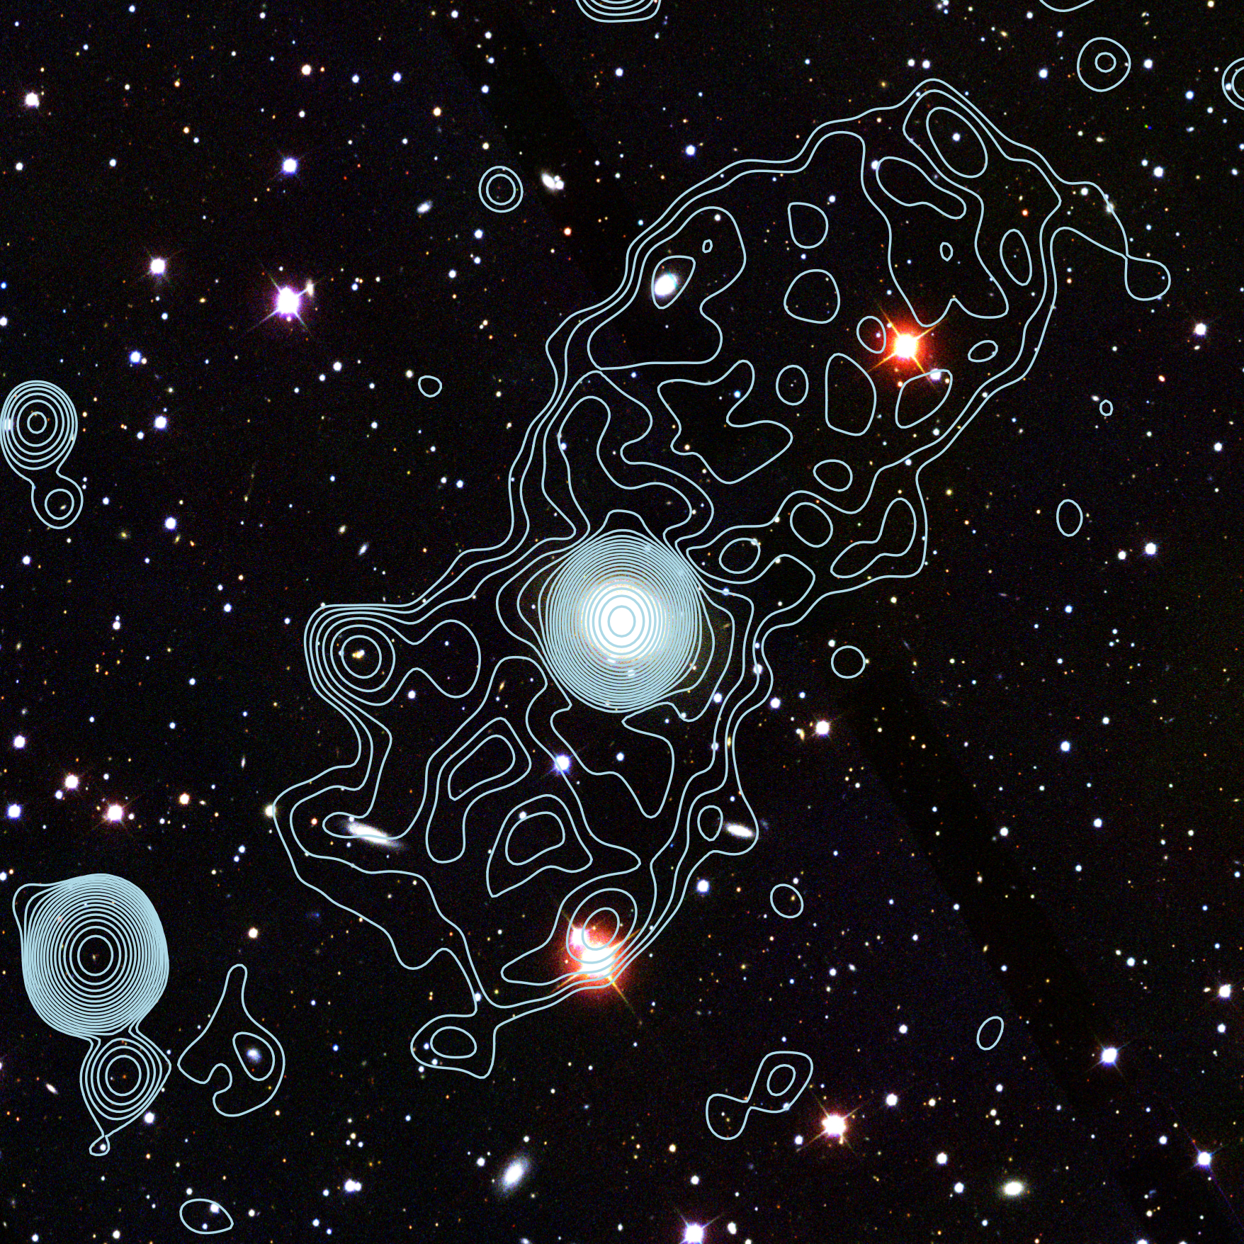
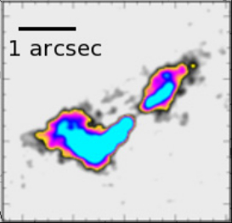
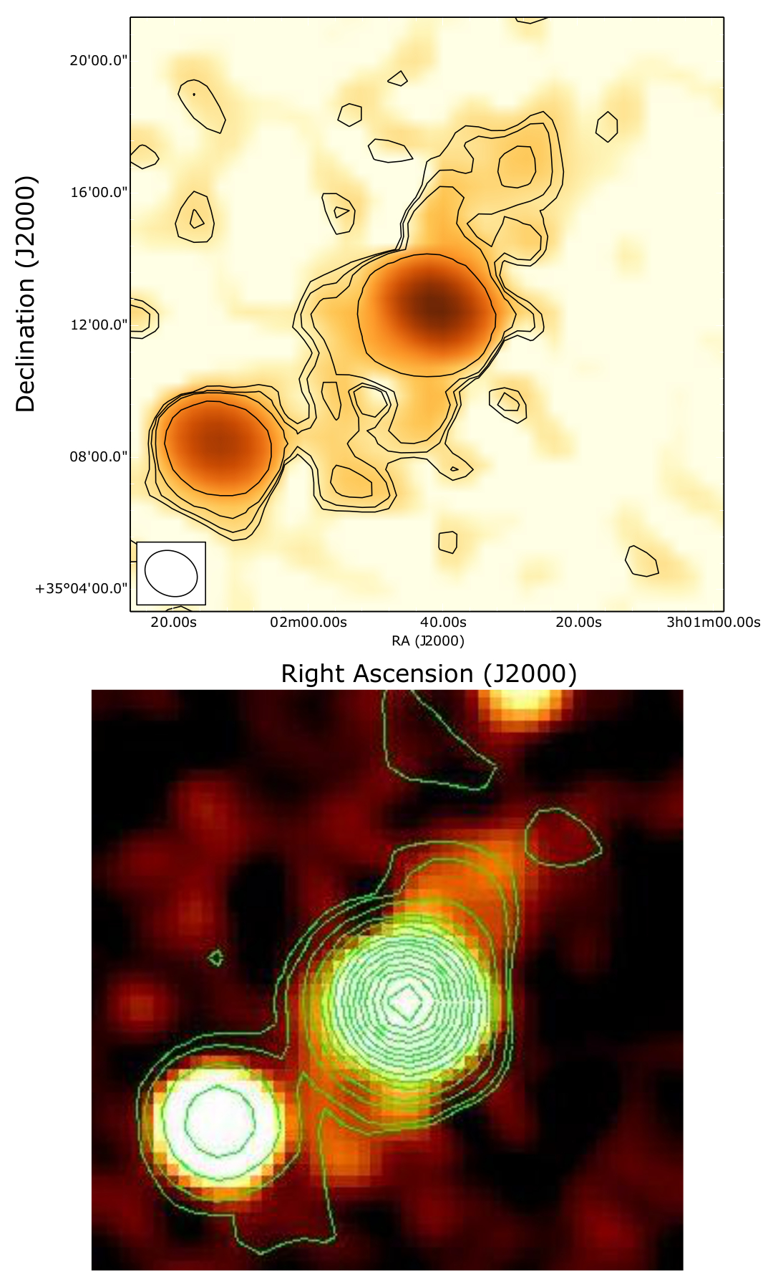
NGC 1167 B2 0258+35 SDSS + λ22cm radio continuum
𝝰(150-6600)≈-0.5
Giroletti et al. 2005
LOFAR 150MHz
No ultra-steep spectral index up to high frequencies
(last particle acceleration <45Myrs)
SRT 6600 MHz
5’ / 100 kpc
𝝺22cm radio continuum from Shulevski et al. 2012
Brienza et al. in prep.

Slide 5
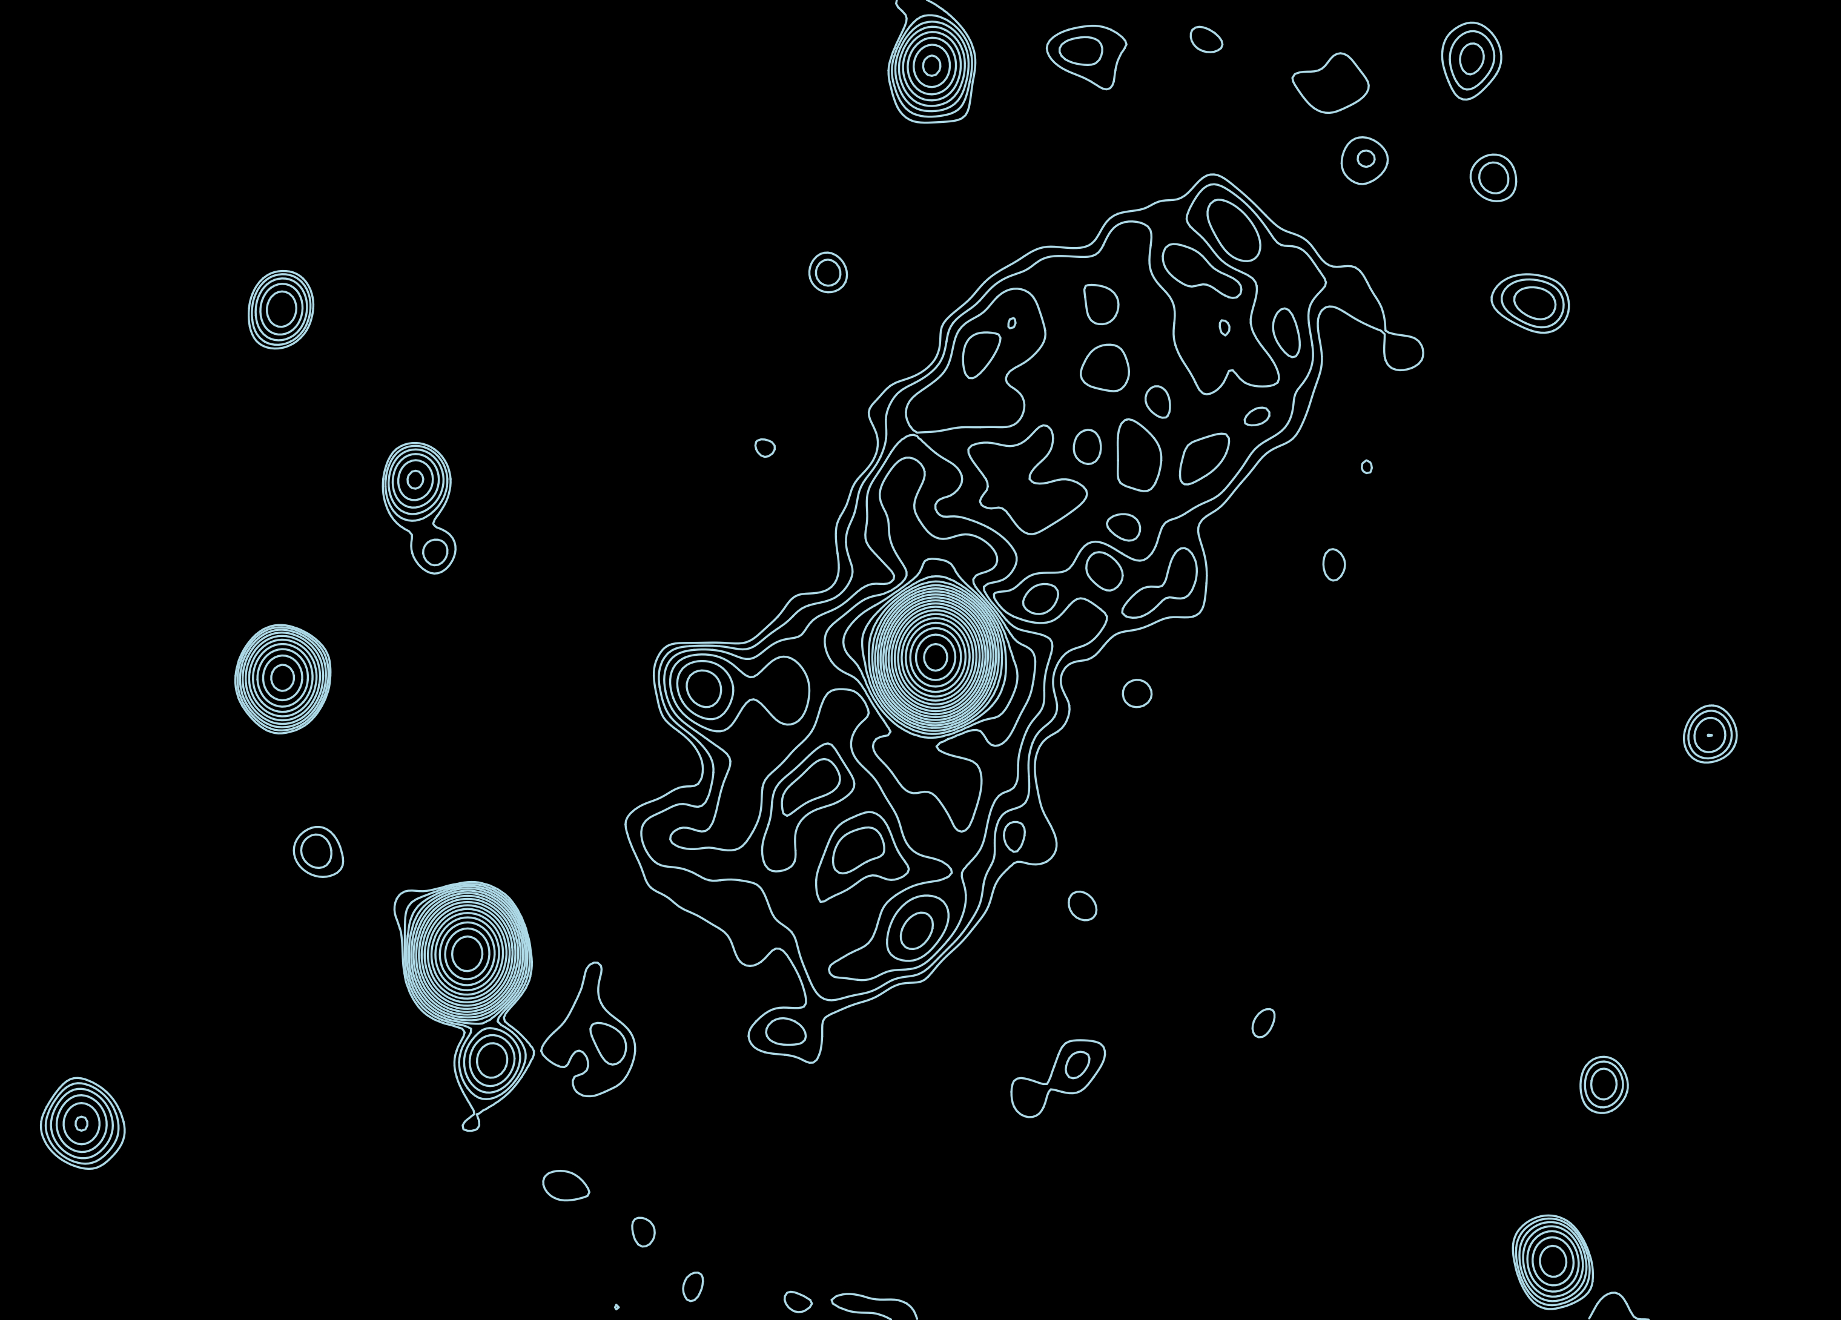
NGC 1167 B2 0258+35 λ22cm radio continuum
𝝺22cm radio continuum from Shulevski et al. 2012
5’ / 100 kpc

Slide 6
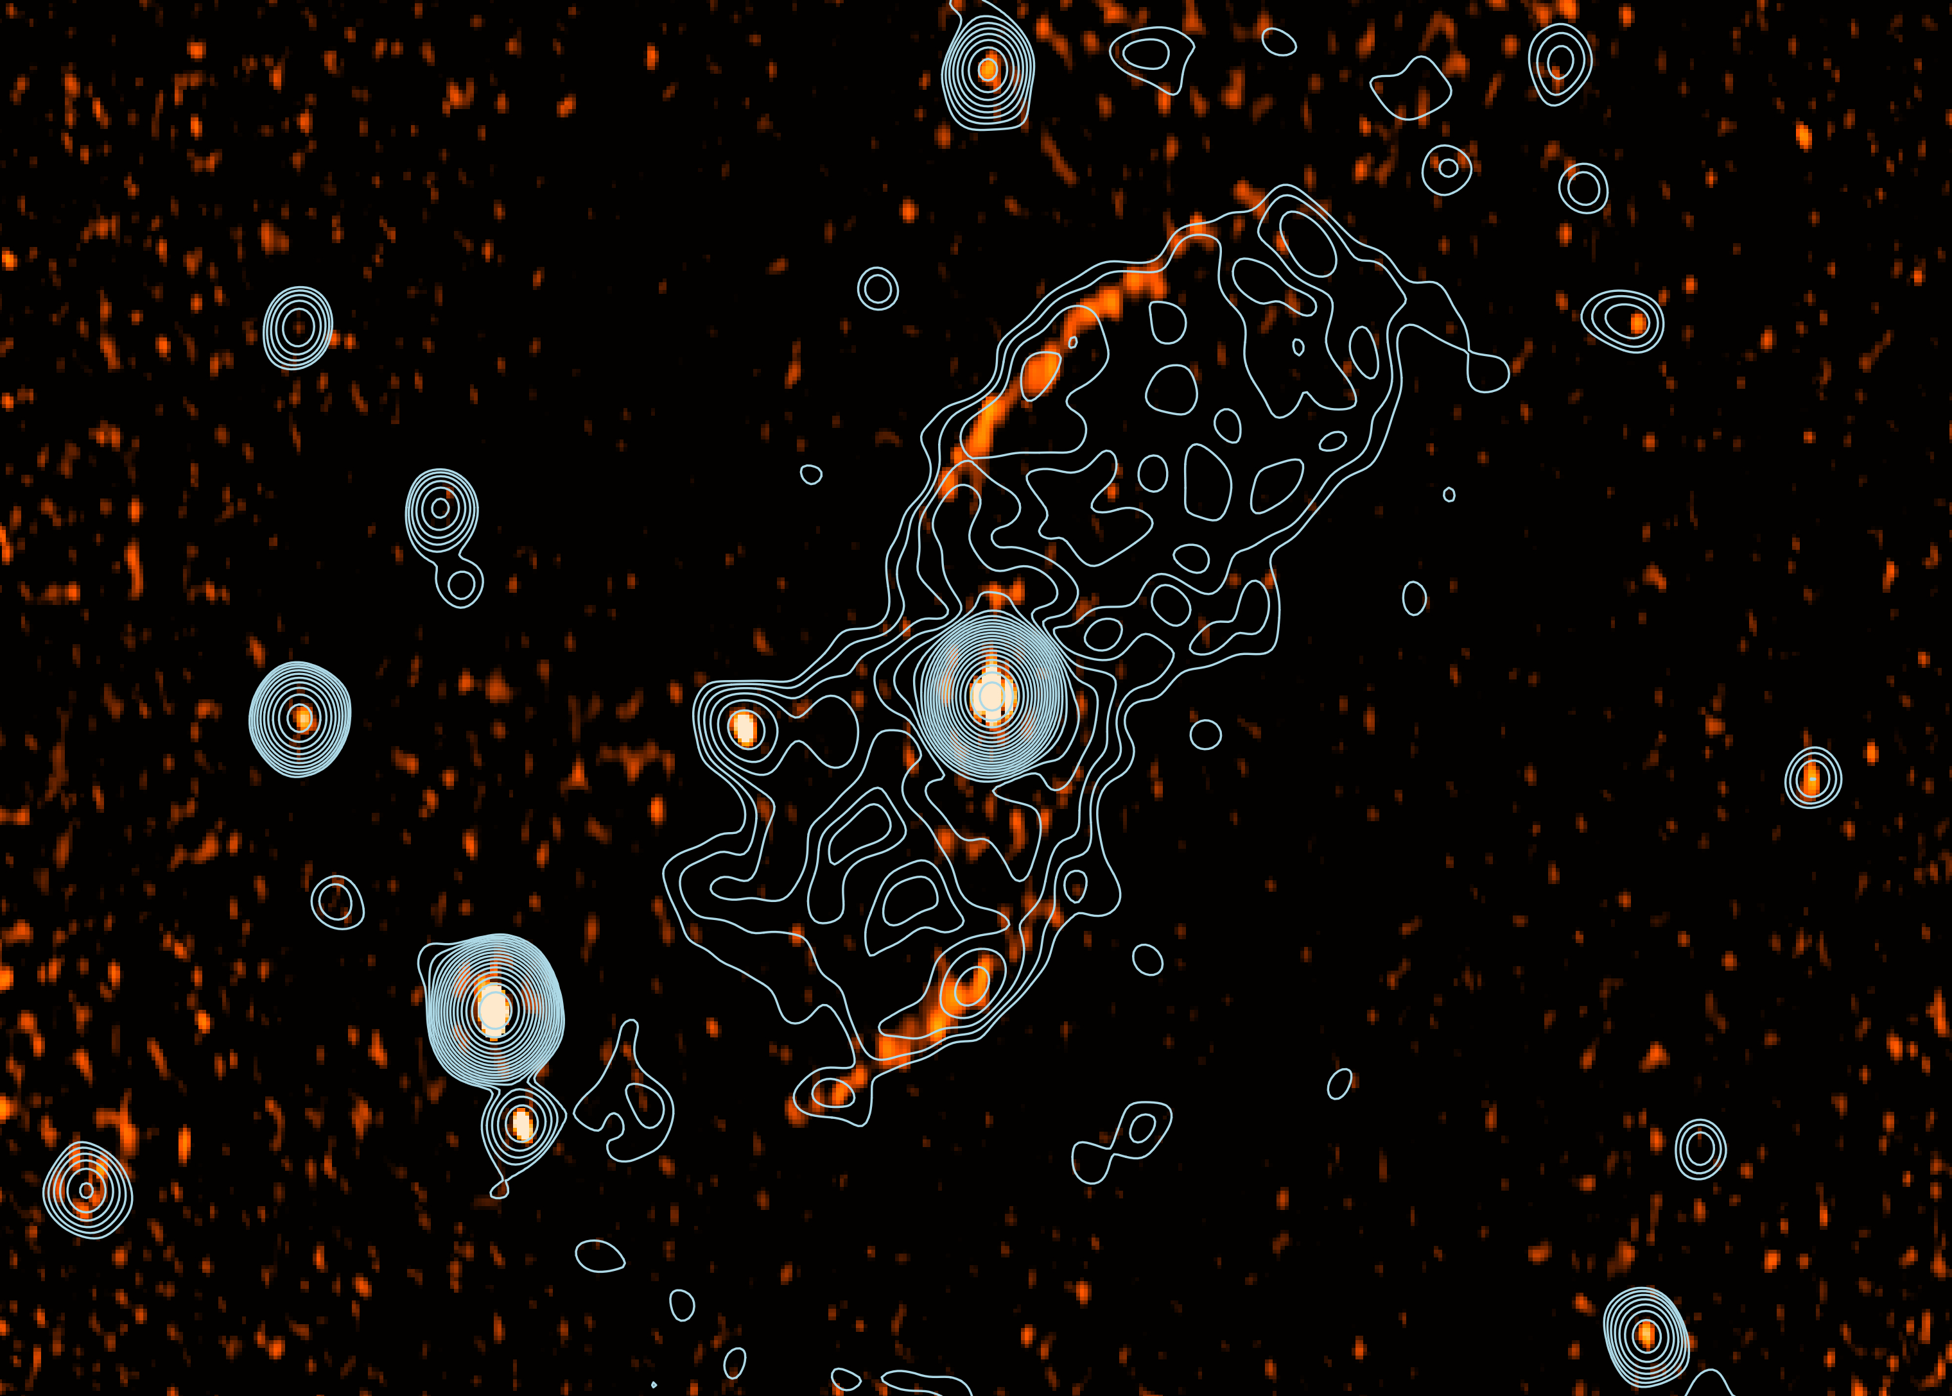
NGC 1167 B2 0258+35 λ22cm PI + λ22cm radio continuum
𝝺22cm radio continuum from Shulevski et al. 2012
51∘
80∘
45∘
Giroletti et al. 2005
Multiple episodes of jet activity
Jet precession
Active cycle might be shorter than precession period
5’ / 100 kpc

Slide 7
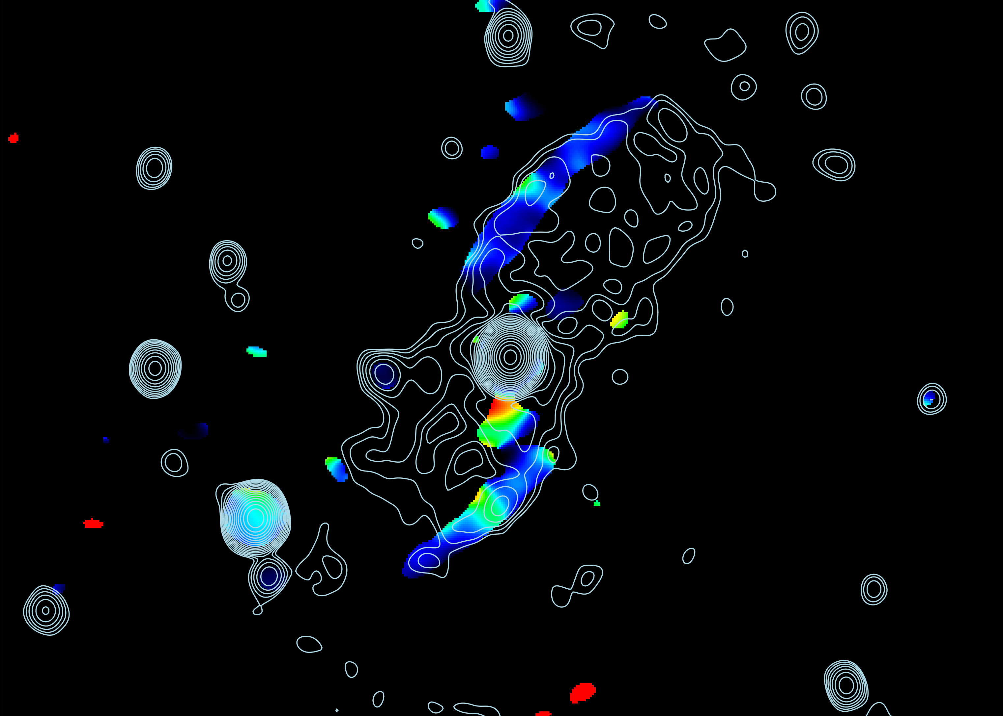
NGC 1167 B2 0258+35 λ22cm RM + λ22cm radio continuum
𝝺22cm radio continuum from Shulevski et al. 2012
Structures are not resolved (even not in the highest resolved maps)
5’ / 100 kpc

Slide 8
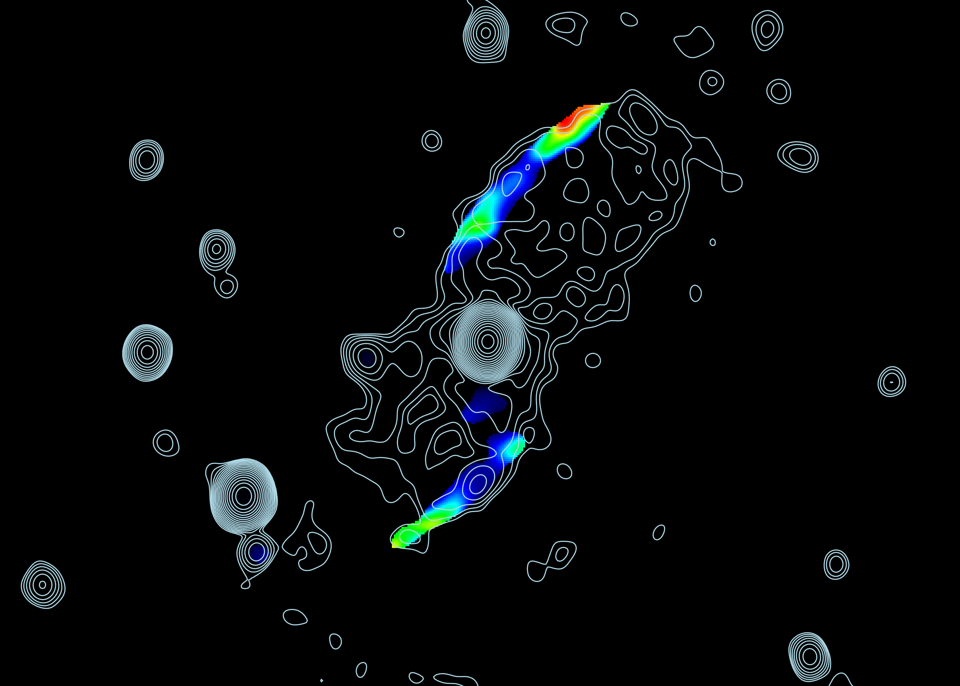
NGC 1167 B2 0258+35 λ22cm Fractional polarisation + λ22cm radio continuum
𝝺22cm radio continuum from Shulevski et al. 2012
60±4%
No luminous X-ray halo detected with shallow observations (≤4∙10³⁹ ergs⁻¹)
No major merger within the last Gyr
Akylas & Georgantopoulos 2009
45±3%
Struve et al. 2010
Generation of the structures due to compression/shocks unlikely
5’ / 100 kpc

Slide 9
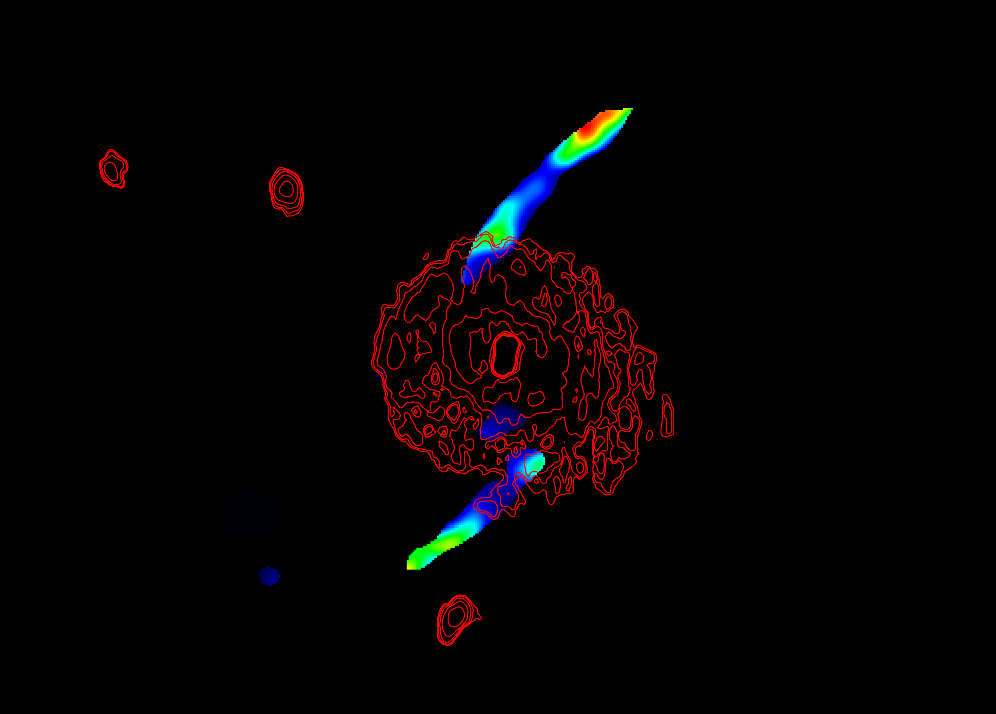
NGC 1167 B2 0258+35 HI + λ22cm radio continuum
HI from Struve et al. 2010
Depolarisation of the polarised structures due to turbulent magnetic field in the HI-disk
Structures are not polarised at the radius of the HI-disk
5’ / 100 kpc

Slide 10
Magnetic draping as an alternative to magnetic field compression
Super-Alfvénic motion of bubble in the medium to isolate the two magnetic fields
Magnetic draping does not need compression of the underlying medium
Dursi and Pfrommer 2008

Slide 11
Magnetic draping as an alternative to magnetic field compression
Outflow speed of the bubble: v≧600 kms⁻¹
Alfvénic Mach number M_{A}≧3
Alfvén speed in the bubble: v_{A}≅200 kms⁻¹
Super-Alfvénic motion
Thickness of layer can be calculated
Lyutikov 2006
Thickness of layer
$$\frac{r}{R}∝\frac{1}{M_{A}^{3}}$$
Radius of the bubble
7’’ (≈2 kpc)
(well below resolution of our observations)

Slide 12
Conclusions and Outlook
Conclusions
First radio galaxy showing polarised emission of this type
Polarisation observations support the recurrent activity scenario claimed before
Magnetic draping as an alternative to magnetic field compression
Outlook
Multi-frequency polarisation observations
Magnetic field angles
Polarisation spectra (depolarisation mechanisms)
Spatially resolved spectral index maps
Deep X-ray observations to constrain the density of the group medium and rule out magnetic field compression

