Slide 1
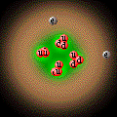
Physics Beyond the Standard Model
I think I finally understand atoms
Democritus 460–370 BC
I. Nestoras
L. Zimmerman
S. Anderl
Notes:
1

Slide 2
General Outline
Part I (I. Nestoras)
SuperSymmetry (SUSY)
Dark Matter
Part II (L. Zimmerman)
Part III (S. Anderl)
String Theory

Slide 3
I think I finally understand atoms
Democritus 460–370 BC

Slide 4
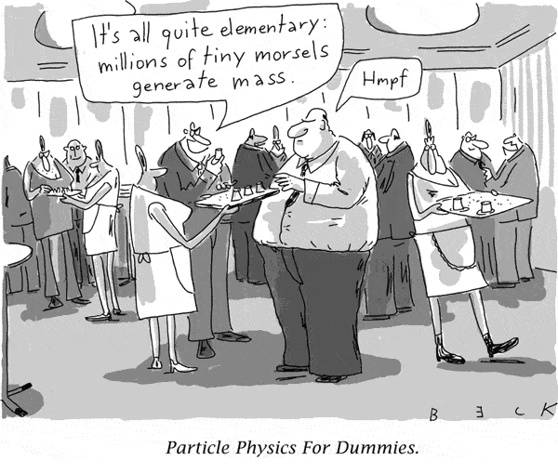
Particle Physics - Intro
• Particle Physics is the study individual particles
(protons, neutrons, electrons muons, kaons, pions, lambdas,quarks,…)
• And the forces between them.
(gravity, electromagnetism, strong force, weak force).

Slide 5
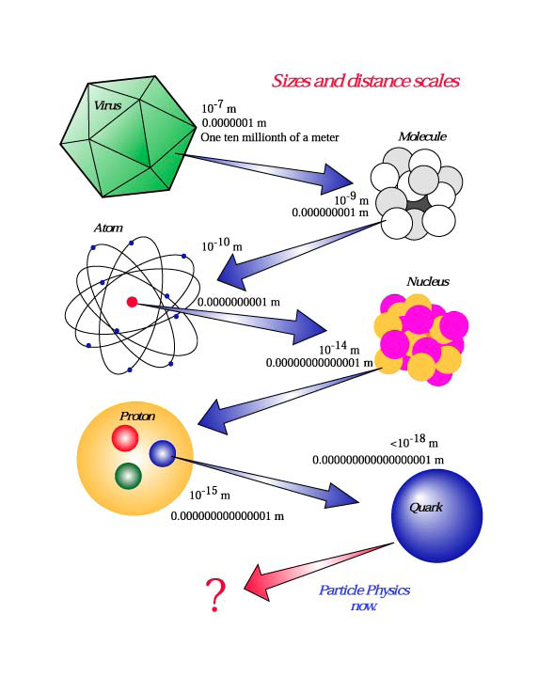
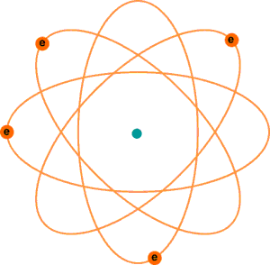
Particle Physics - Intro
Question: how many cuts are required?
Answer: only 84 times!
A nucleus with orbiting electrons
nanometre

Slide 6
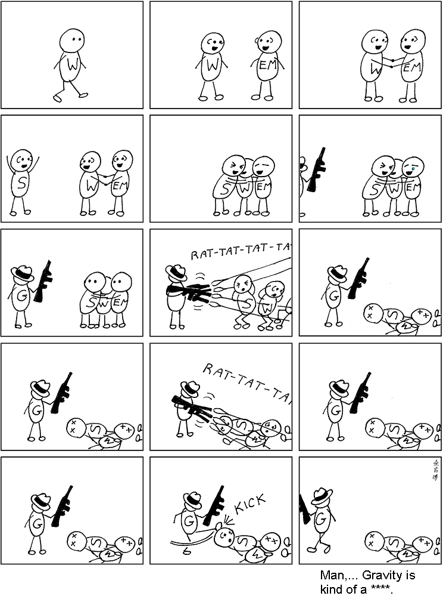
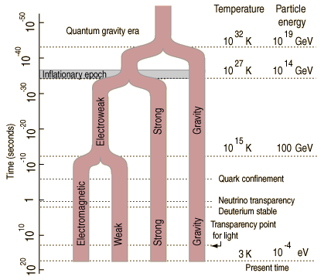
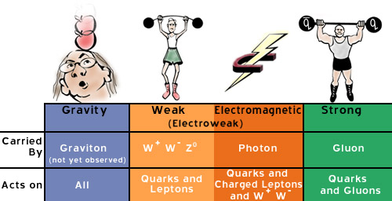
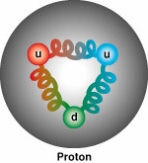
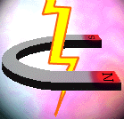
Particle Physics - Intro
The forces of nature
Unified?

Slide 7
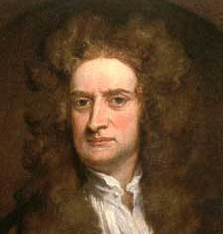
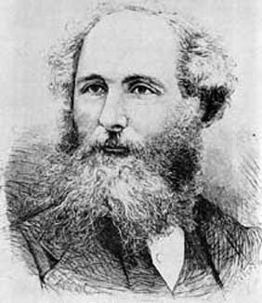
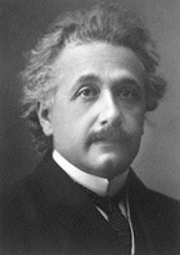
History of Unification
Planets
Apple
Electric
Magnetism
Atoms
Gravity
Mechanics
Electromagnetism
Quantum mechanics
g-decay
QED
b-decay
Weak force
GR
Special relativity
a-decay
Electroweak theory
SM
Strong force
SM
String theory?
SUSY - Grand Unification?

Slide 8
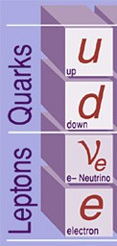
Problems of SM (Experimental)
Gravity
Dark matter and dark energy
Neutrino masses
Matter–antimatter asymmetry
Notes:
Gravity. The standard model does not provide an explanation of gravity. Moreover it is incompatible with the most successful theory of gravity to date, general relativity.
Dark matter and dark energy Cosmological observations tell us that the standard model is able to explain only about 4% of the energy present in the universe. Of the missing 96% percent about 24% should be dark matter, i.e. matter that behaves just like the other matter we know, but which interacts only weakly with the standard model fields. The rest should be dark energy, a constant energy density for the vacuum. Attempts to explain the dark energy in terms of vacuum energy of the standard model lead to a mismatch of 120 orders of magnitude.
Neutrino masses According to the standard model the neutrinos are massless particles. However, neutrino oscillation experiments have shown that neutrinos do have mass. Mass terms for the neutrinos can be added to the standard model by hand, but these lead to new theoretical problems. (For example, the mass terms need to be extraordinarily small).
Matter–antimatter asymmetry The universe is made out of mostly matter. However, the standard model predicts that matter and anti-matter should have been created in (almost) equal amounts, which would have annihilated each other as the universe cooled

Slide 9
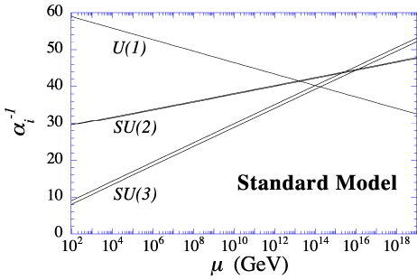
Problems of SM (Theoretical)
Problem
Hierarcy problem
Strong CP problem
Number of parameters
Notes:
Hierarchy problem The standard model introduces particle masses through a process known as spontaneous symmetry breaking caused by the Higgs field. Within the standard model, the mass of the Higgs gets some very large quantum corrections due to the presence of virtual particles (mostly virtual top quarks). These corrections are much larger than the actual mass of the Higgs. This means that the bare mass parameter of the Higgs in the standard model must be fine tuned in such a way that almost completely cancels the quantum corrections. This level of fine tuning is deemed unnatural by many theorists.
Strong CP problem Theoretically it can be argued that the standard model should contain a term that breaks CP symmetry —relating matter to antimatter— in the strong interaction sector. Experimentally, however, no such violation has been found, implying that the coefficient of this term is very close to zero. This fine tuning is also considered unnatural.
Number of parameters The standard model depends on 19 numerical parameters. Their values are known from experiment, but the origin of the values is unknown. Some theorists have tried to find relations between different parameters, for example, between the masses of particles in different generations.

Slide 10
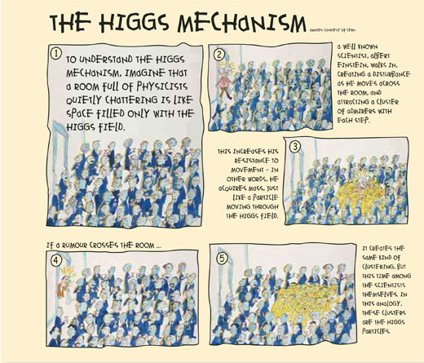
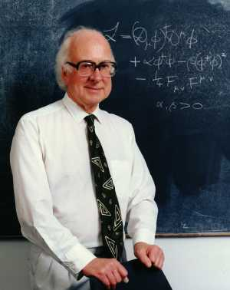
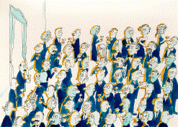
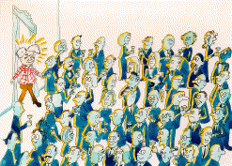
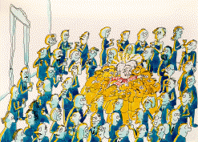
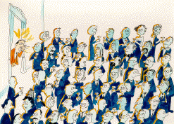
Problems of SM (Predictions not observed)
In the “Standard Model” the origin of mass is addressed using a mechanism named after the British physicist Peter Higgs. This predicts a new particle:
the Higgs boson.
Notes:
Most of the particles predicted by the Standard Model have been observed at particle colliders. The exception is the Higgs boson, which is predicted by the Standard Model's explanation of the Higgs mechanism that describes how the weak SU(2) gauge symmetry is broken and how fundamental particles obtain mass. Experimental searches have determined that if the Standard Model is correct and the Higgs boson exists, then it most likely has a mass between 114 GeV/c2 and 157 GeV/c2,[3] although simple extensions to the Standard Model allow for a mass between 185 GeV/c2 and about 250 GeV/c2. If the Higgs boson exists, experiments at the CERN Large Hadron Collider should find it; if the Higgs boson is not found at the LHC, then SU(2) breaking and mass generation must involve physics beyond the Standard Model.

Slide 11
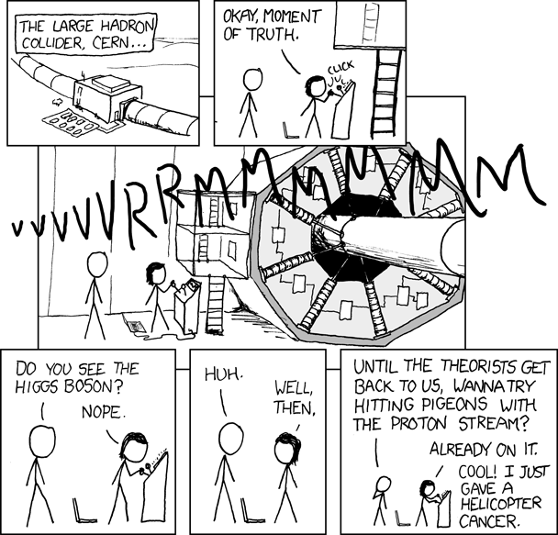

Slide 12
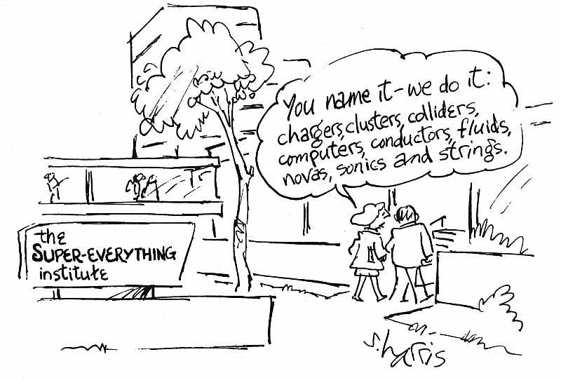
What about Super- symmetry?

Slide 13
Beyond SM
Super-symmetry
OR
SUSY

Slide 14
Brief history of Supersymmetry
First proposed by Hironari Miyazawa in 1966
Supersymmetry was revealed in two-dimensional string models in 1971 by Ramond, Neveu, Schwarz, Gervais and Sakita
The history of supersymmetry is exceptional. In the past, virtually all major conceptual breakthroughs have occurred because physicists were trying to understand some established aspect of nature. In contrast, the discovery of supersymmetry in the early 1970s was a purely intellectual achievement, driven by the logic of theoretical development rather than by the pressure of existing data.
Notes:
A supersymmetry relating mesons and baryons was first proposed, in the context of hadronic physics, by Hironari Miyazawa in 1966, but his work was ignored at the time.[6][7][8][9] In the early 1970s, J. L. Gervais and B. Sakita (in 1971), Yu. A. Golfand and E.P. Likhtman (also in 1971), D.V. Volkov and V.P. Akulov (in 1972) and J. Wess and B. Zumino (in 1974) independently rediscovered supersymmetry, a radically new type of symmetry of spacetime and fundamental fields, which establishes a relationship between elementary particles of different quantum nature, bosons and fermions, and unifies spacetime and internal symmetries of the microscopic world. Supersymmetry first[clarification needed] arose in 1971 in the context of an early version of string theory by Pierre Ramond, John H. Schwarz and Andre Neveu, but the mathematical structure of supersymmetry has subsequently been applied successfully to other areas of physics; firstly by Wess, Zumino, and Abdus Salam and their fellow researchers to particle physics, and later to a variety of fields, ranging from quantum mechanics to statistical physics. It remains a vital part of many proposed theories of physics.
The first realistic supersymmetric version of the Standard Model was proposed in 1981 by Howard Georgi and Savas Dimopoulos and is called the Minimal Supersymmetric Standard Model or MSSM for short. It was proposed to solve the hierarchy problem and predicts superpartners with masses between 100 GeV and 1 TeV. As of 2009 there is no irrefutable experimental evidence that supersymmetry is a symmetry of nature[citation needed]. Since 2010 the Large Hadron Collider at CERN is producing the world's highest energy collisions and offers the best chance at discovering superparticles for the foreseeable future. Recently prediction markets like intrade offered scientific contracts that give estimates for that probability.

Slide 15
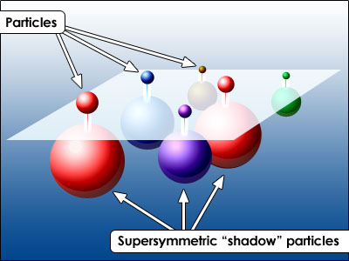
What is Supersymmetry ?
There are two types of particles in nature: fermions and bosons.
Fermions have half units of spin, and tend to shy away from each other, like people who always stay in single rooms at the fermion motel.
Bosons have zero or integer units of spin, and like to be with each other, like people who stay in shared dormitories at the boson inn.
Supersymmetry says that for every fermion in Nature there must be a boson and vice-versa. Super-symmetric particles have not been observed (yet) so they must be heavier - SUSY must be broken by some mechanism

Slide 16
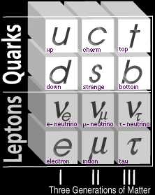
SuperSymetry
SPIN ½ FERMIONS
SPIN 0 BOSONS
Quarks
Squarks
SUSY
Leptons
Sleptons
The Generations of Matter
The Generations of Smatter

Slide 17
SuperSymetry
BOSONS
SUSY
FERMIONS
Gravitino
Photino
Gluino
17

Slide 18
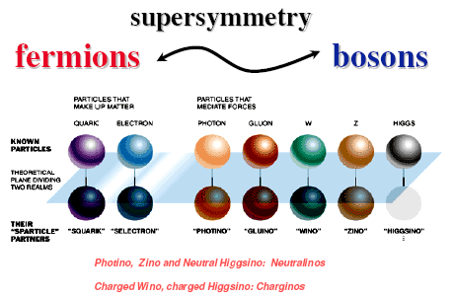
SuperSymetry

Slide 19
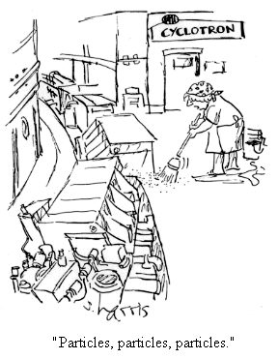

Slide 20
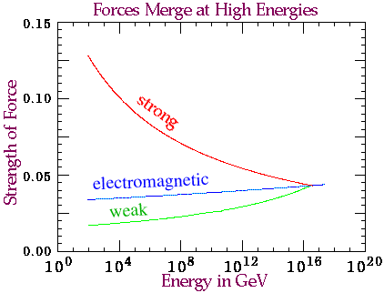
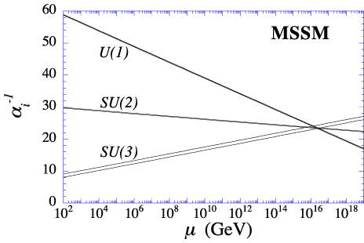
SuperSymetry
Strong
Weak
Electromagnetic
Strong
Weak
Electromagnetic
Not a Problem
Standard Model
SUSY

Slide 21
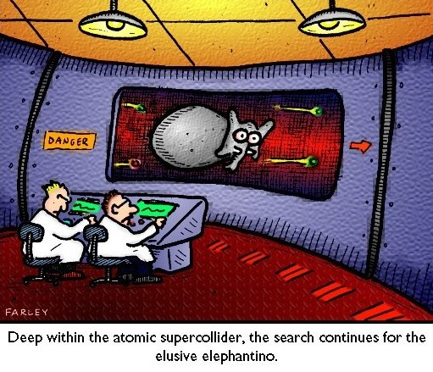
Quote from Ed Witten in preface of Gordon Kane’s book “Super-symmetry”
“Super-symmetry, if it holds in nature, is part of the quantum structure of space and time…
Discovery of super-symmetry would be one of the real milestones in physics… Indeed, super-symmetry is one of the basic requirements of string theory…
Discovery of super-symmetry would surely give string theory an enormous boost…
The search for super-symmetry is one of the great dramas in present day physics.”

Slide 22
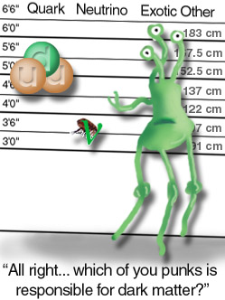
SuperSymetry
SUSY provides an excellent candidate for dark matter.
In SUSY we TRUST!!!

Slide 23
Welcome Lisa for dark matters (applause)

